Slide 1


Module 7: Borrowing Basics
Module 7
Borrowing Basics
September 2018

Slide 2
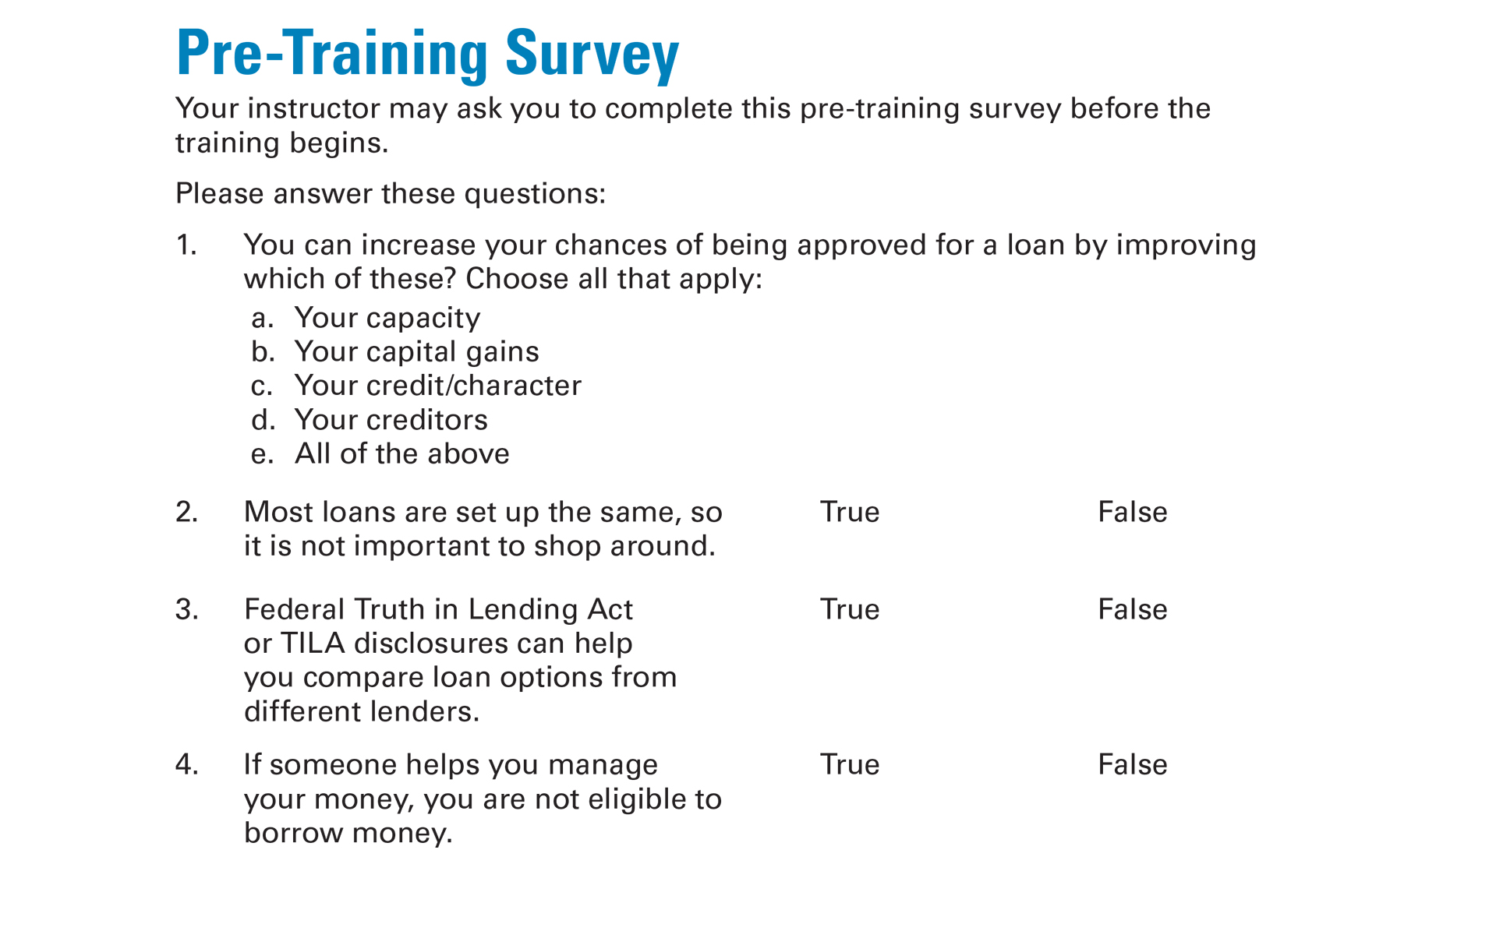
Pre-Training Survey See page 21 in your Participant Guide

Slide 3

Section 1: Ways to Borrow Money and What It Costs
Section 1
Ways to Borrow Money and What It Costs
See page 3 in your Participant Guide

Slide 4
Section 1: Key Takeaway
Be sure you can afford the payments before getting a loan. Also, know how much it will cost and what will happen if you can’t pay it back.

Slide 5
What Borrowing Means
Lender provides you money and you have to pay it back, usually with interest

Slide 6
Types of Loans
Installment Loans
Usually repaid in equal payments over set period of time
Examples include most fixed rate mortgages, auto loans, and student loans.
Revolving Loans
Repaid based on how much you have borrowed
Examples include most credit cards and home equity lines of credit

Slide 7
Rent-to-Own Services
Not a loan
Use an item for a period of time and make monthly or weekly rental payments
Rental payments partly credited toward purchase price
Store can take back the item if you miss a payment
Longer Time Making Payments
More You Pay

Slide 8

Buying on Layaway
Not a loan
Initial deposit, then payments over time
Store holds merchandise until you pay in full
Understand the layaway plan
Fees
Consequences of late or missed payments
Refund policy

Slide 9
Secured and Unsecured Loans
Secured Loans
Require collateral, such as your house, vehicle, or cash
You lose the collateral if you don’t pay as agreed
Unsecured Loans
No collateral
Often higher interest rates than secured loans

Slide 10
The Cost of Borrowing
You generally repay more money than you borrowed
Principal: The money you borrowed
Interest: Amount of money financial institution charges for allowing you to use its money
Fees: May be charged for certain activities like reviewing loan application
Amount you repay on loan
>
Amount you borrowed

Slide 11
Prepayment
Early repayment of ALL of a loan
Reduces interest costs
Pays off the loan
Or, early repayment of PART of a loan
Generally reduces interest costs
Potentially earlier payoff date
Some loans have prepayment penalties; others do not

Slide 12
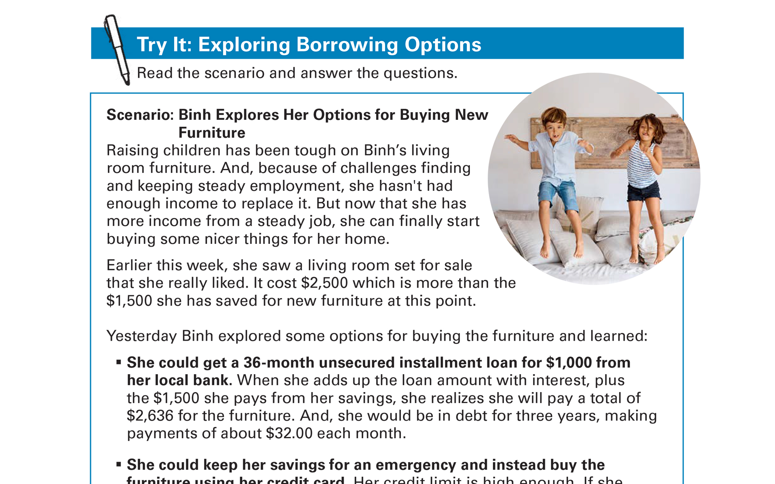
Try It: Exploring Borrowing Options See page 5 in your Participant Guide

Slide 13
Truth in Lending / Comparing Offers
Truth in Lending Act (TILA) written disclosure
Shows loan terms in clear and uniform manner
Receive the TILA disclosure before you sign for loan
Can help you compare loan offers

Slide 14
Part of a Sample TILA Disclosure*
Annual Percentage Rate | Finance Charge | Amount Financed | Total of Payments
The cost of your credit as a yearly rate | The dollar amount the credit will cost you | The amount of credit provided to you on your behalf | The amount you will have paid after you have made all payments as scheduled
12.00 % | $ 600.00 | $ 5,000.00 | $ 5,600.00
*Disclosures for mortgages (home loans) and some student loans will look different than this.

Slide 15
Finance Charge*
Annual Percentage Rate | Finance Charge | Amount Financed | Total of Payments
The cost of your credit as a yearly rate | The dollar amount the credit will cost you | The amount of credit provided to you on your behalf | The amount you will have paid after you have made all payments as scheduled
12.00 % | $ 600.00 | $ 5,000.00 | $ 5,600.00
0.12 x $5,000 = $600.00
*Disclosures for mortgages (home loans) and some student loans will look different than this.

Slide 16
Total of Payments*
Annual Percentage Rate | Finance Charge | Amount Financed | Total of Payments
The cost of your credit as a yearly rate | The dollar amount the credit will cost you | The amount of credit provided to you on your behalf | The amount you will have paid after you have made all payments as scheduled
12.00 % | $ 600.00 | $ 5,000.00 | $ 5,600.00
$600.00 + $5,000.00
*Disclosures for mortgages (home loans) and some student loans will look different than this.

Slide 17

Shop Around
Use TILA disclosures, particularly the annual percentage rates (APRs), to compare offers
Seek help if needed
Housing counseling agencies approved by the U.S. Department of Housing and Urban Development
Credit counseling organization

Slide 18
Section 1: Remember the Key Takeaway
Be sure you can afford the payments before getting a loan. Also, know how much it will cost and what will happen if you can’t pay it back.

Slide 19

Section 2: Preparing to Apply for a Loan
Section 2
Preparing to Apply for a Loan
See page 8 in your Participant Guide

Slide 20
Section 2: Key Takeaway
Considering what lenders look for when deciding to loan money helps prepare you to apply for a loan.

Slide 21
Factors Lenders May Use in Their Decisions
Methods vary by lender
Key factors lenders may use:
Your credit (also known as character)
Your capacity
Your capital
Your collateral (for secured loans only)
Conditions

Slide 22
Credit / Character
How you have paid your bills or debts
Your credit reports and scores are used to evaluate:
How you have used credit in the past
How many credit accounts you have
Whether you have ever filed for bankruptcy, had property repossessed or foreclosed upon, made late payments

Slide 23
Capacity
Your present and future ability to meet your payments
How much of your income goes to pay debt
Your debt-to-income ratio
How long you have been employed
How much money you make each month
What your monthly expenses are

Slide 24
Capital
The value of your assets and net worth
How much money is in your checking and savings accounts
Your investments and other assets
Your net worth
Net Worth = Assets - Liabilities

Slide 25
Collateral
For secured loans only
Assets that will secure the loan
For example, your house or money in a bank account
Conditions
Depends on type of loan

Slide 26
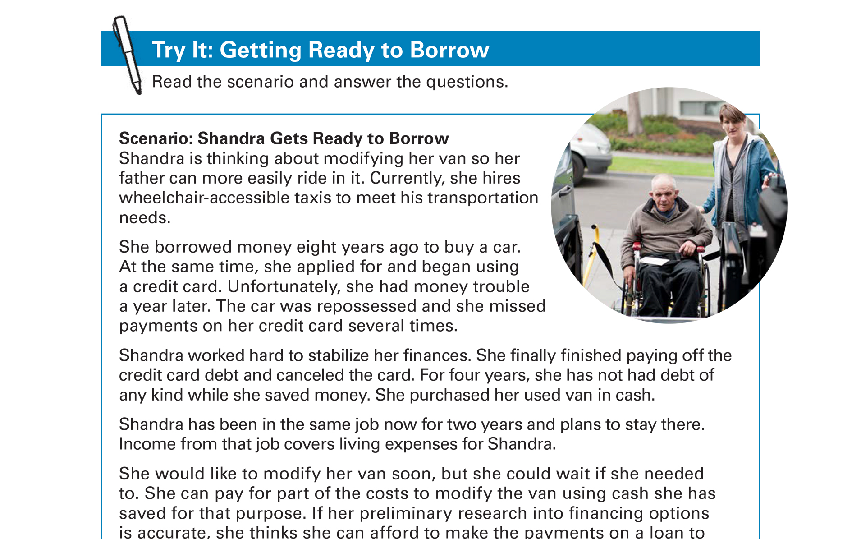
Try It: Getting Ready to Borrow See page 10 in your Participant Guide

Slide 27
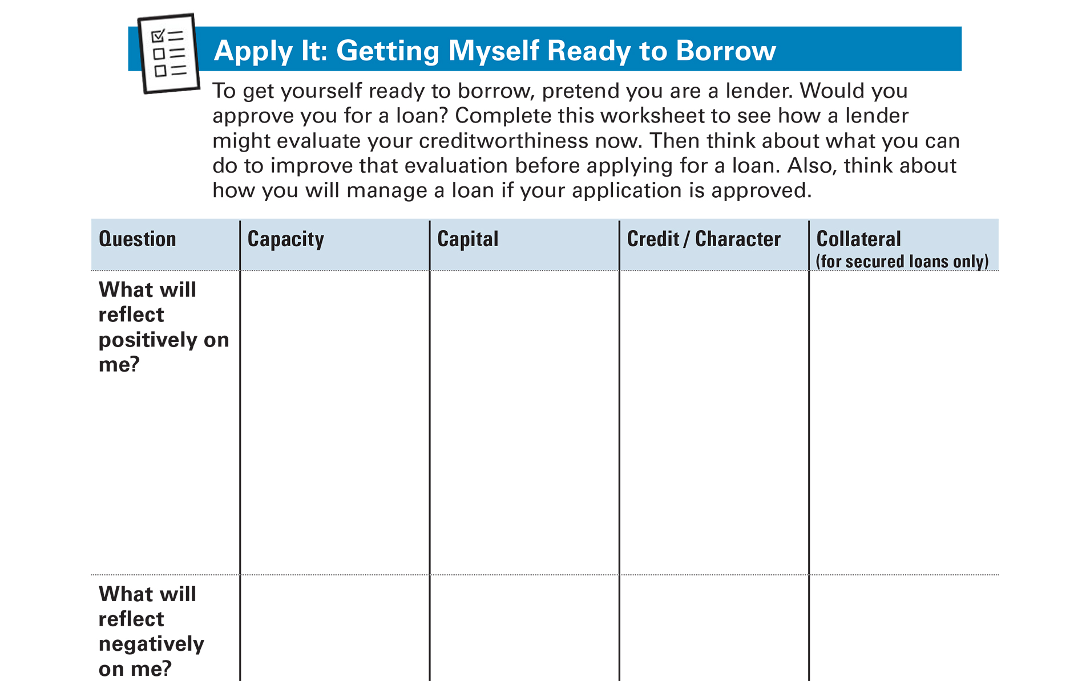
Apply It: Getting Myself Ready to Borrow See page 12 in your Participant Guide

Slide 28
Co-Borrowing and Cosigning
Co-Borrowing
Taking out a loan jointly with others
You must repay debt even if co-borrower(s) do not
Cosigning
Loan proceeds go to the borrower, not cosigner
Cosigner promises to pay debt if borrower does not

Slide 29
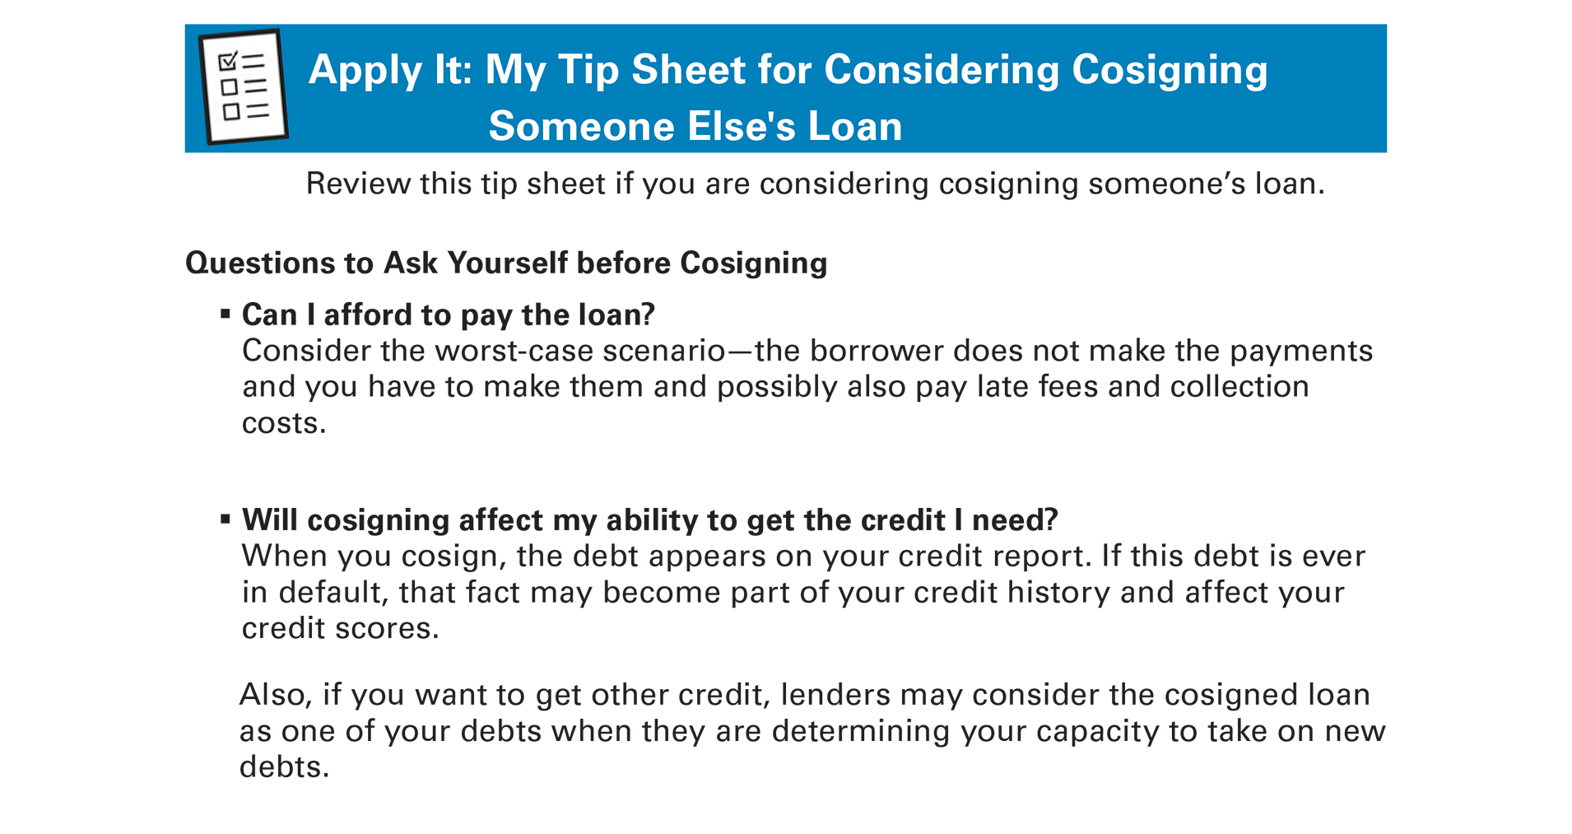
Apply It: My Tip Sheet for Considering Cosigning Someone Else’s Loan See page 14 in your Participant Guide

Slide 30
Section 2: Remember the Key Takeaway
Understanding what lenders look for when deciding to loan money helps prepare you to apply for a loan.

Slide 31

Section 3: Borrowing When Someone Helps You Manage Your Money
Section 3
Borrowing When Someone Helps You Manage Your Money
See page 16 in your Participant Guide

Slide 32
Section 3: Key Takeaway
Even if someone helps you manage your money, understand the terms of a loan before you commit to it.

Slide 33
Responsibilities of Person Helping You
Act in your best interest
Manage your money and property carefully
Keep your money and property separate from theirs
Keep good records
Include you in decision-making to the extent possible

Slide 34
What to Discuss
Why do you need to borrow money?
Do you have enough money to repay the loan?
How will you make payments on the loan?
Will it affect any of your sources of income?
What is the best borrowing option for your needs?

Slide 35
If You Decide to Borrow Money
You can get help considering the terms
You can get help completing the application
Lender will decide if you are a good credit risk
Lender will not consider creditworthiness of the person helping you
Ask for help if you need it to remember to make timely payments and keep good records

Slide 36
Section 3: Remember the Key Takeaway
Even if someone helps you manage your money, understand the terms of a loan before you commit to it.

Slide 37
Take Action See page 18 in your Participant Guide
What will I do?
How will I do it?
Will I share my plans with anyone? If so, who?
Visit fdic.gov/education to learn more

Slide 38

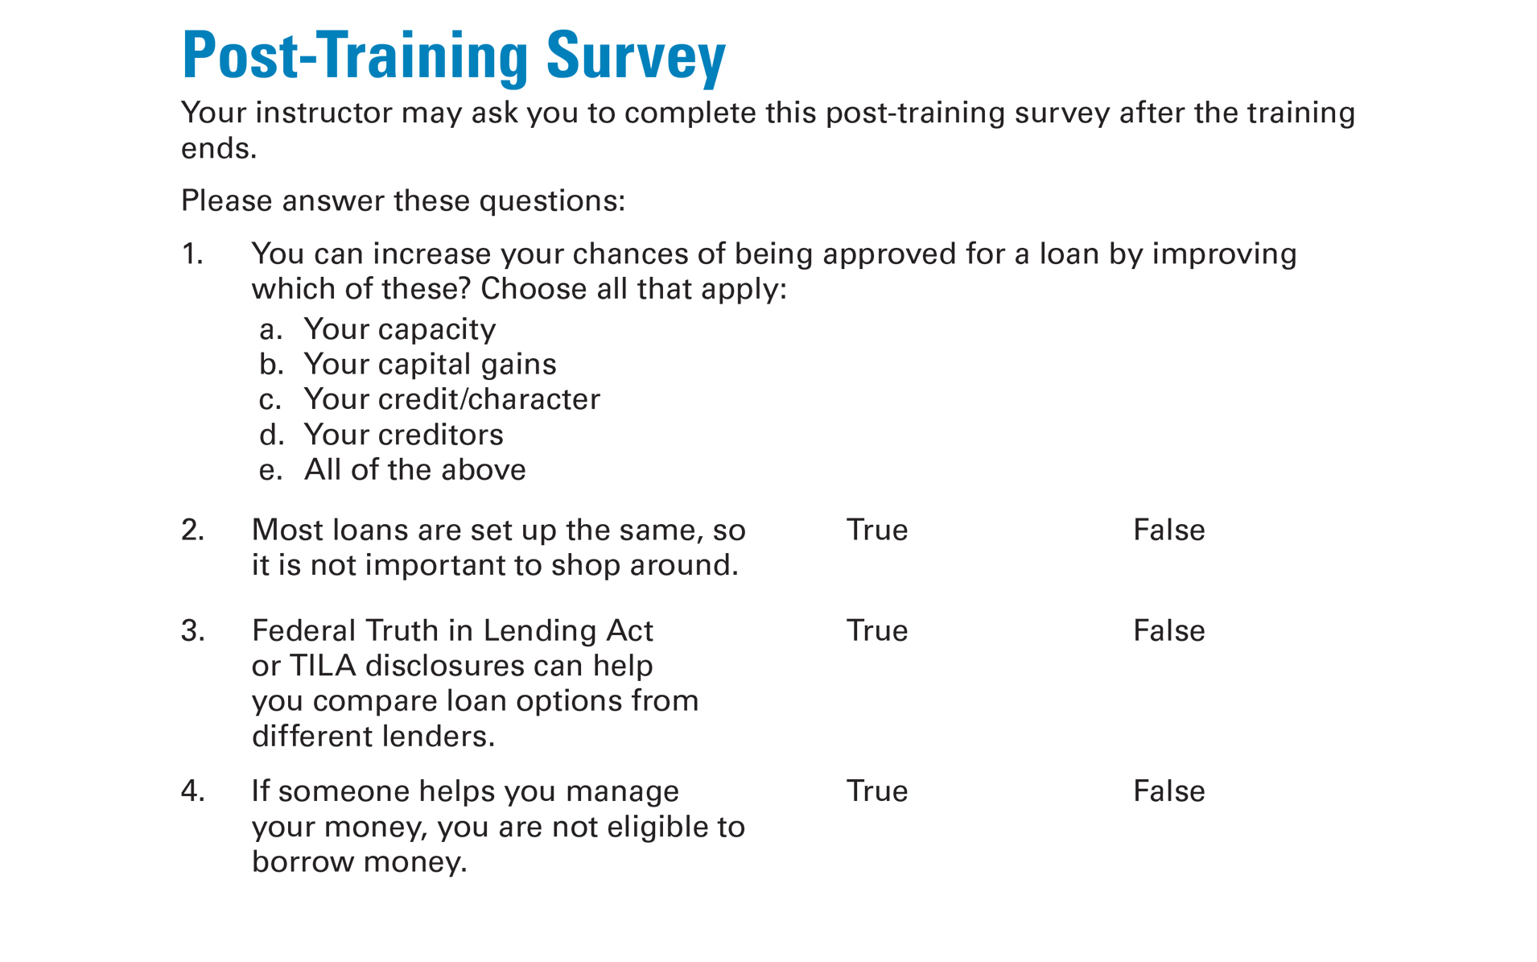
Post-Training Survey See page 23 in your Participant Guide

