Slide 1
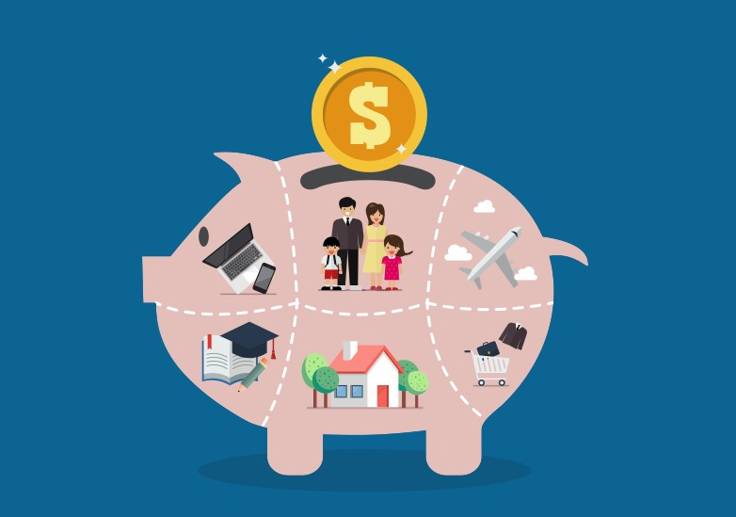

Module 5: Your Savings
Module 5
Your Savings
September 2018

Slide 2
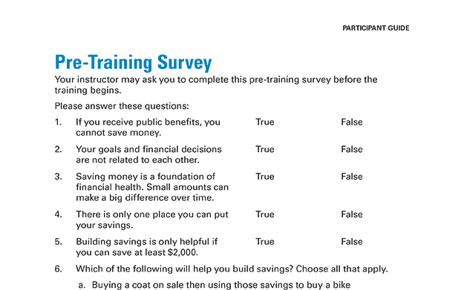
Pre-Training Survey See page 33 in your Participant Guide

Slide 3
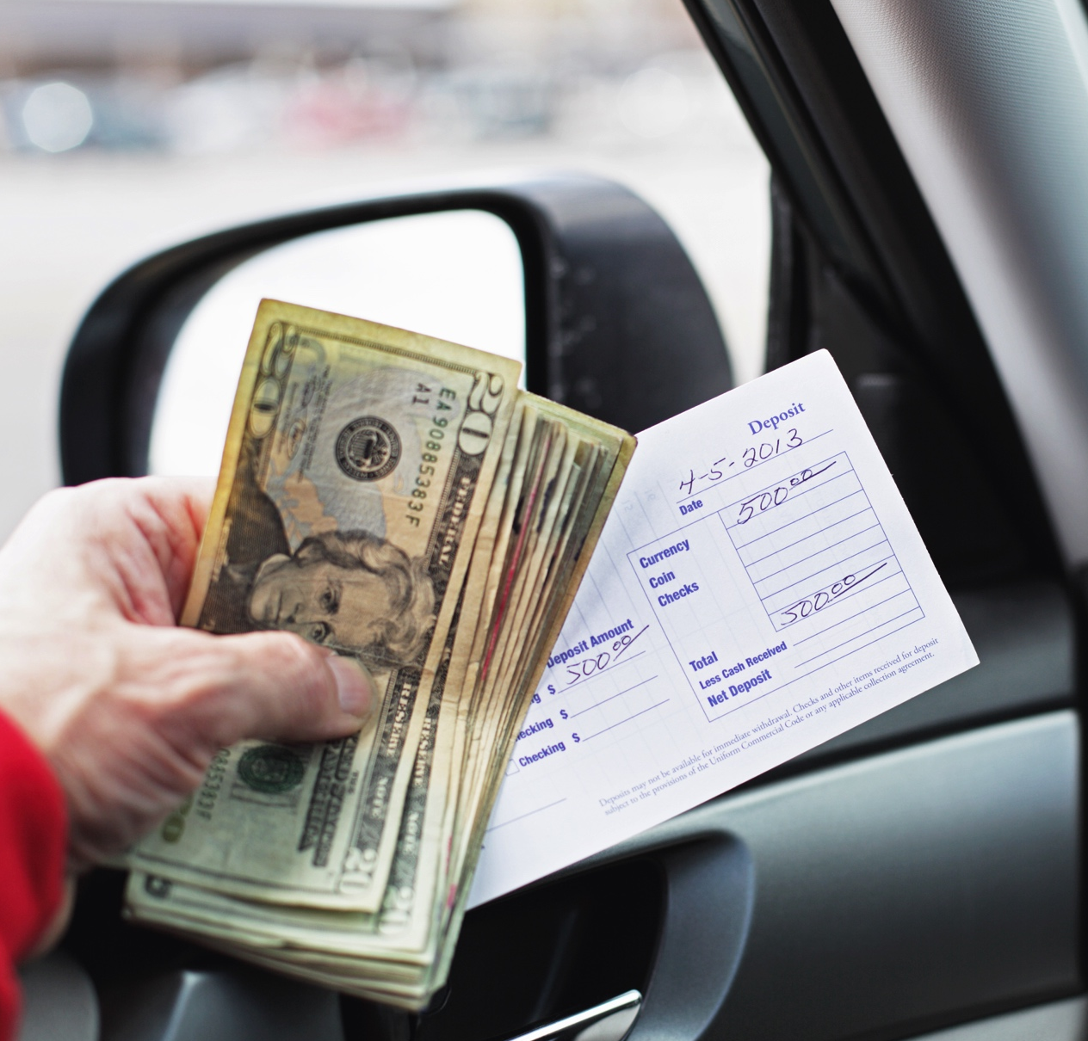
Section 1: What is Saving?
Section 1
What is Saving?
See page 3 in your Participant Guide

Slide 4
Section 1: Key Takeaway
Set aside some money every time you get income. Regularly saving money, even if only a small amount, can make a big difference over time.

Slide 5

Defining Saving
What does “saving” mean?

Slide 6

Is Spending Less Money the Same as Saving Money?
Only if you save what you didn’t spend
Saving is setting aside money today for the future
To build savings → Spend less money and put some or all of what you didn’t spend into savings

Slide 7
Why Save Money?
Goals
Build wealth
Emergencies
Times with less income or more expenses
Peace of mind
Get and keep a job
Other reasons

Slide 8
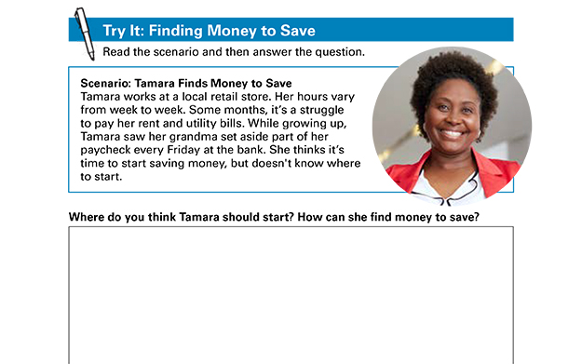
Try It: Finding Money to Save
Try It: Finding Money to Save See page 4 in your Participant Guide

Slide 9
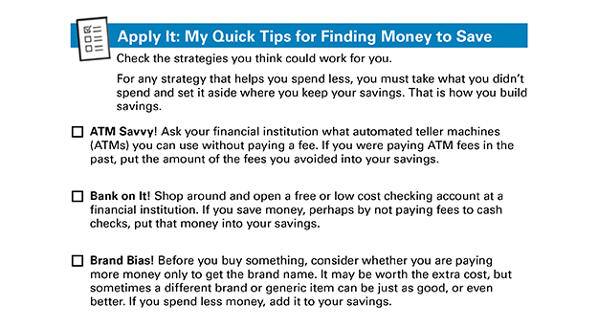
Apply It: My Quick Tips for Finding Money to Save
Apply It: My Quick Tips for Finding Money to Save See page 5 in your Participant Guide

Slide 10
Section 1: Remember the Key Takeaway
Set aside some money every time you get income. Regularly saving money, even if only a small amount, can make a big difference over time.

Slide 11

Section 2: Where to Build Your Savings
Section 2
Where to Build Your Savings
See page 8 in your Participant Guide

Slide 12
Section 2: Key Takeaway
Consider the advantages and disadvantages of savings options before choosing where to build your savings.

Slide 13

Where to Put Your Savings
Many options
Each one has advantages and disadvantages

Slide 14
Small Group Discussion
Home
Friend or family
Prepaid card
Rotating savings and credit association (ROSCA)
Savings account

Slide 15
Home
Advantages | Disadvantages
No fees No rules No additional costs to maintain Convenient Easy-to-access | Can be lost or stolen Can be destroyed in fire, flood, or other disaster Easy-to-access

Slide 16
Friend or Family
Advantages | Disadvantages
No fees No additional costs to maintain May be convenient May keep you from spending the money so you can build savings | Can be lost or stolen Can be destroyed in fire, flood, or other disaster May strain relationship if something happens to the money

Slide 17
Prepaid Card
Advantages | Disadvantages
Easy to get Electronic/online functionality Convenient Might be able to directly deposit wages onto the card and automatically move funds from the card to savings | Fees Theft or loss—review card agreement to find out if you are protected from theft or loss Might not have federal deposit insurance Might not be possible to easily move money to savings Might have an expiration date

Slide 18
Rotating Savings and Credit Association (ROSCA)
Advantages | Disadvantages
Commitment to group to save on a schedule Can’t easily access money Get a lump sum of money at a known date | Theft or loss due to group mismanagement of funds Depending where funds are kept, might not have federal deposit insurance Group members might not make their deposits when required Group may become too large

Slide 19
Savings Account
Advantages | Disadvantages
Deposits in federally insured financial institutions insured up to $250,000 by FDIC (banks) or NCUA (credit unions) May be able to directly deposit wages into account May be able to automatically move money from checking to savings May earn interest Easy-to-access Establish a banking relationship | Monthly/recurring fees can vary Not always best option for saving money for long term goals because interest you earn may be lower than with other options A financial institution may not be available or you may not have access to online banking or want to use it May have limited number of withdrawals

Slide 20
Other Places for Savings
Money market deposit accounts
Certificates of deposit (CDs)
U.S. savings bonds
Retirement accounts
From your employer
Individual Retirement Accounts (IRAs)
Investments, such as stocks, corporate bonds and mutual funds

Slide 21
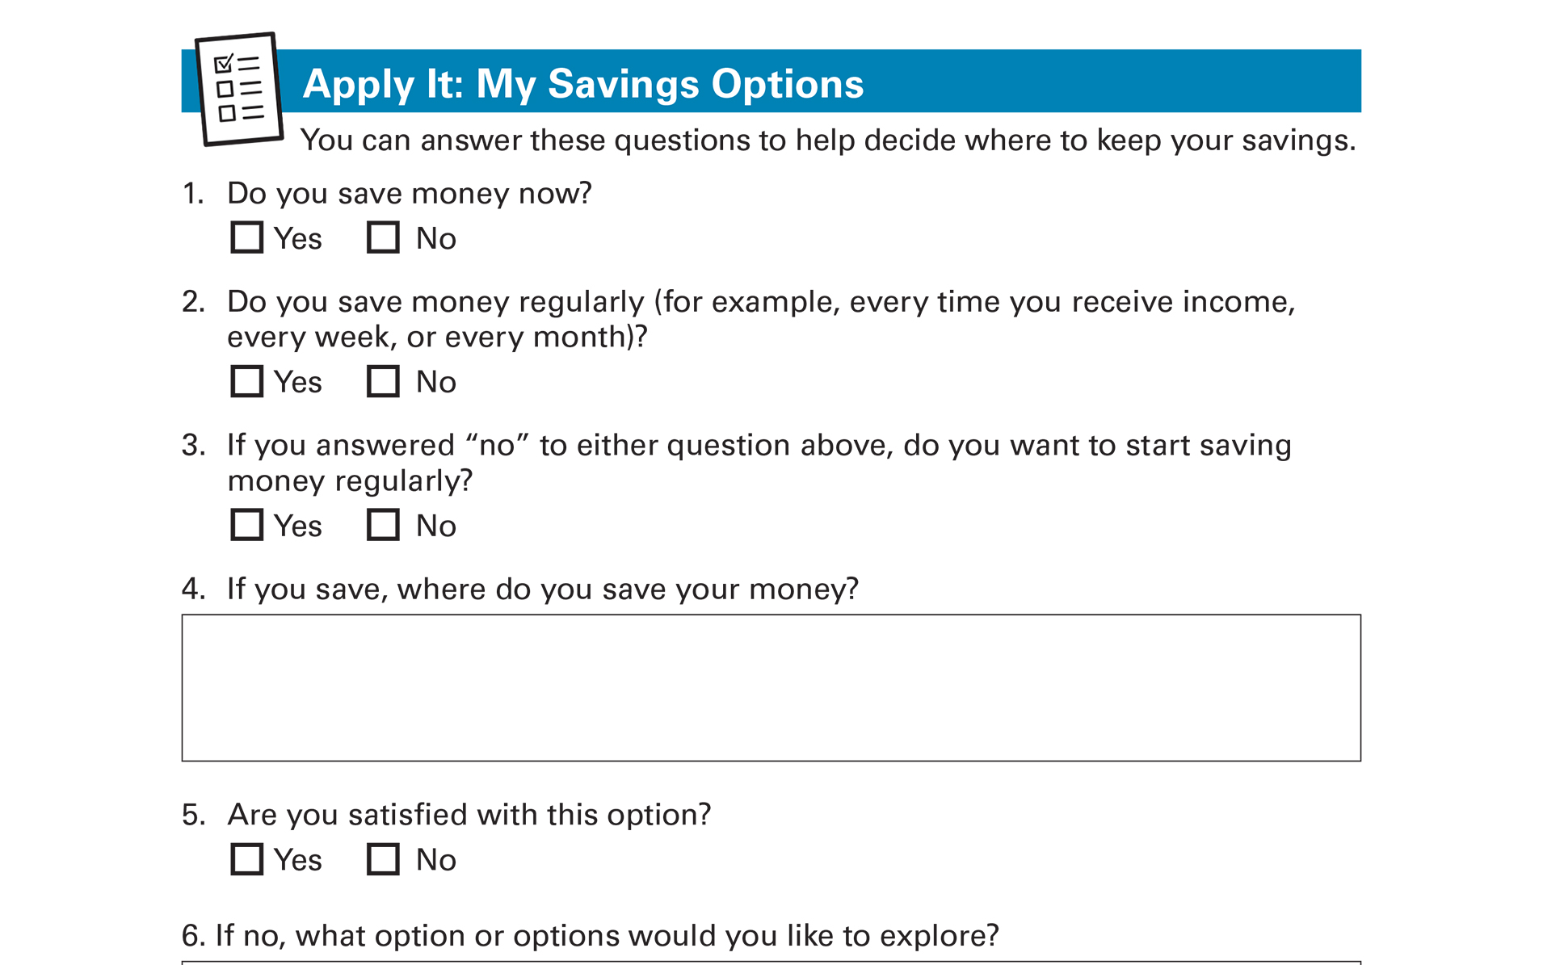
Apply It: My Savings Options
Apply It: My Savings Options See page 10 in your Participant Guide

Slide 22

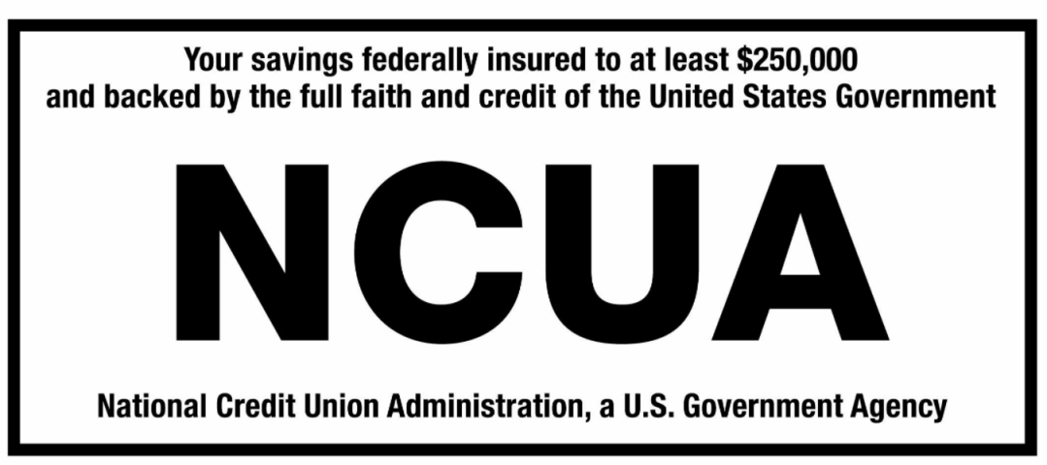
Deposit Insurance
Deposits in a federally insured financial institution are insured to at least $250,000.

Slide 23

Interest and Compounding
Interest: money financial institutions pay you for keeping money deposited with them
Expressed as a percentage
May need to pay income tax on interest
Compounding: earning interest on the interest

Slide 24
Mattress versus Bank Account
For Example… | 5 Years | 10 Years
Under Your Mattress (No interest, and assuming it is not stolen or lost) | $1,000.00 | $1,000.00
Bank Account (pays 2% interest, compounded monthly) | $1,105.08 | $1,221.10

Slide 25
Interest Combined with Regular Savings of $5.00 per Month
 | Under Your Mattress (No interest and assuming it is not stolen or lost) | Bank Account (pays 2% interest, compounded monthly)
Year 1 | $60.00 ($5 per month x 12 months) | $60.55
Year 5 | $300.00 ($60 per year x 5 years) | $315.24
Year 10 | $600.00 ($60 per year x 10 years) | $663.60
Year 30 | $1,800.00 ($60 per year x 30 years) | $2,463.63

Slide 26
Annual Percentage Yield (APY)
Reflects amount of interest on a yearly basis
Different from the interest rate
Includes the effects of compounding
The more often your money compounds:
The higher the APY
The more interest you earn
Compare APYs not interest rates

Slide 27
The Rule of 72
Formula that estimates how long it will take for money to double in value
Divide 72 by interest rate
Result is the estimated number of years to double the money, assuming:
No change in interest rate
No deposits or withdrawals

Slide 28
Rule of 72 Examples
Example 1:
$50 in a savings account with a 2% interest rate
72 divided by 2 = 36
It will take about 36 years for $50 to double to $100
Example 2:
What interest rate would double your money in 10 years?
72 divided by 10 = .072 or 7.2%
Need to earn about 7.2% to double your money in 10 years

Slide 29
Section 2: Remember the Key Takeaway
Consider the advantages and disadvantages of savings options before choosing where to build your savings.

Slide 30

Section 3: Saving for Unexpected Expenses
Section 3
Saving for Unexpected Expenses
See page 14 in your Participant Guide

Slide 31
Section 3: Key Takeaway
An emergency savings fund is part of the foundation of financial health. Setting aside $500 to $1,000 can cover many unexpected expenses.

Slide 32

Why Save for Unexpected Expenses?
Because life happens!
Because unexpected events occur!

Slide 33
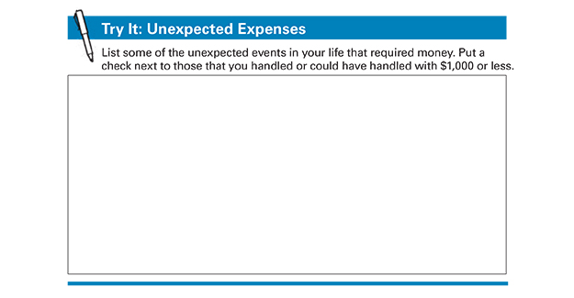
Try It: Unexpected Expenses
Try It: Unexpected Expenses See page 14 in your Participant Guide

Slide 34
Emergency Savings Fund Goal
If you pay for unexpected expenses with money you have saved, you avoid creating debt
Takes time and commitment
It’s a cycle
Still worth doing
Important step to improve financial health and stability

Slide 35
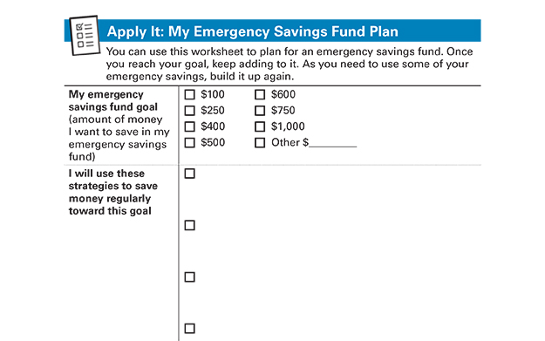
Apply It: My Emergency Savings Fund Plan
Apply It: My Emergency Savings Fund Plan See page 15 in your Participant Guide

Slide 36

Anticipating Changes to Income and Expenses
Your income and expenses can change
You may have bills that arrive only once or a few times per year
Your spending can increase temporarily

Slide 37
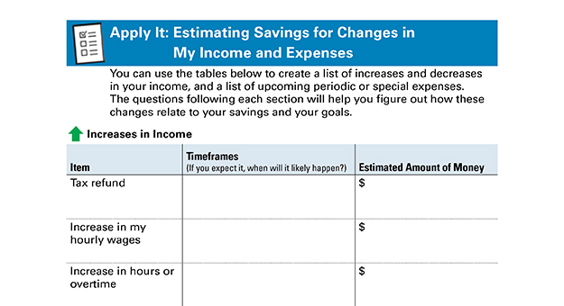
Apply It: Estimating Savings for Changes in My Income and Expenses
Apply It: Estimating Savings for Changes in My Income and Expenses See page 17 in your Participant Guide

Slide 38
Section 3: Remember the Key Takeaway
An emergency savings fund is part of the foundation of financial health. Setting aside $500 to $1,000 can cover many unexpected expenses.

Slide 39

Section 4: Saving for Your Goals
Section 4
Saving for Your Goals
See page 21 in your Participant Guide

Slide 40
Section 4: Key Takeaway
Create a plan to save money for your goals.

Slide 41

Your Hopes and Dreams
What do you hope for or want in life for yourself?
What about for your family?

Slide 42

SMART Goals
Specific
Measurable
Action-oriented
Reachable
Time-bound
"I will save $10 each month for six months, by getting cash at my bank's ATM rather than the ATM that charges fees, so that I have $60 for holiday gifts by November 1."

Slide 43

More Likely to Achieve Your Goals
Write them down
Post them
Share them
Focus

Slide 44
How Much Money Should You Save for Your Goals?
What are you saving for?
How much will it cost?
How much of that cost do you need to save?
What is your deadline?
Money Needed divided by Time to Save
For example: Emergency savings fund of $1,000 in 2 years
$1,000 ÷ 100 (50 weeks x 2 years) = Save $10/week
After 2 years you will have $1,040!

Slide 45
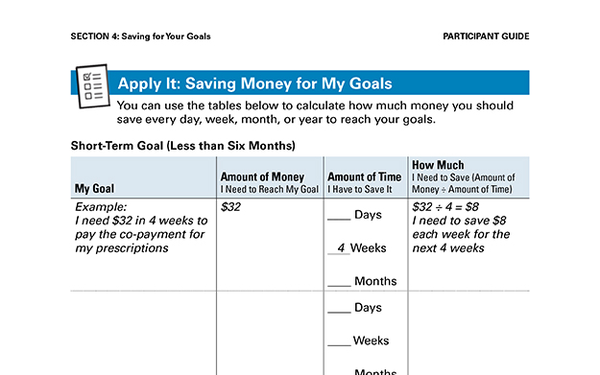
Apply It: Saving Money for My Goals
Apply It: Saving Money for My Goals See page 23 in your Participant Guide

Slide 46

Large Expenses
Many goals are related to large expenses
Large expenses generally require more money than you have leftover after one or two paychecks

Slide 47
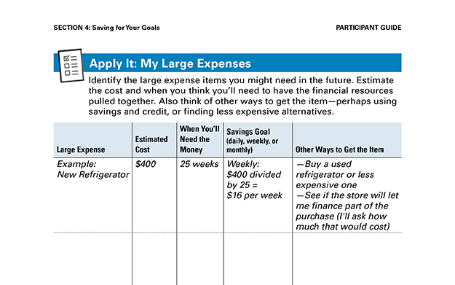
Apply It: My Large Expenses
Apply It: My Large Expenses See page 25 in your Participant Guide

Slide 48
Section 4: Remember the Key Takeaway
Create a plan to save money for your goals.

Slide 49

Section 5: Saving and Public Benefits
Section 5
Saving and Public Benefits
See page 26 in your Participant Guide

Slide 50
Section 5: Key Takeaway
Some public benefits may be reduced or removed when you exceed income or asset limits. However, some special accounts enable people to save more money without losing eligibility for their benefits.

Slide 51
Assets and Income Limits
Public Benefit | Asset Limit as of 2018
Temporary Assistance for Needy Families or TANF | $1,000 to $3,000 in most states
Supplemental Nutrition Assistance Program or SNAP | Varies by state
Medicaid | $2,000 if single; $3,000 if married for some disability-linked Medicaid benefits
Supplemental Security Income or SSI | $2,000 if single; $3,000 if married
Social Security Disability Insurance or SSDI | No asset limits

Slide 52
ABLE Accounts
Tax-advantaged savings accounts for individuals with disabilities
Blind or qualifying disability that began before 26th birthday; can be any age when account is opened
Save money without losing eligibility for Supplemental Security Income (SSI), Medicaid, or other federal means-tested public benefits

Slide 53
More on ABLE Accounts
Anyone can contribute
Can only have one ABLE account
Total annual contributions limit set each year
Federal gift tax exclusion limit
Can be higher if account owner contributes earned income
Can include transfers from 529 accounts

Slide 54
ABLE Account Balance Limits
Up to $100,000: SSI cash benefit continues
Over $100,000: SSI eligibility retained but cash benefit suspended
Total account limit: set by sponsoring state
Shop around
Open ABLE account on state program website, not at a bank

Slide 55
ABLE Account Uses
Use money in ABLE account for “qualified disability expenses”
If used for anything else, withdrawal becomes taxable

Slide 56
Qualified Disability Expenses
Education, Housing, Transportation
Employment training and support
Assistive technology, personal support services
Health care expenses
Financial management and administrative services
Other expenses which help improve health, independence, and/or quality of life

Slide 57
Special Needs Trust
Designed to fund long-term expenses and needs of someone with a disability
Can be complicated; may need an attorney

Slide 58
Pooled Special Needs Trust
Provides benefits of a special needs trust, but costs less
Single entity manages sub-accounts
Nonprofit corporation usually manages trust

Slide 59
Plan to Achieve Self-Support
Set aside money for items or services needed to achieve a specific education or work goal
Objective: Employment (including self-employment) that reduces or eliminates the need for disability benefits

Slide 60
PASS Uses
Supplies to start a business
School expenses
Equipment, tools, uniforms
Transportation
Other items or services needed to reach employment goals

Slide 61
Matched Savings Accounts
Encourage saving money for specific purpose
Usually run by local community-based organizations
Savings matched by organization running program
Individual Development Accounts (IDAs) and Children’s Savings Accounts (CSAs)

Slide 62
Purposes of Matched Savings
Allowable purposes may include:
Job training
College education
Small business start-up
Purchasing a home
May require financial education courses
May not count against benefits if federally funded or part of a PASS

Slide 63
Section 5: Remember the Key Takeaway
Some public benefits may be reduced or removed when you exceed income or asset limits. However, some special accounts enable people to save more money without losing eligibility for their benefits.

Slide 64
Take Action See page 31 in your Participant Guide
What will I do?
How will I do it?
Will I share my plans with anyone? If so, who?
Visit fdic.gov/education to learn more

Slide 65

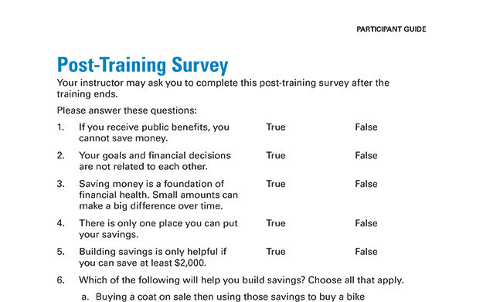
Post-Training Survey See page 35 in your Participant Guide

