Slide 1


Buying a Home
Module 13
September 2018

Slide 2
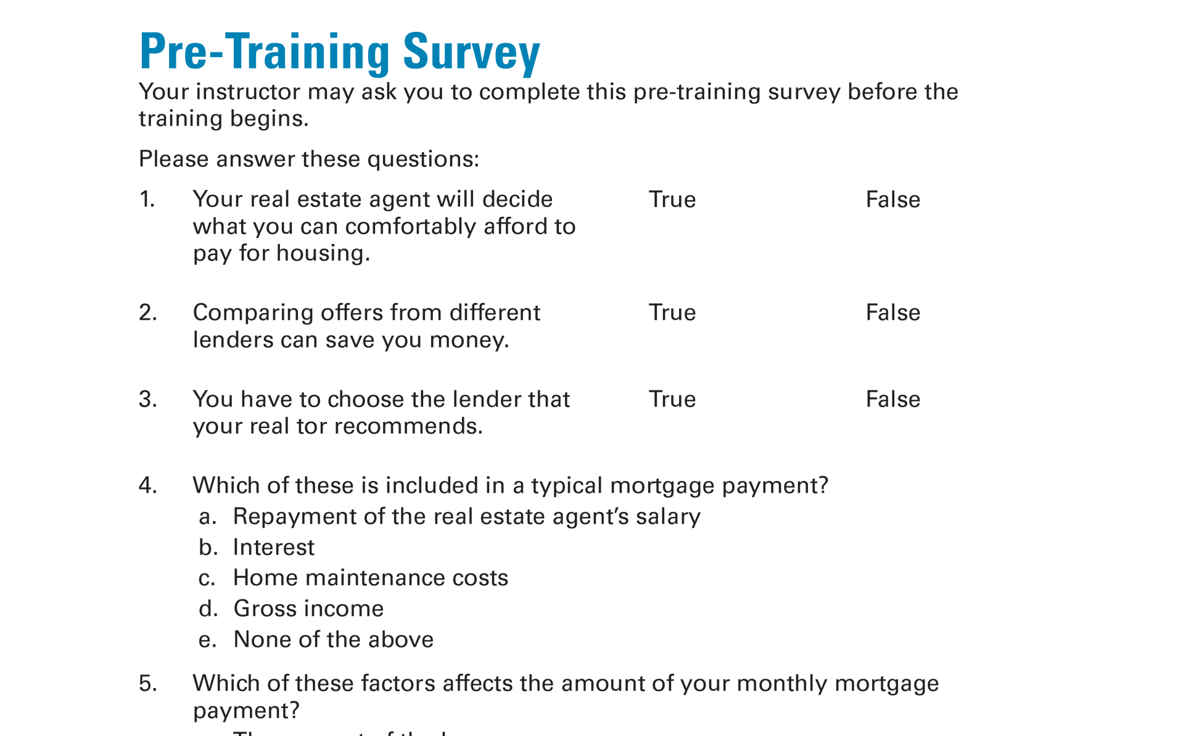
Pre-Training Survey
See page 39 in your Participant Guide

Slide 3

Section 1: Getting Ready to Own Your Home
Section 1
Getting Ready to
Own Your Home
See page 3 in your Participant Guide

Slide 4
Section 1: Key Takeaway
Buying a home is a process. Start by making sure you’re ready to buy and figure out what you can afford.

Slide 5
Reasons for Buying a Home
There are many reasons people want to buy their own home.
What are some of those reasons?
?

Slide 6
Equity
Equity equals the market value of your home minus what you owe on the home
Can increase, stay the same or decrease
Home’s
Market
Value
What You Still
Owe on the
Mortgage
Equity
=
-

Slide 7
Market Value
What are some factors that affect the market value of a home?
?

Slide 8
Steps to Buying a Home
1
Step 1: Get ready
  Decide if you are ready to buy a home
  Figure out how much you can afford
  Check your credit history
Step 2: Figure out the financing
  Learn about mortgages or other financing options
  Shop around
  Get pre-qualified or pre-approved
2

Slide 9
More Steps to Buying a Home
3
Step 3: Shop for your home
  Put together your team
  Find a home that fits your needs that you can afford
Step 4: Buy your home
  Make an offer
  Negotiate
  Consider getting a home inspection
  Close
Step 5: Maintain your home
4
5

Slide 10
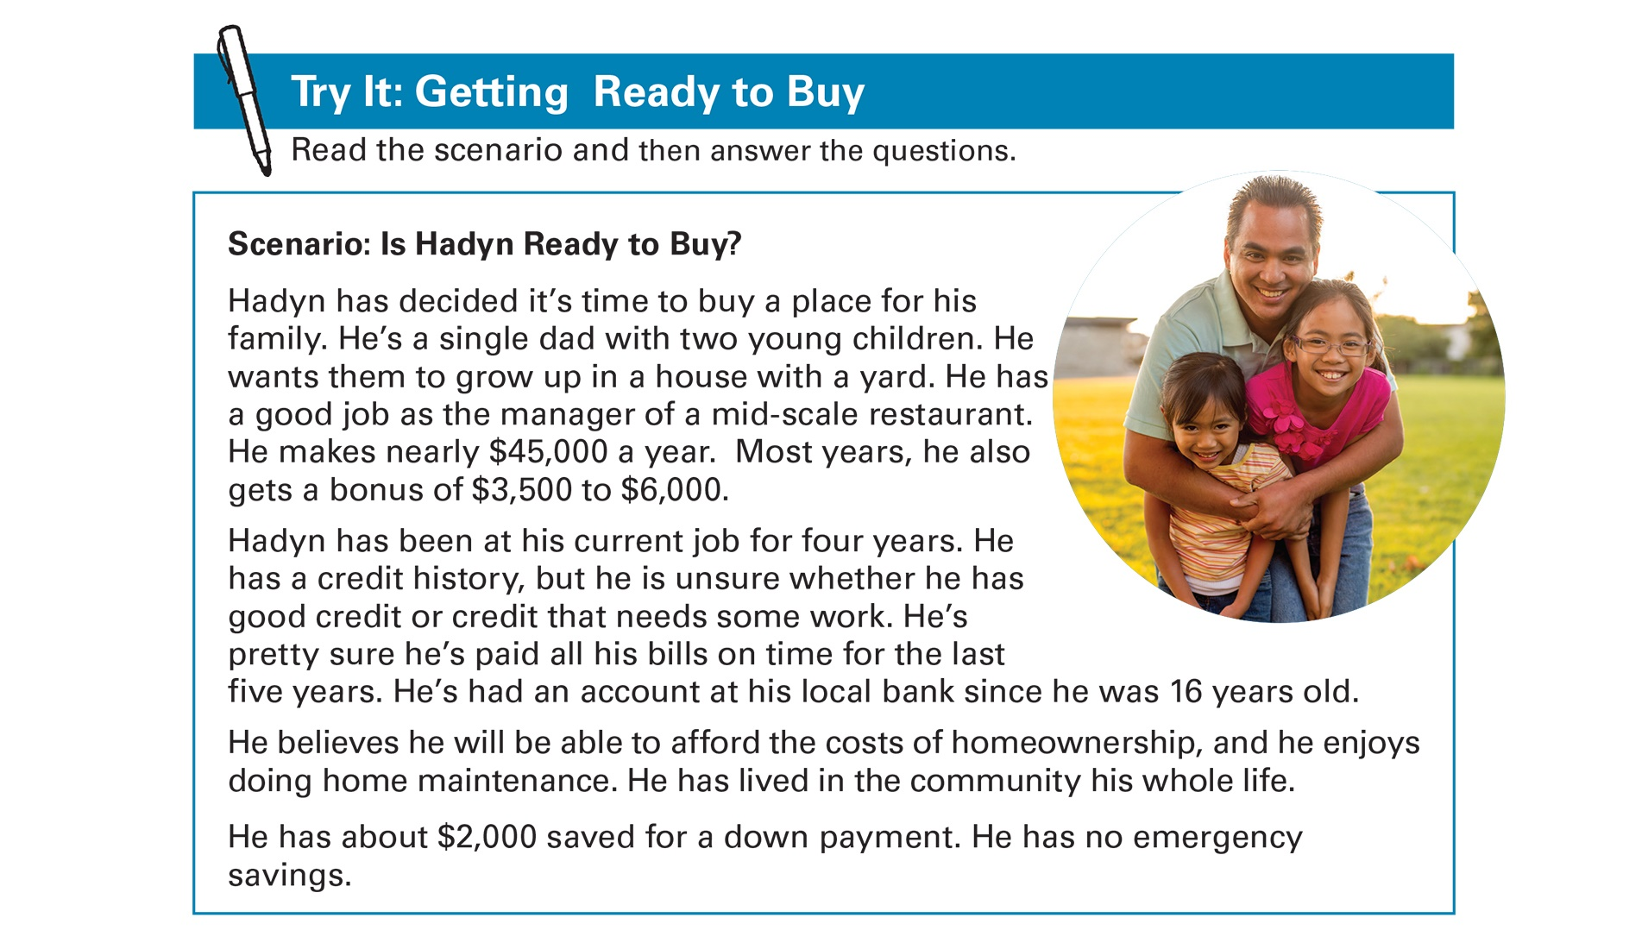
Try It: Getting Ready to Buy
See page 5 in your Participant Guide

Slide 11
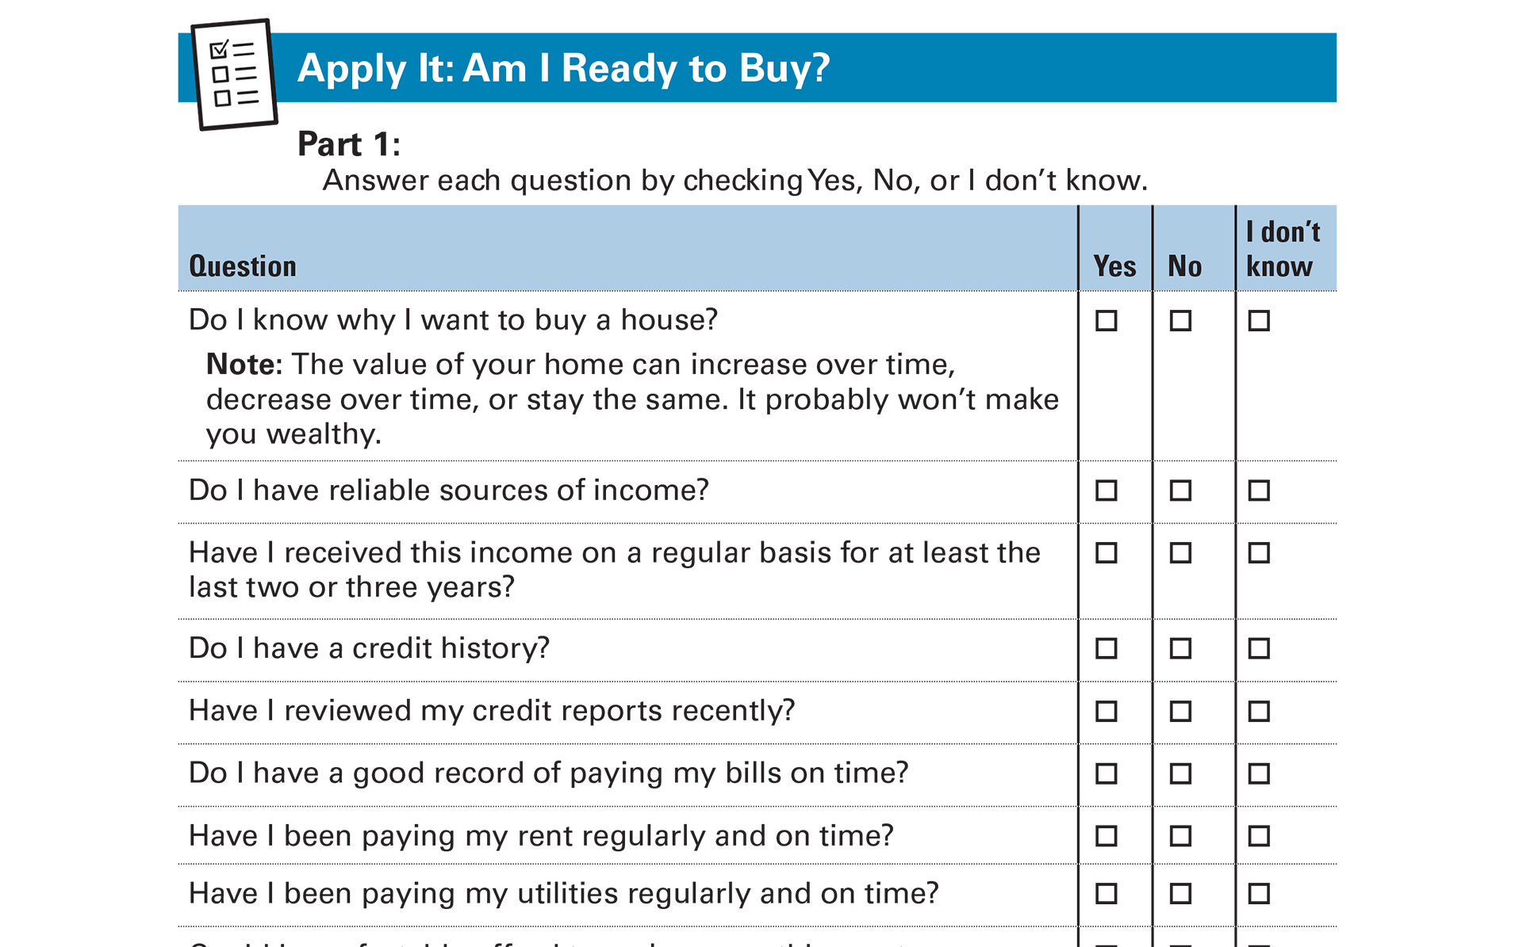
Apply It: Am I Ready to Buy?
See page 7 in your Participant Guide

Slide 12
How Much Can You Afford?
Only YOU can decide!
There are two ways to estimate this:
Your Spending and Saving Plan
Your Debt-to-Income Ratio

Slide 13
Spending and Saving Plan Method
Total Net
Monthly Income
Total Monthly Non-Housing Expenses
Amount Left for Housing Costs
-
=
?
Can you increase your income?
Can you decrease your expenses?
Can you eliminate any expenses?

Slide 14
Monthly Mortgage Payments
Principal: The amount you borrowed
Interest: Interest on your principal
Taxes: Real estate taxes
Insurance: Homeowner’s insurance
PITI

Slide 15




Additional Costs of Homeownership
One-time costs
Ongoing costs

Slide 16
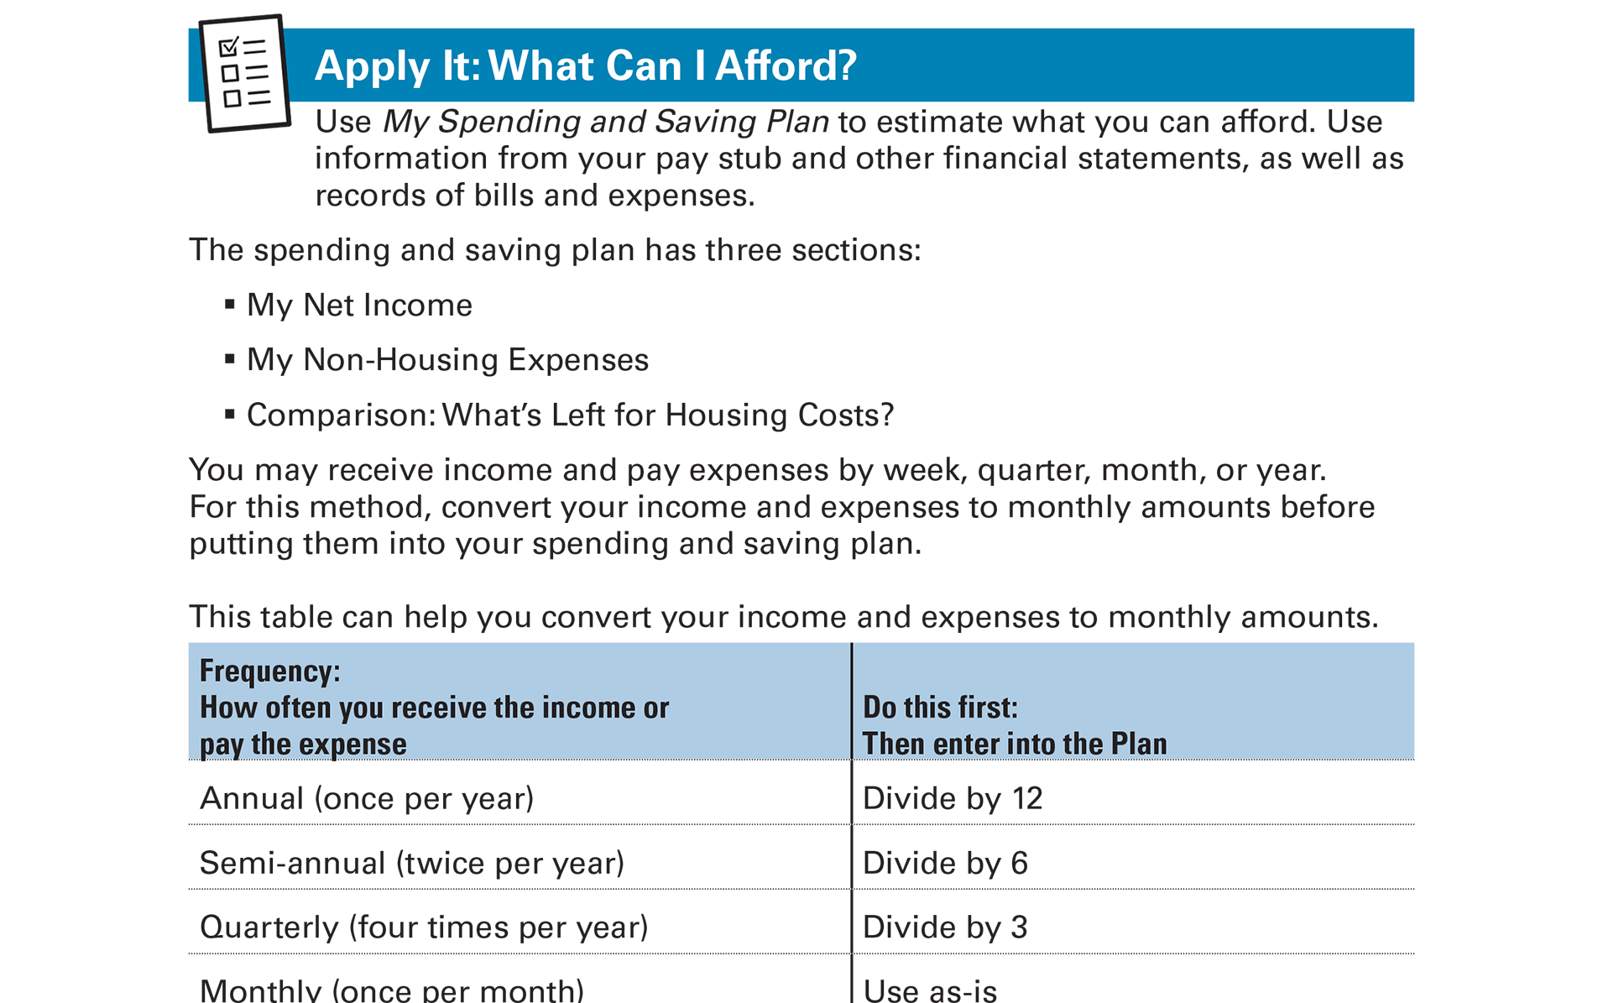
Apply It: What Can I Afford?
See page 10 in your Participant Guide

Slide 17
Debt-to-Income Ratio
Total monthly debt payments
  Divided by
Total monthly gross income
Shows how much of your monthly gross income (income before taxes or other deductions) goes to covering your monthly debt payments

Slide 18



Other Expenses Besides Debt
The higher your debt-to-income ratio, the less money you have to cover these expenses

Slide 19
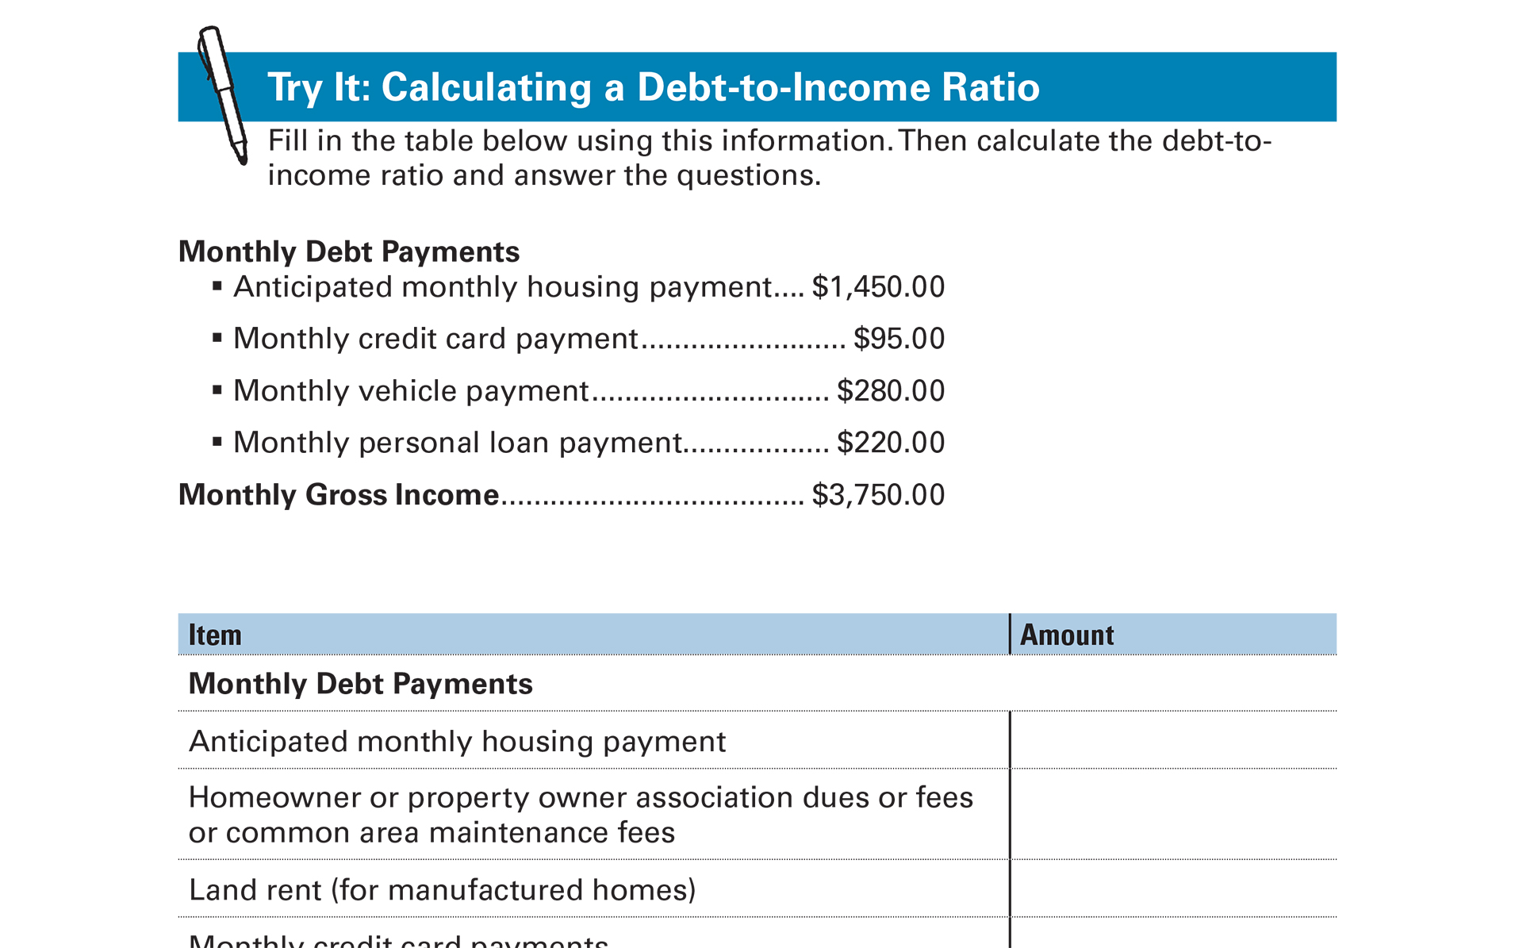
Try It: Calculating a Debt-to-Income Ratio
See page 16 in your Participant Guide

Slide 20
Try It: Calculating a Debt-to-Income Ratio: Answer Key
Item | Amount
Total Monthly Debt Payments | $2,045
Monthly Gross Income | $3,750
Debt-to-Income Ratio (Total Monthly Debt Payments divided by Monthly Gross Income) | $2,045/$3,750 = 0.5453 or 54.5%

Slide 21
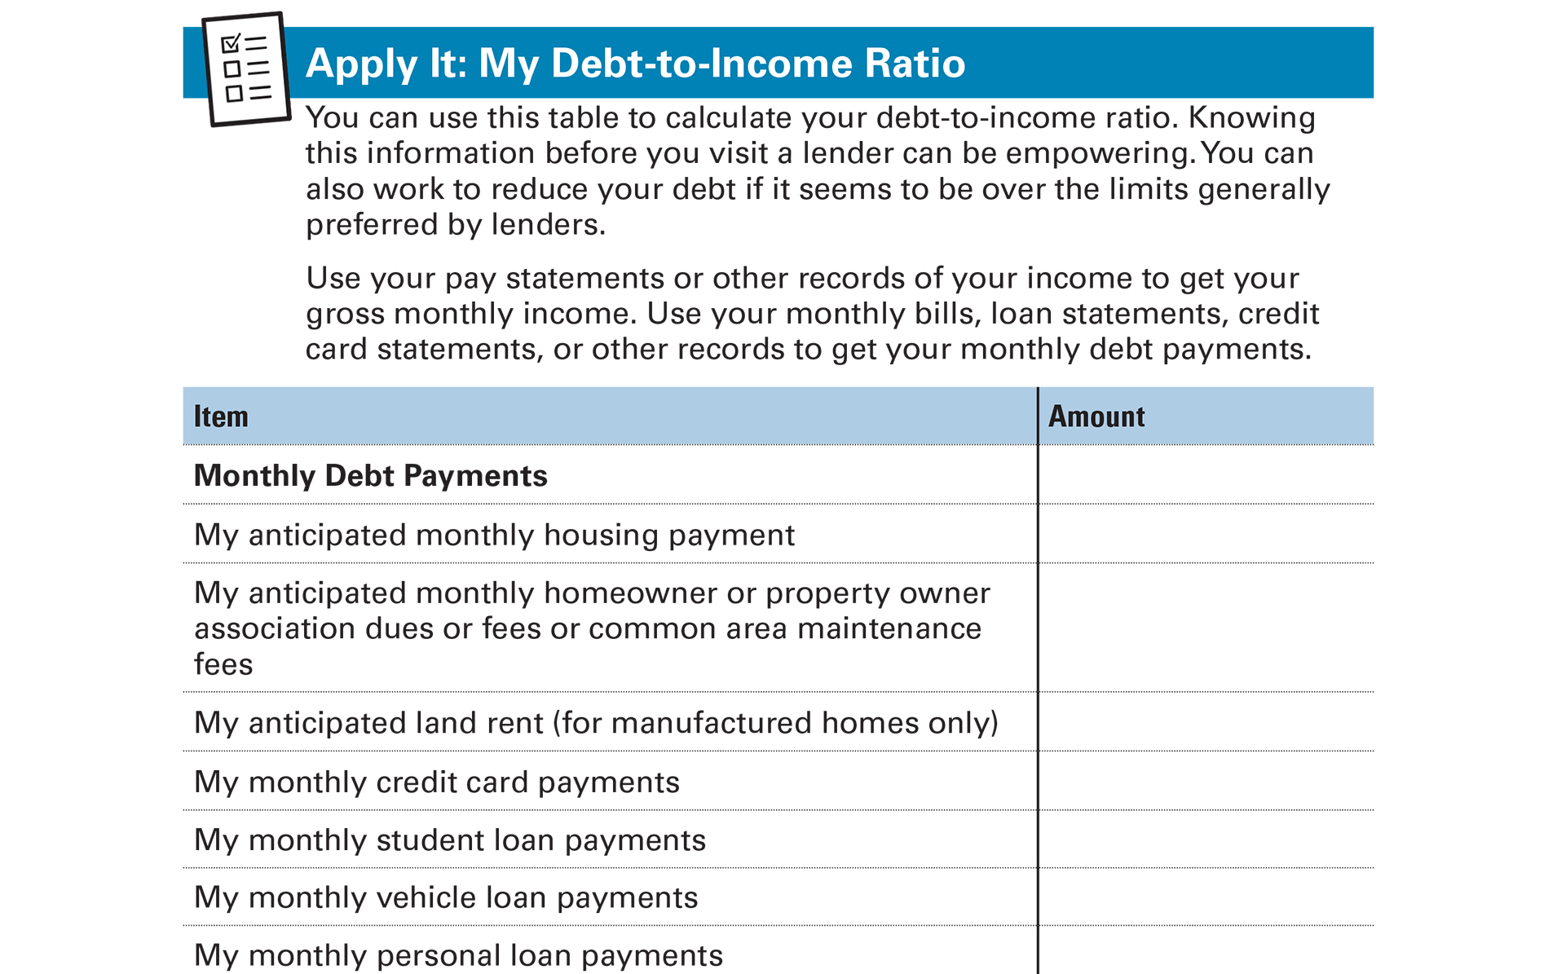
Apply It: My Debt-to-Income Ratio
See page 18 in your Participant Guide

Slide 22
Section 1: Remember the Key Takeaway
Buying a home is a process. Start by making sure you’re ready to buy and figure out what you can afford.

Slide 23

Section 2: Financing a Home Purchase
Section 2
Financing a Home Purchase
See page 19 in your Participant Guide

Slide 24
Section 2: Key Takeaway
Know your loan. Learn about your financing options for buying a home and shop around to get the best
deal for you.

Slide 25
Types of Loans
Type of Housing | Type of Loan
Manufactured housing (mobile home) on rented land and/or not on a permanent foundation | Personal or chattel loan
Unit in a cooperative | Co-op loan or Co-op share loan
House, condominium, or townhouse | Mortgage

Slide 26
Learn About Mortgages
Mortgage: | A loan to buy a home
Principal: | The amount of money you borrow
Costs: | Interest, points, fees, other charges
Annual Percentage Rate (APR): | Overall cost of the loan on an annual basis

Slide 27
Down Payment
Portion of home’s price you pay in cash
Example:
  $160,000 home with $8,000 down payment
  Borrow $152,000 ($160,000 minus $8,000)
  That’s a five percent down payment
  $8,000 ÷ $160,000 = .05 or 5%
Higher down payment → Less money to borrow

Slide 28
Private Mortgage Insurance (PMI)
May be required by lender when your down payment is less than 20 percent of the purchase price of the home
Lowers the risk to the lender
Increases your monthly payments

Slide 29
Other Mortgage Characteristics
Loan amount
Type of interest rate
Loan term
Upfront costs you must pay at closing

Slide 30
Two Common Ways to
Pay for Taxes and Insurance
Pay them as part of your monthly mortgage payment
  Escrow account
  May be required by the lender
Pay them yourself directly
  Not as common

Slide 31
Major Types of Mortgage Loans
Fixed-rate mortgages
Adjustable-rate mortgages (ARMs)

Slide 32
Fixed-Rate Mortgage
Interest rate does not change
Pay same amount each month
  Unless taxes or insurance in escrow change
May be a good choice if:
  Interest rates are low
  You plan to keep the mortgage for a long time

Slide 33
Adjustable Rate Mortgage
Interest rate may start lower than fixed rate
Adjusts on pre-determined dates or tied to an index
May be a good choice if:
  You plan to keep the mortgage for a short time
  You can afford paying more in interest if rates increase and you can’t refinance with a lower rate

Slide 34

Rate Lock
Mortgage interest rates can change daily and sometimes hourly
Rate lock means interest
rate won’t change during
the rate lock period
Rate lock periods can be
30, 45, or 60 days, and
sometimes longer

Slide 35

Balloon Payment
Larger-than-usual one-time payment at the end of the loan term

Slide 36
Conventional Mortgage
You generally need:
  A credit history that lenders consider good
  Regular income
  Debt-to-income ratio within acceptable limits
  Down payment

Slide 37
Jumbo Loan and Second Mortgages
“Jumbo loan”
  Mortgage above a certain amount of money
  For relatively expensive homes or homes in a high-cost area
“Second mortgage”
  To supply additional financing beyond the first mortgage

Slide 38
Government-Guaranteed Loans
Federal Housing Administration (FHA)
U.S. Department of Agriculture (USDA)
U.S. Department of Veterans Affairs (VA)
U.S. Department of Housing and Urban Development (HUD)

Slide 39
Other Assistance
Down payment assistance
Closing costs assistance
First time homebuyer programs
Help for people in specific professions
Loan programs and other programs from your state housing finance agency

Slide 40
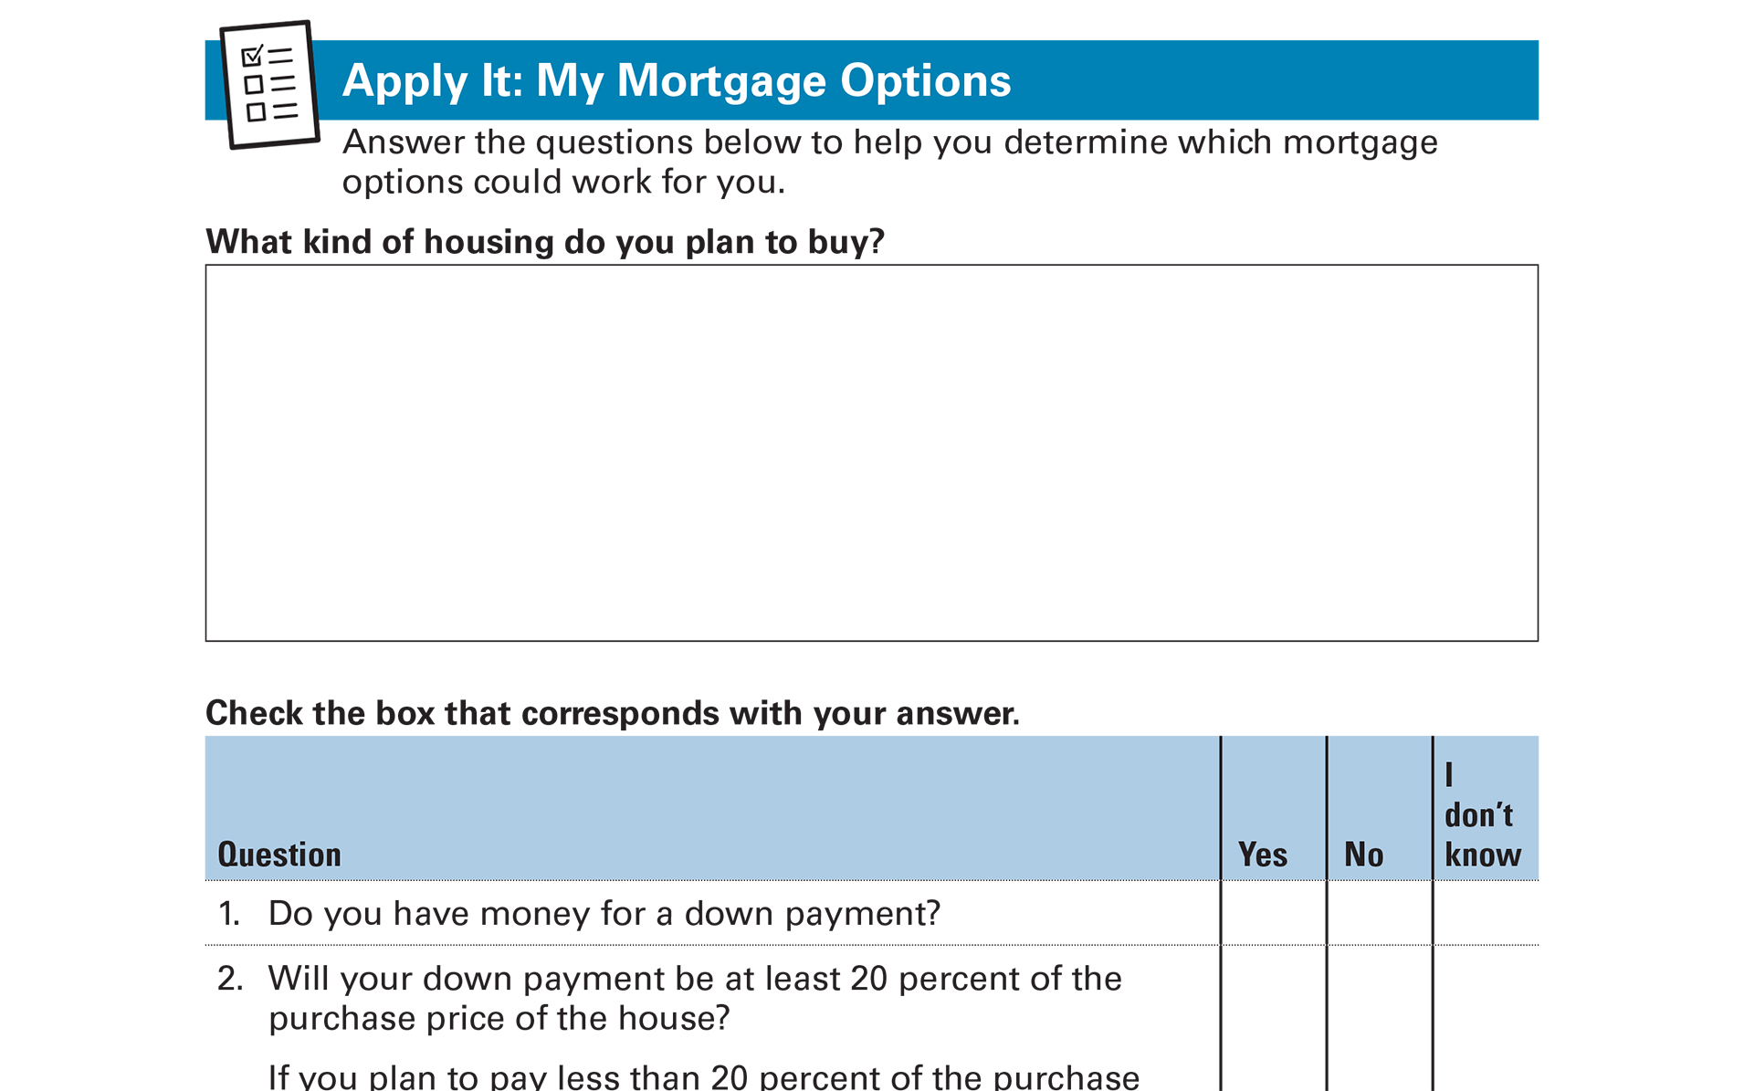
Apply It: My Mortgage Options
See page 22 in your Participant Guide

Slide 41
How Mortgages Work
Amount of the loan
Interest rate
Kind of interest rate (fixed or adjustable)
Term of the loan (15 year, 30 year, other)
Amortization schedule

Slide 42
Comparing Loans with Different Terms
15-year Loan
30-Year Loan
Higher monthly payment
Pay less interest over life of the loan
Finish paying off loan sooner
Lower monthly payment
Pay more interest over life of the loan
Take longer to pay off loan

Slide 43
Amortization
Amount you pay each month is “amortized”
Amortization schedule
  Shows how much money from each payment goes toward principal and how much goes toward interest

Slide 44
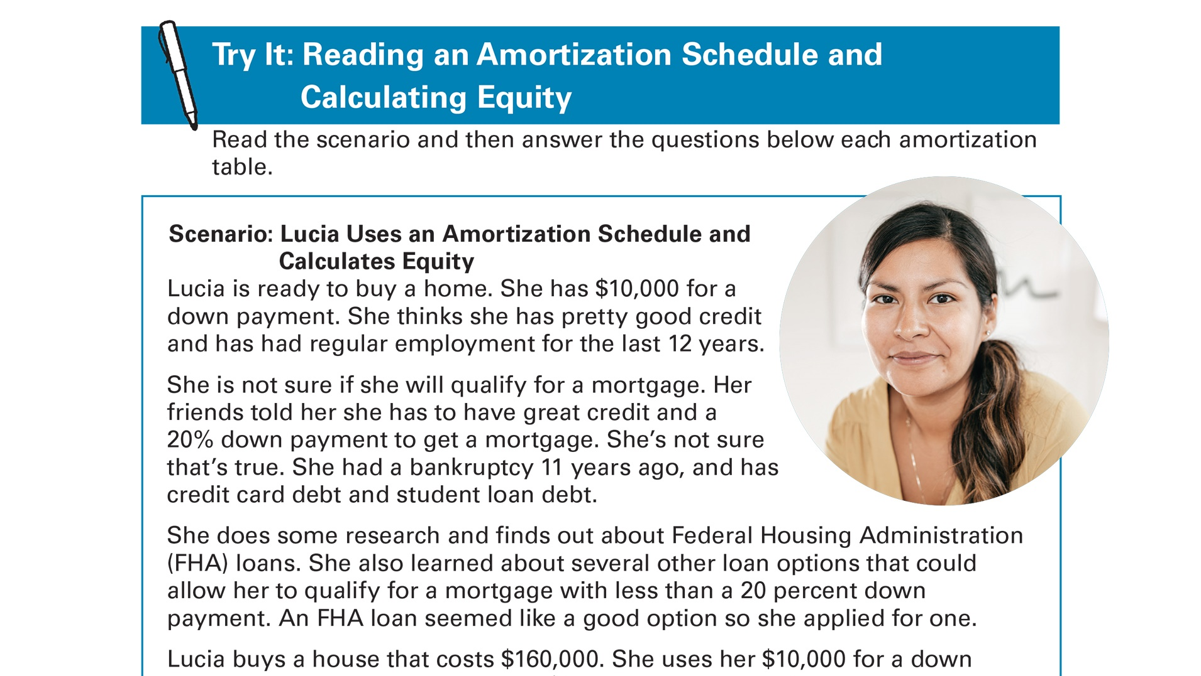
Try It: Reading an Amortization Schedule and Calculating Equity
See page 23 in your Participant Guide

Slide 45
Getting Pre-Qualified or Pre-Approved
Pre-qualification
  Estimate of how much money you may be able to borrow
  Not an approval for a loan
Pre-approval
  Commitment from lender to lend you money under some conditions they specify

Slide 46
Shop Around for a Mortgage
Shopping around can save you money
Loan Estimates: Three-page form you receive after applying for a mortgage
Gives you important details about the loan
Get one from several lenders (they’re free)
Ask questions

Slide 47
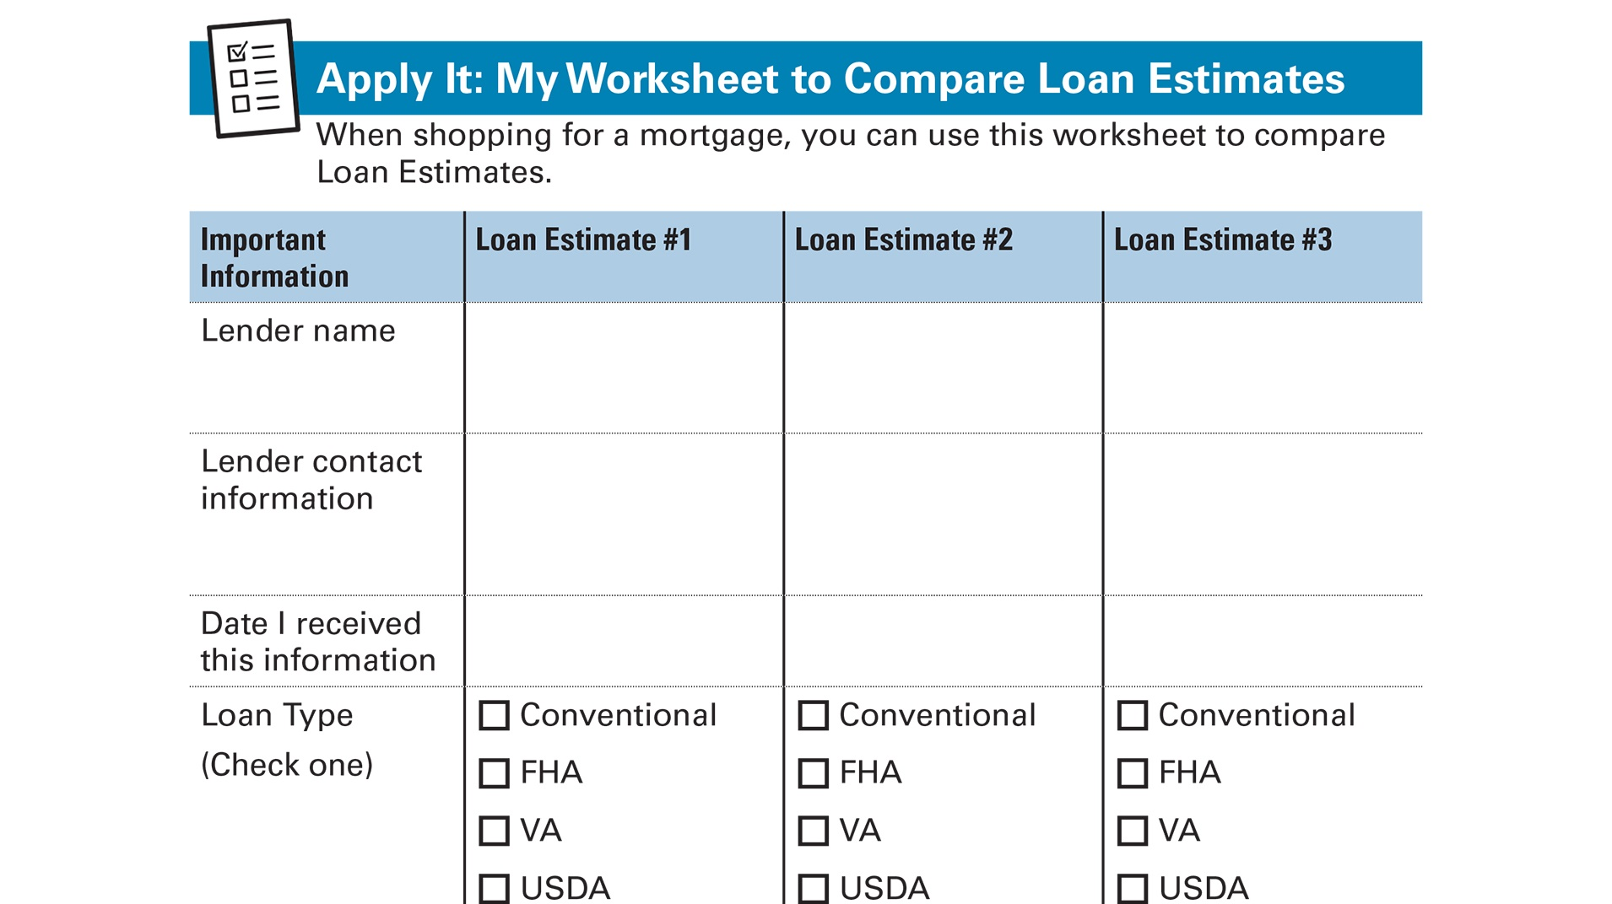
Apply It: My Worksheet to Compare Loan
Estimates
See page 26 in your Participant Guide

Slide 48
Section 2: Remember the Takeaway
Know your loan. Learn about your financing options for buying a home and shop around to get the best deal for you.

Slide 49
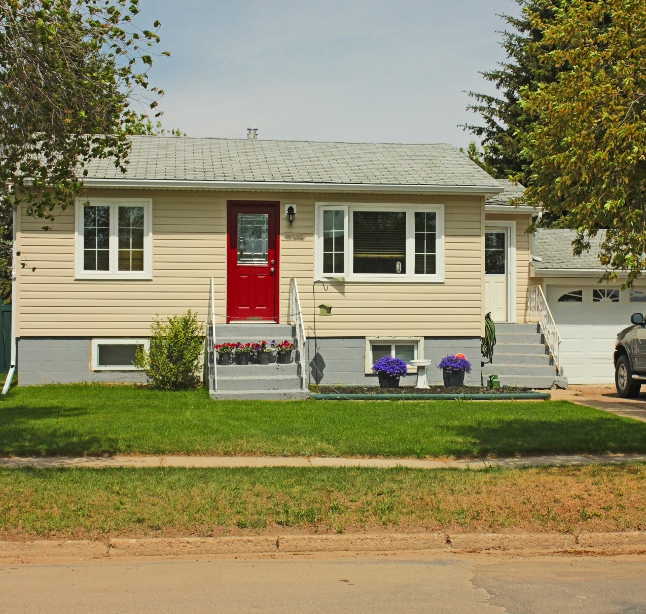
Section 3: Getting Help and Buying Your Home
Section 3
Getting Help
and Buying Your Home
See page 29 in your Participant Guide

Slide 50
Section 3: Key Takeaway
Get help with the home buying process. Interview before you hire help and ask for references. Understand
what services you will
receive and how much they will cost.

Slide 51
Putting Together Your Team and
Finding a Home
Real estate agent
Who else might play a role in helping you buy a home?

Slide 52
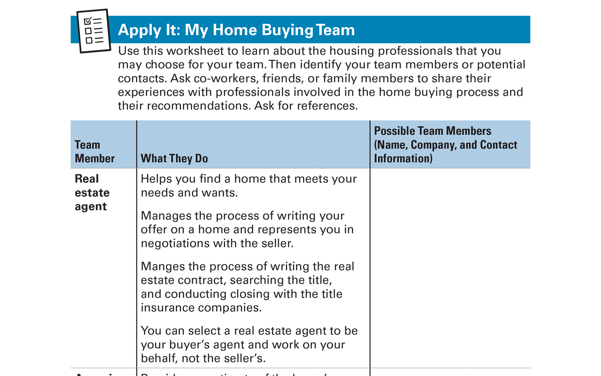
Apply It: My Home Buying Team
See page 30 in your Participant Guide

Slide 53

Making an Offer
Can be complicated; definitely exciting!
Your offer says:
“I want to buy your home. And this is how much I am going to pay.”
Your real estate
agent or attorney
will write your offer

Slide 54
What’s In an Offer
Address and description of property
Sale price
How much money you are offering to pay
Target date for closing
Amount of earnest money you are offering
How taxes and utilities will be handled

Slide 55

What Else Is In an Offer
Who pays for title insurance, termite inspections, property surveys, etc.
Walk-through clause
Date the offer expires
Contingencies
Special requests
Other terms

Slide 56
You’ve Made an Offer…
In response, the seller can:
Accept your offer
Reject your offer and make a counteroffer
Reject your offer and not make a counteroffer

Slide 57
Home Inspection
It’s one of the most important steps in protecting you and your investment
In-depth, unbiased look at the home:
  Evaluates the physical condition
  Identifies items that need repair or replacement
  Estimates remaining useful life of major systems, equipment, structure, and finishes

Slide 58
Closing on a Home
Last step in the home buying process
Loan becomes final
Funds are distributed
Congratulations! You own the home!

Slide 59
Documents at Closing
You can expect:
Closing Disclosure
Initial escrow statement
Promissory note
Payment option information
Mortgage or security instrument

Slide 60
Getting Help When You’re in Trouble
Important to get help if you are unable to make your mortgage payments
Contact:
  Your lender
  The home preservation hotline
  HUD-approved housing counseling agency
  State housing finance agency

Slide 61
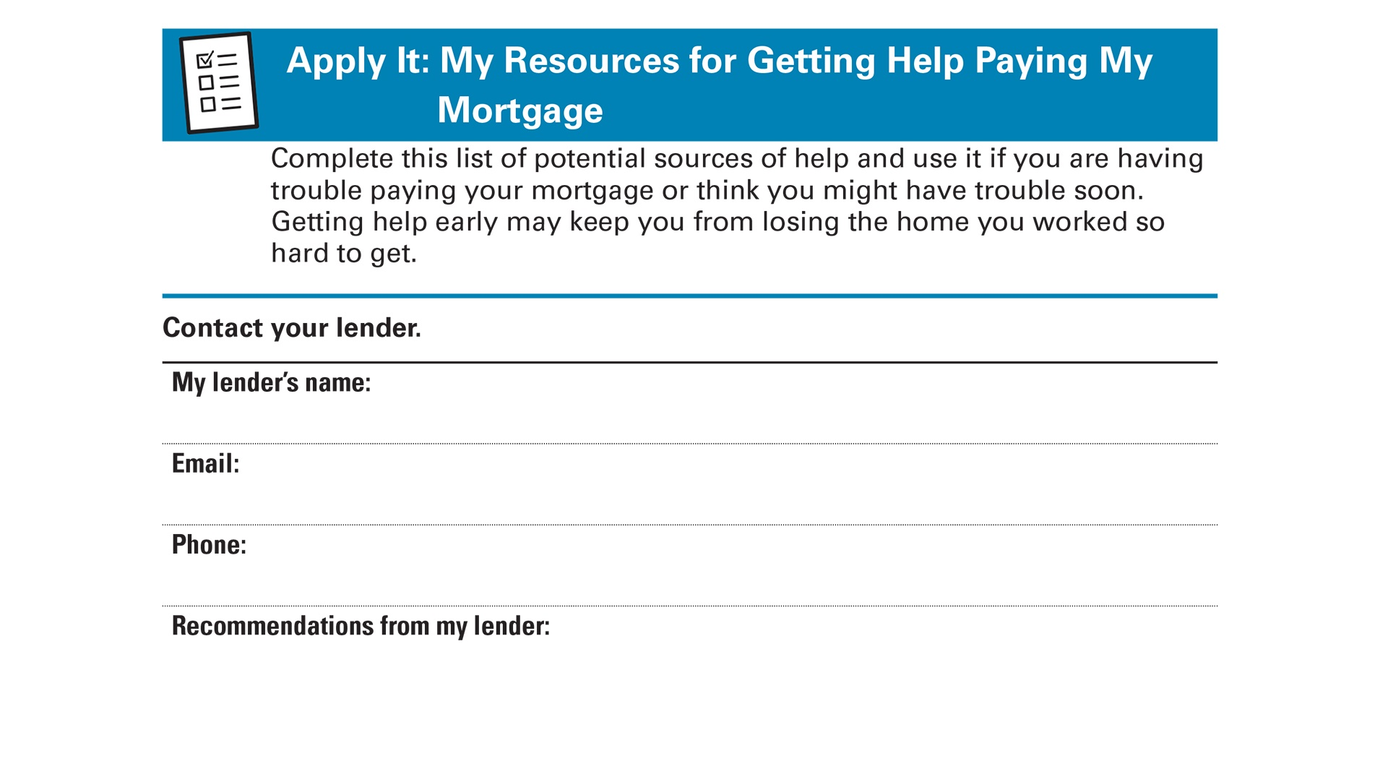
Apply It: My Resources for Getting Help
Paying My Mortgage
See page 34 in your Participant Guide

Slide 62
Section 3: Remember the Takeaway
Get help with the home buying process. Interview before you hire help and ask for references. Understand what services you will receive and how much they will cost.

Slide 63
Take Action
See page 36 in your Participant Guide
What will I do?
How will I do it?
Will I share my plans with anyone? If so, who?
Visit fdic.gov/education to learn more

Slide 64

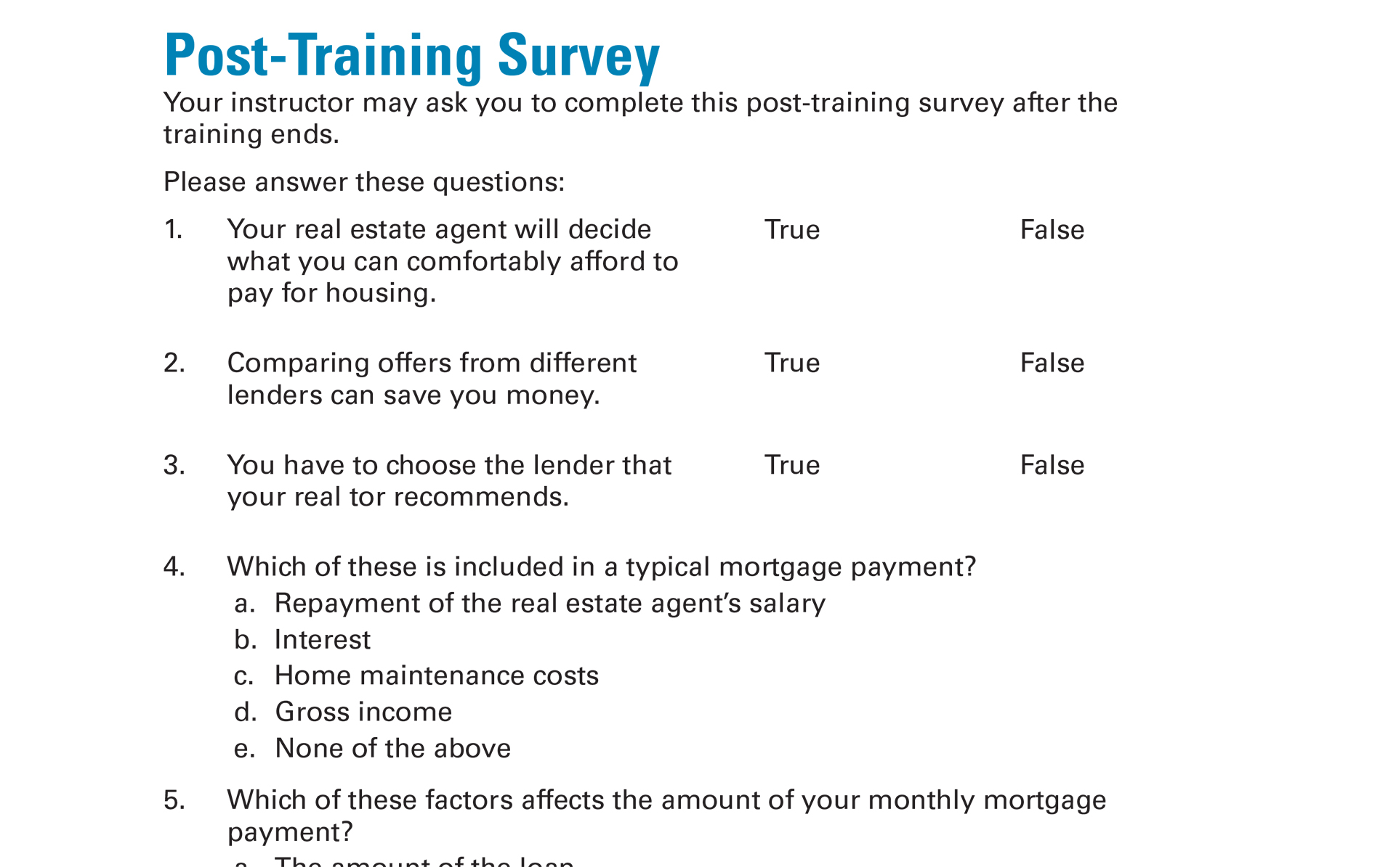
Post-Training Survey
See page 41 in your Participant Guide

