Slide 1


Module 3: Your Income and Expenses
Module 3
Your Income and Expenses
September 2018

Slide 2
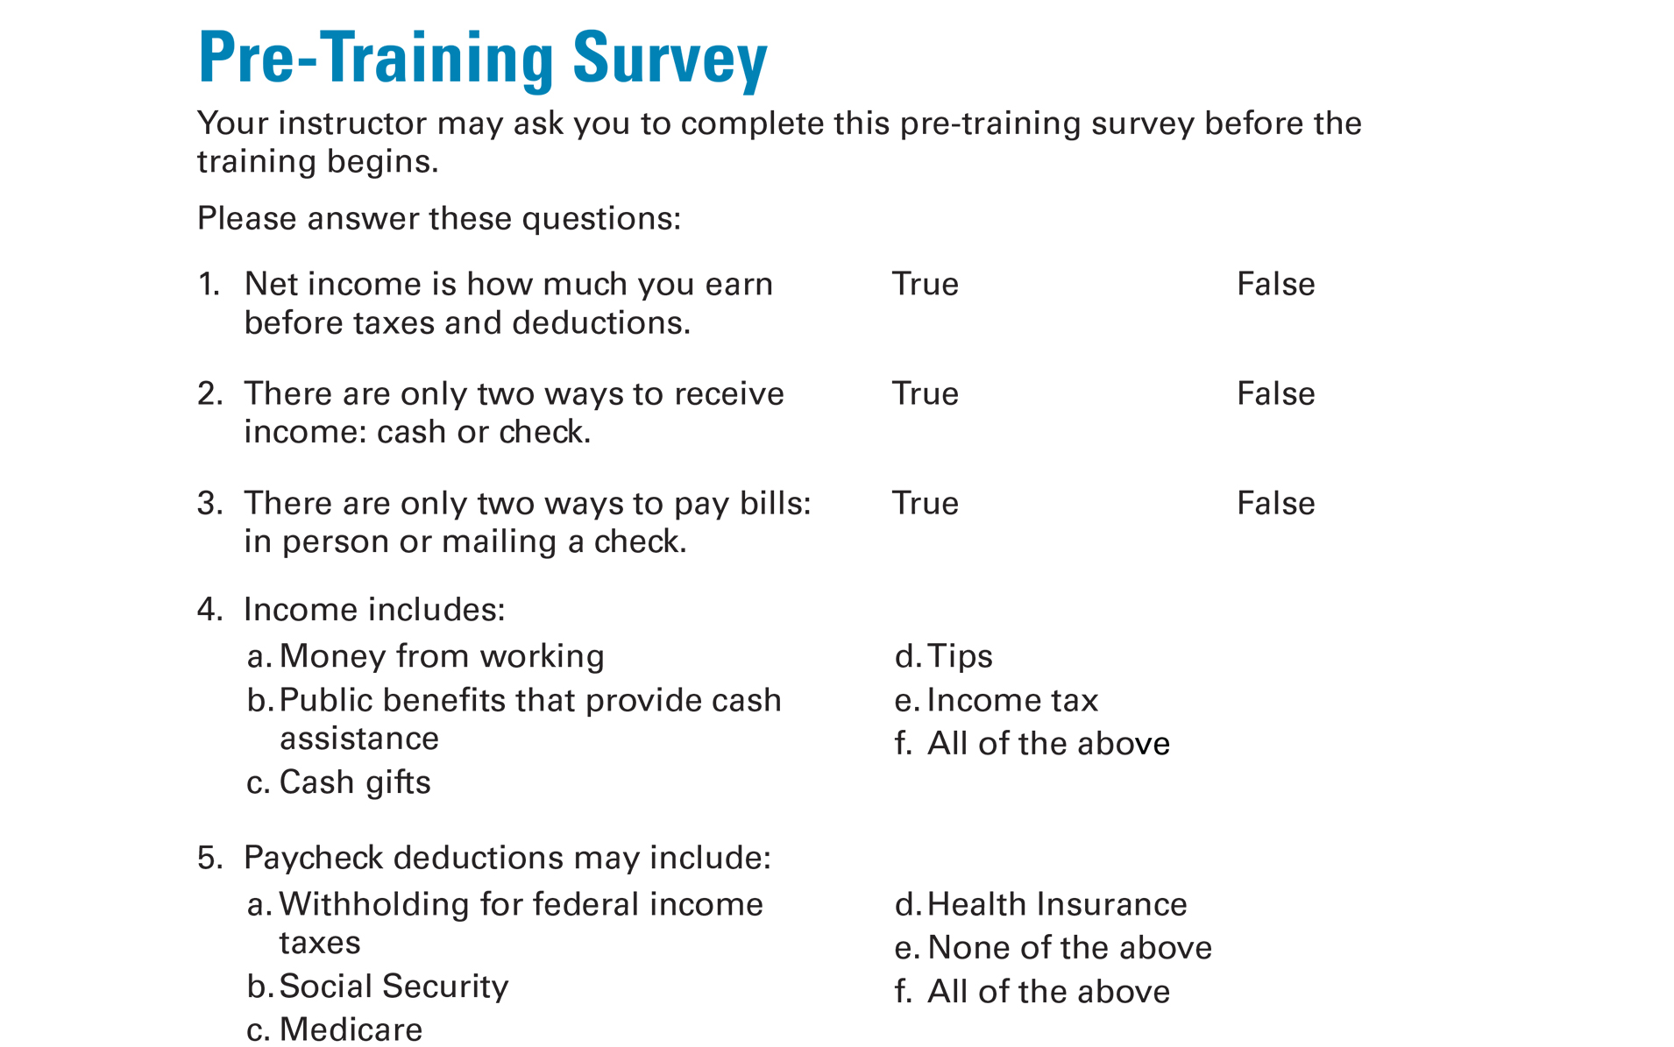
Pre-Training Survey See page 27 in your Participant Guide

Slide 3

Section 1: Income
Section 1
Income
See page 3 in your
Participant Guide

Slide 4
Section 1: Key Takeaway
Understand your income. That is the first step to using it to meet your needs.

Slide 5

What is Income?
Income is money you receive
What are some types of income?

Slide 6
Types of Income
Earned income
Income from assets or investments
Public benefits or entitlements that pay money
Other benefits or other entitlements
Other income

Slide 7
Gross and Net Income
Gross income
Total income without deductions
Net income
Gross income minus deductions
What you have to save, share, and spend
Your take-home pay

Slide 8
Garnishment
Wage garnishment
Account garnishment
Treasury offset

Slide 9


What Are Ways You Can Be Paid Money?

Slide 10
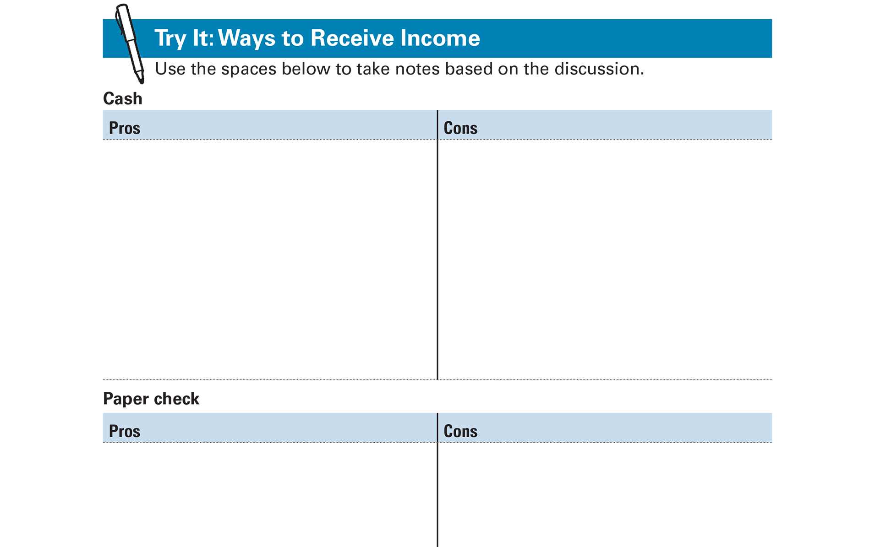
Try It: Ways to Receive Income See page 4 in your Participant Guide

Slide 11
Ways to Receive Income: Small Groups
Cash
Paper check
Direct deposit
Payroll card
Electronic benefits transfer

Slide 12

Understanding Pay Statements
Typical pay statement information:
Personal information
Pay period
Pay date
Gross pay
Deductions
Net pay
Employer contributions

Slide 13
Deductions
Required deductions
FICA: Social Security and Medicare
Income tax: Federal, state, local
Elective (voluntary) deductions
Such as insurance premiums, union dues, retirement account contributions, charitable contributions, direct deposits

Slide 14
Income Tax Withholding
Internal Revenue Service Form W-4
Possibly state and local income tax forms too
Additional
Withholding
Lower Take-Home Pay
Reduced
Withholding
Higher Take-Home Pay
Be careful not to have too little withheld!

Slide 15
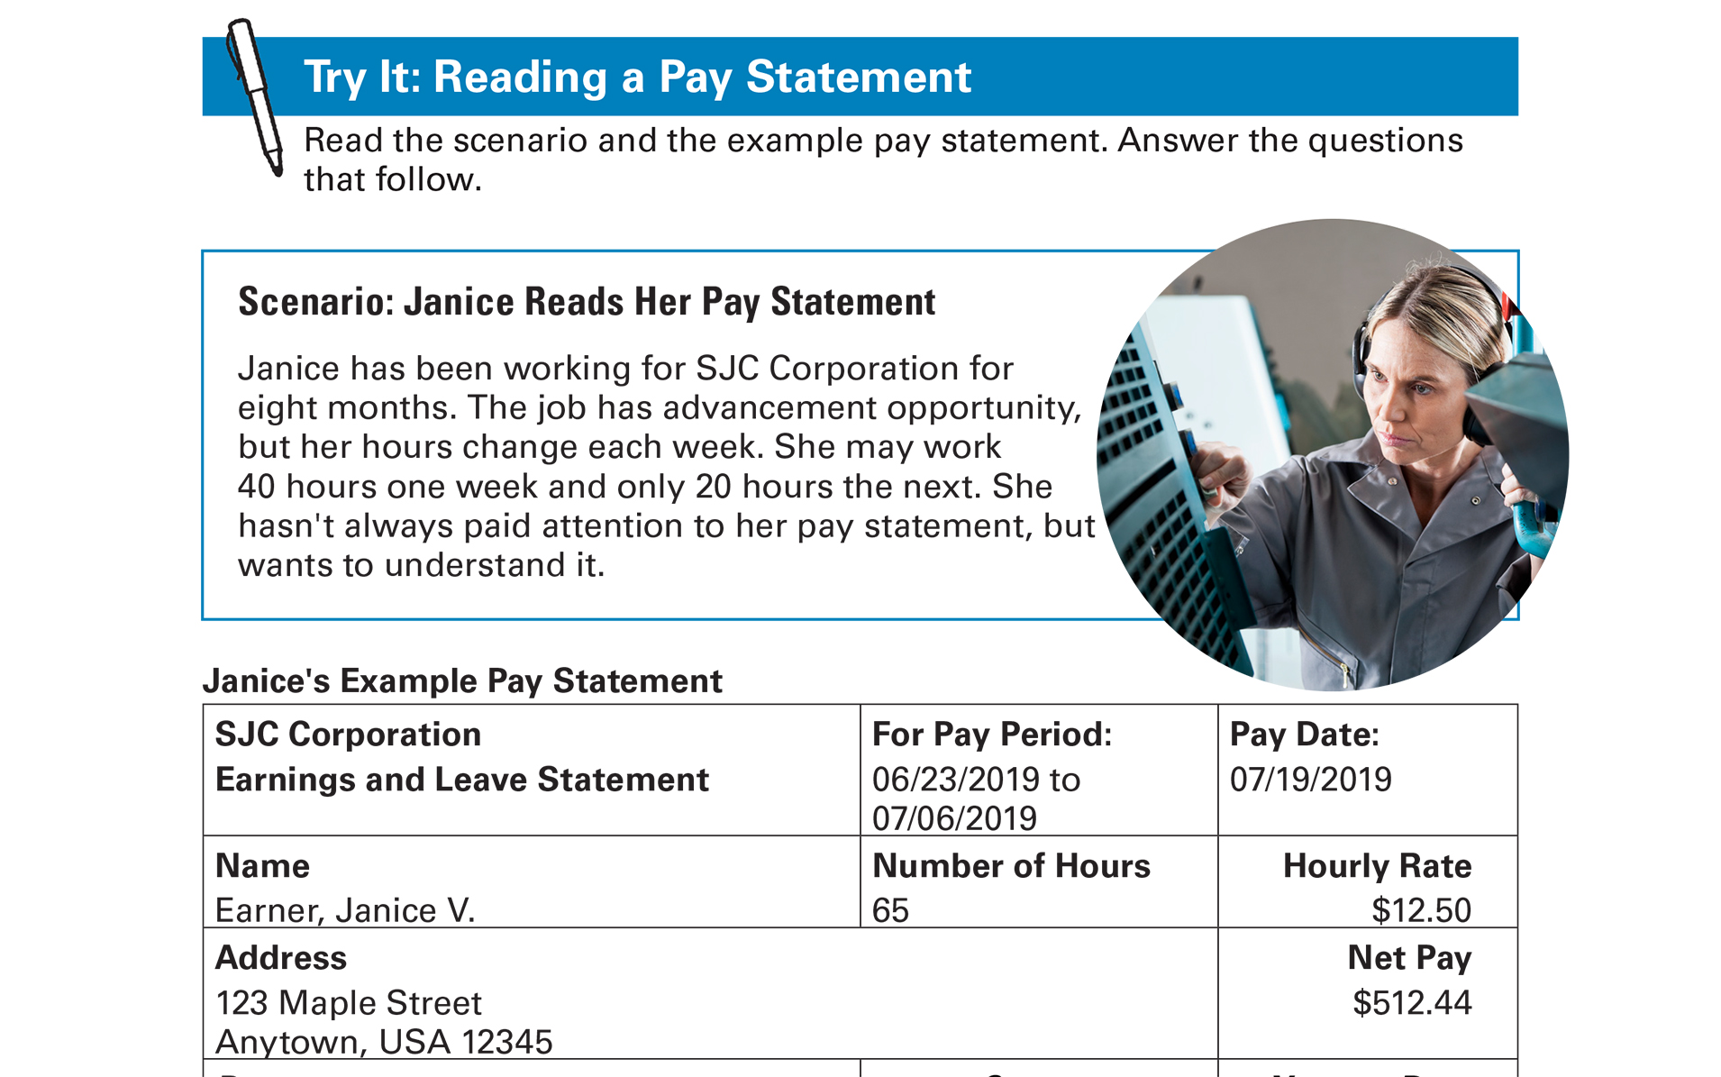
Try It: Reading a Pay Statement See page 8 in your Participant Guide

Slide 16
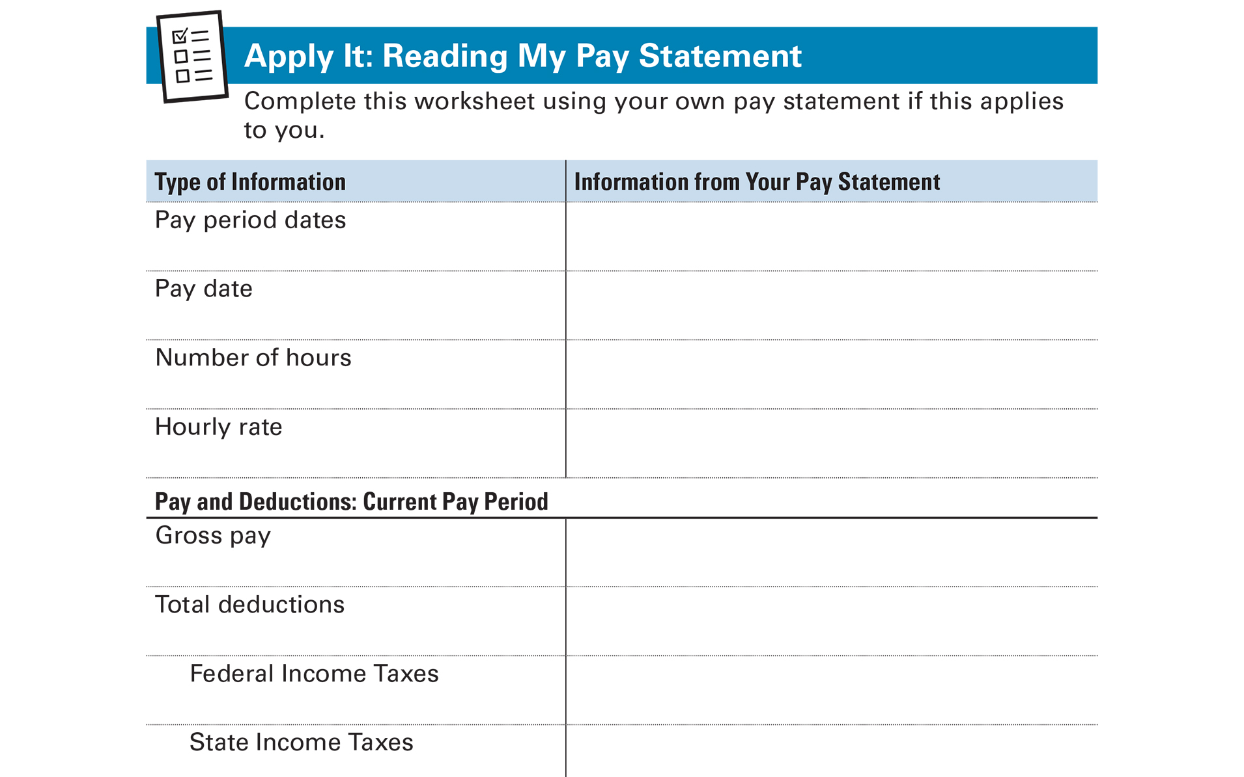
Apply It: Reading My Pay Statement
Apply It: Reading My Pay Statement
See page 10 in your Participant Guide

Slide 17
More Than One Job or a Paid “Hobby”
If You Receive… | Employer Considers You …
IRS Form W-2 | An employee
IRS Form 1099-MISC | Self-employed
Understand how you are being paid
May have to pay taxes yourself
Consider putting money aside for the future
Keep accurate records!

Slide 18
Tracking Your Income
Regular income
Unpredictable income
Seasonal income
One-time income

Slide 19
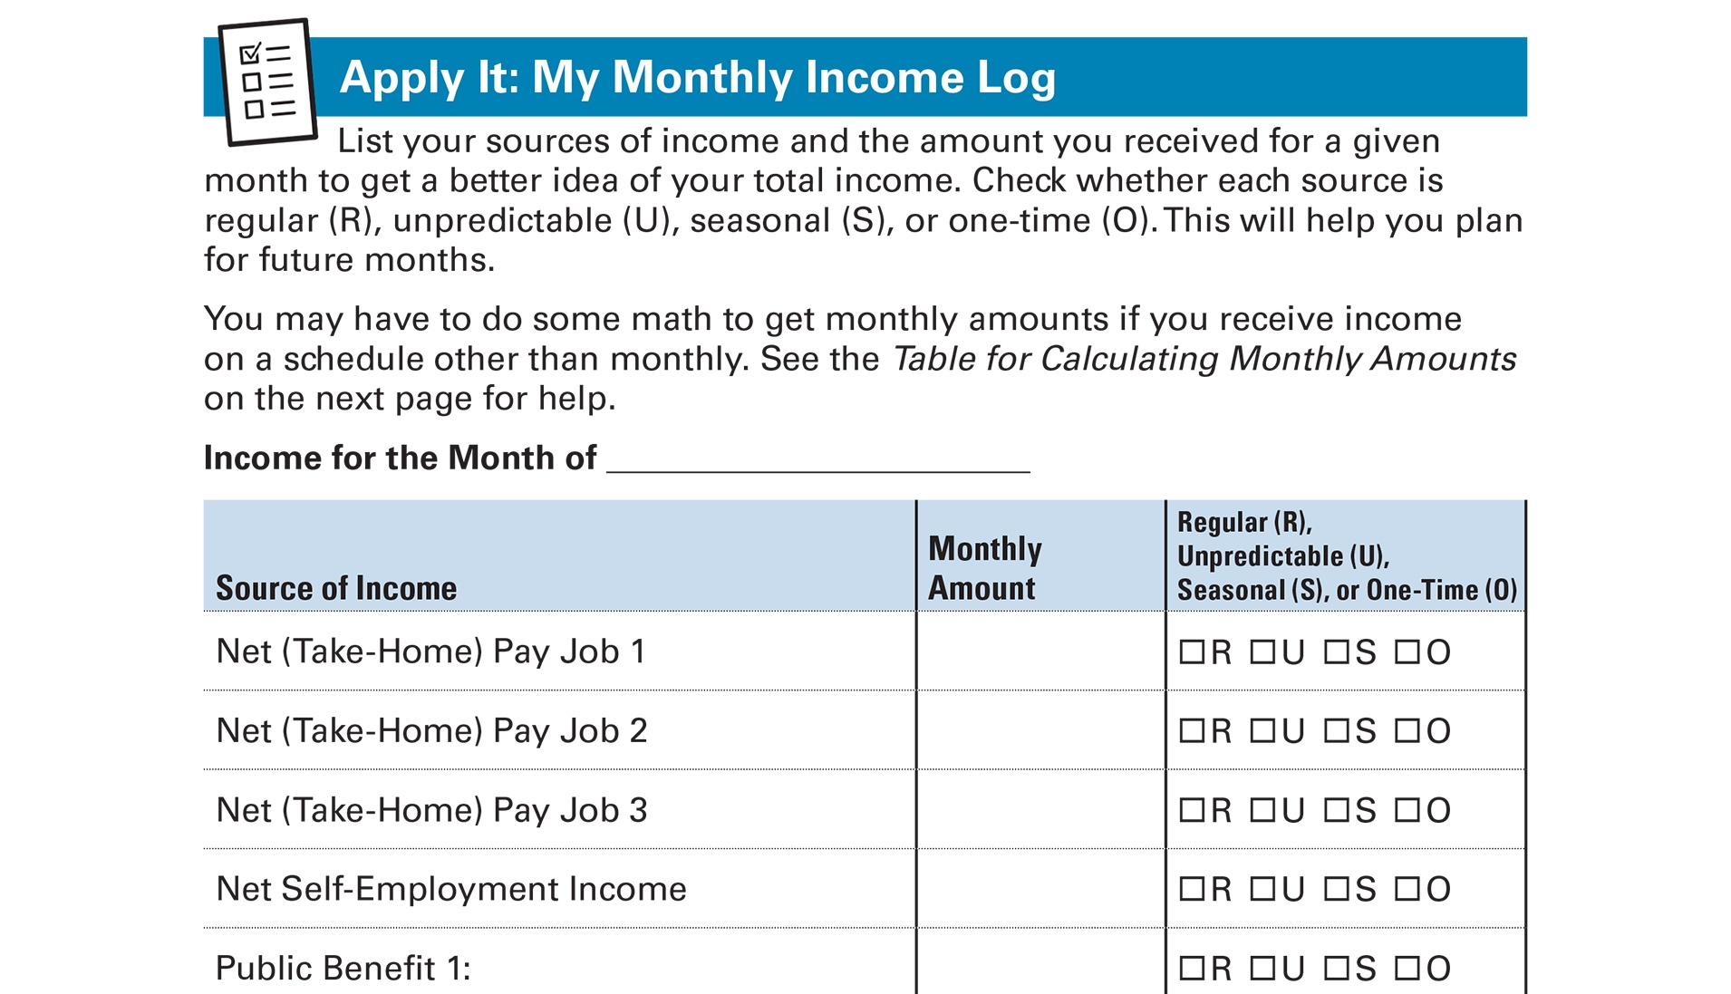
Apply It: My Monthly Income Log See page 13 in your Participant Guide

Slide 20
Section 1: Remember the Key Takeaway
Understand your income. That is the first step to using it to meet your needs.

Slide 21

Section 2: Expenses
Section 2
Expenses
See page 15 in your
Participant Guide

Slide 22
Section 2: Key Takeaway
Understand your expenses. That will help you decide how to save, share and spend your income.

Slide 23




Ways to Use Your Money
What do people do with their money?

Slide 24
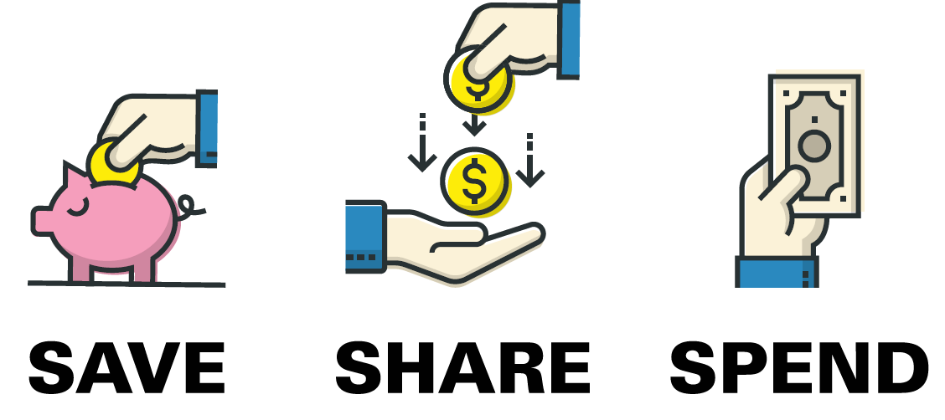
Think About How You Use Your Money
Saving it
Sharing it
Spending it

Slide 25
Ways to Think About Expenses
Needs: Things you must have to live
Wants: Things you desire and can live without
Obligations: Debts you owe
Can you:
Find less expensive ways to meet needs?
Use less money for wants?
Negotiate lower payments for obligations?

Slide 26
If You Receive Public Benefits
Learn about resource and asset limits
Monitor how your spending and saving affects countable assets
Use income in ways that avoid exceeding asset limits

Slide 27
Tracking Your Expenses
Helps you understand if you are using your money in line with your value and goals
Uncovers where you can make changes
AND … it can help you spend less

Slide 28
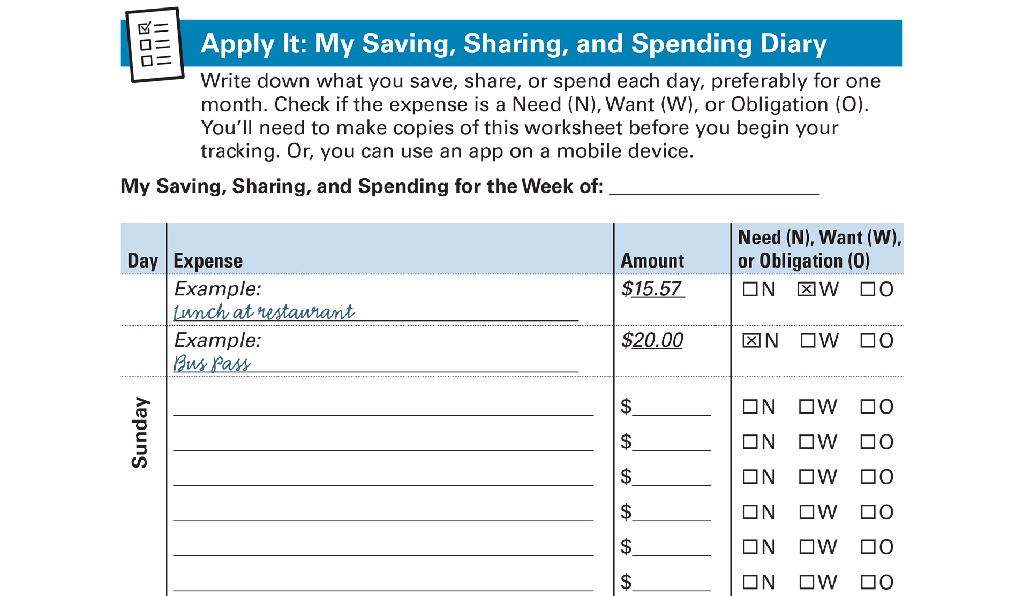
Apply It: My Saving, Sharing, and Spending Diary See page 16 in your Participant Guide

Slide 29
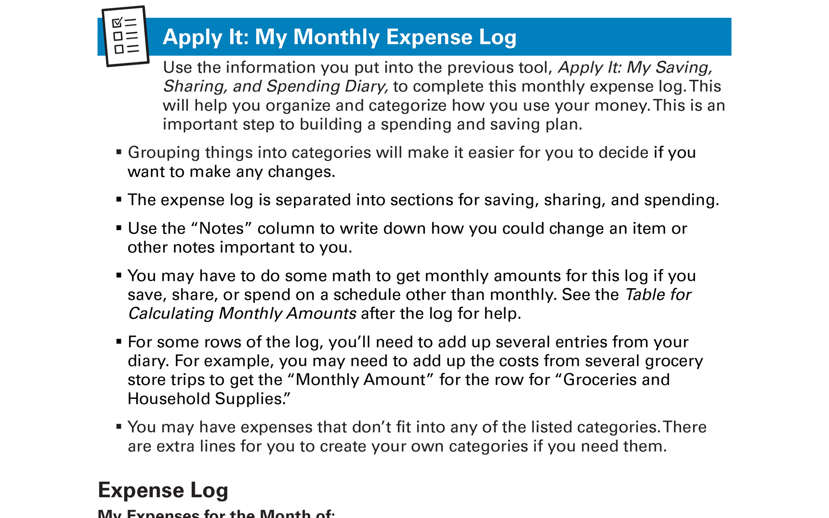
Apply It: My Monthly Expense Log See page 18 in your Participant Guide

Slide 30

Managing Your Expenses
Helps you avoid:
Late fees
Interest on unpaid balances
Negative credit report entries
Loss of services
Additional charges associated with loss of services

Slide 31
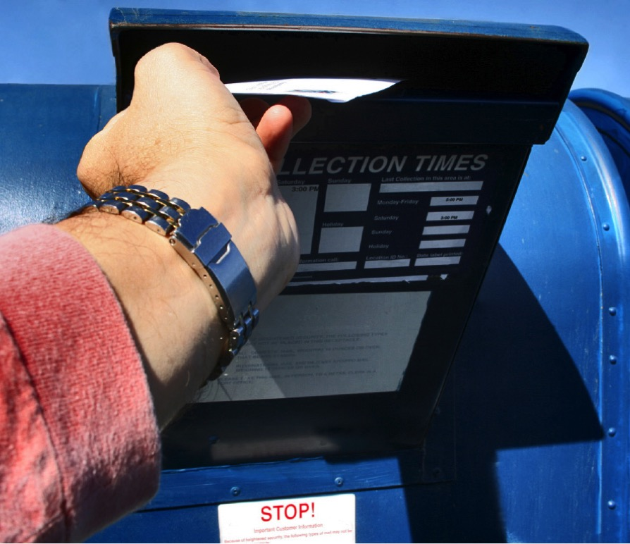
Ways to Pay Bills
In person
By mail
Electronically
Through financial institution
Credit card website
Through entity you owe money to
Bill paying service
Via mobile app

Slide 32
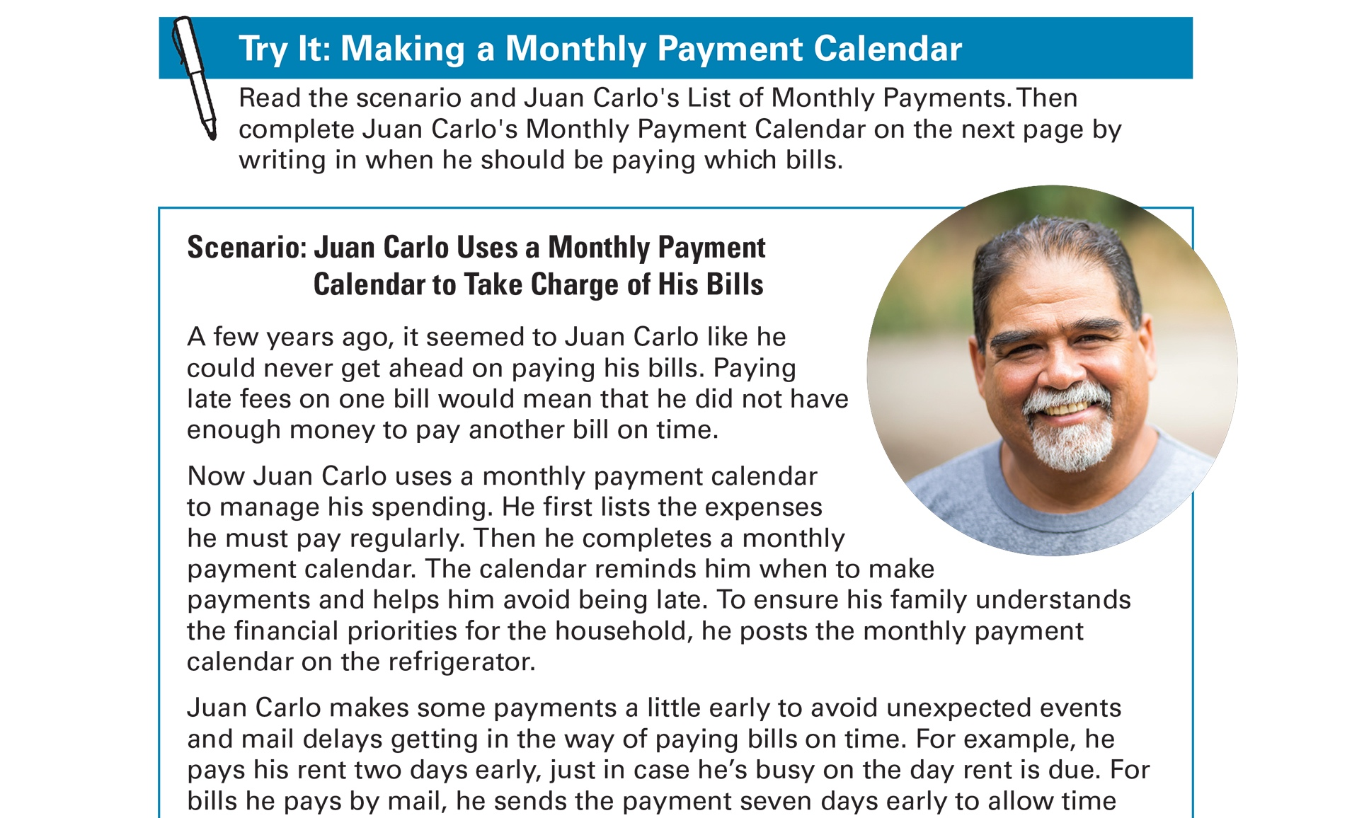
Try It: Making a Monthly Payment Calendar See page 22 in your Participant Guide

Slide 33
Remember the Key Takeaway
Understand your expenses. That will help you decide how to save, share and spend your income.

Slide 34
Take Action See page 24 in your Participant Guide
What will I do?
How will I do it?
Will I share my plans with anyone? If so, who?
Visit fdic.gov/education to learn more

Slide 35

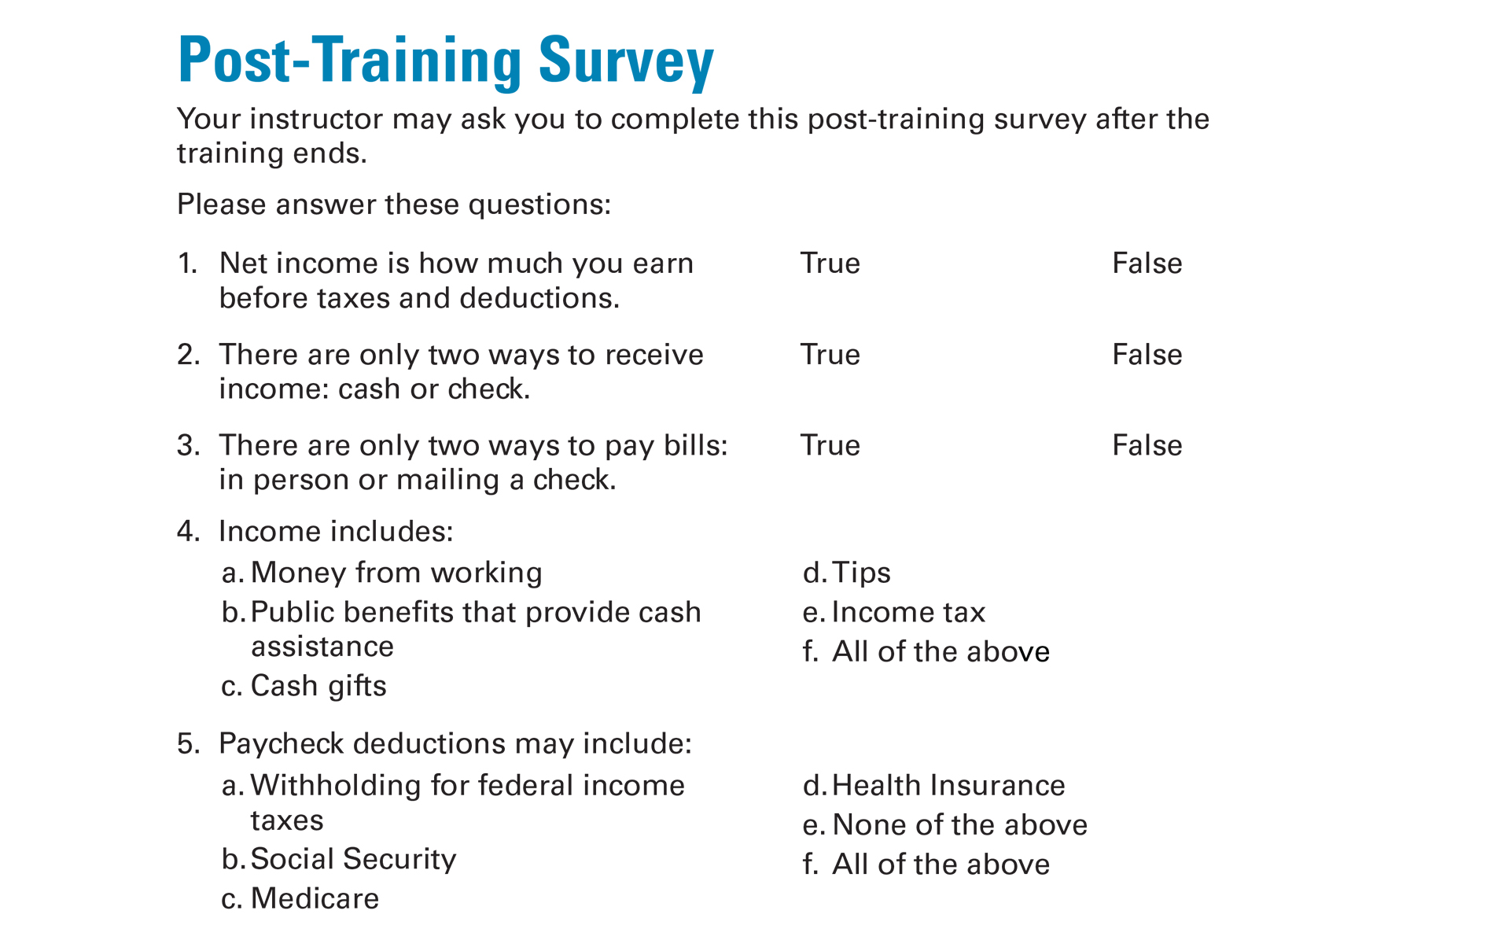
Post-Training Survey See page 29 in your Participant Guide

