Slide 1
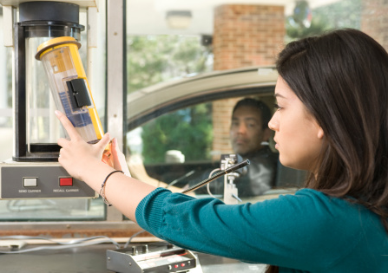

Module 2: You Can Bank On It
Module 2
You Can Bank On It
September 2018

Slide 2
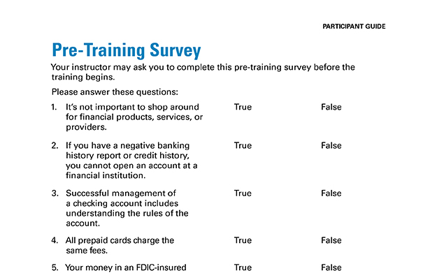
Pre-Training Survey See page 41 in your Participant Guide

Slide 3

Section 1: Financial Products, Services, and Providers
Section 1
Financial Products, Services, and Providers
See page 4 in your Participant Guide

Slide 4
Section 1: Key Takeaway
Consider your needs and shop around for financial products and services.

Slide 5
Financial Institutions: Banks and Credit Unions
Banks (including savings associations)
Credit Unions
Accept deposits of money
Lend money
May offer other products and services, such as credit cards, car loans, personal loans, mortgages, and others

Slide 6
Differences Between Banks and Credit Unions
Banks | Credit Unions
Customers | Members
Usually no membership criteria | Membership criteria
Most are owned by shareholders | Not-for-profit organizations owned by members

Slide 7
Deposit Insurance—For Banks
Federal Deposit Insurance Corporation
Protects funds depositors place in federally insured banks in case of bank failure
Insurance up to at least $250,000 per depositor, per FDIC-insured bank, per ownership category

Slide 8
Share Insurance—For Credit Unions
National Credit Union Administration
Protects funds depositors place in federally insured credit unions
Insurance rules are similar to those of the FDIC

Slide 9
Accessing Services
Access services through:
Retail locations
Automated teller machines (ATMs)
Customer service phone numbers and email
Websites
Mobile banking and smartphone apps
Request reasonable accommodations if needed

Slide 10
Products and Services Available at Financial Institutions
Deposit products
Credit products
Other products and services

Slide 11
Deposit Products include…
Savings accounts
Checking accounts
Certificates of deposit
Money market accounts

Slide 12
Credit Products include…
Credit cards
Lines of credit
Installment loans
Mortgages

Slide 13
Other Products and Services include…
Check cashing | Automated teller machines (ATMs)
Money orders | ATM cards
Prepaid cards | Online or mobile banking and bill-paying services
Debit cards | “Person-to-person” payments (P2P)
Cashier’s checks | Remittance transfers

Slide 14
Other Financial Service Providers
Convenience stores and U.S. Post Offices
Stores that sell prepaid cards
Check-cashing stores and outlets
Payday lenders
Pawn shops
Vehicle title lenders

Slide 15

What Financial Products and Services Do You Need?
Financial products and services can help you:
Save money
Spend money
Manage money
Borrow money
Start with your needs

Slide 16
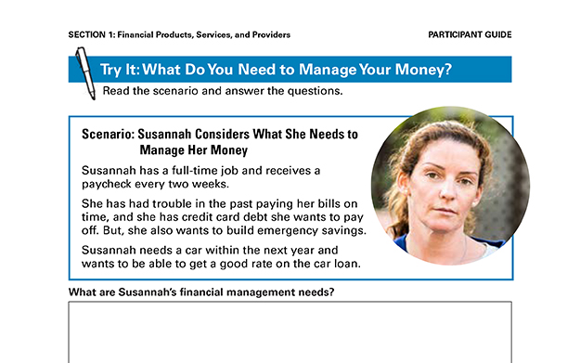
Try It: What Do You Need to Manage Your Money? See page 8 in your Participant Guide

Slide 17
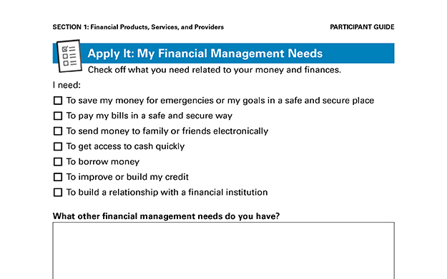
Apply It: My Financial Management Needs See page 9 in your Participant Guide

Slide 18
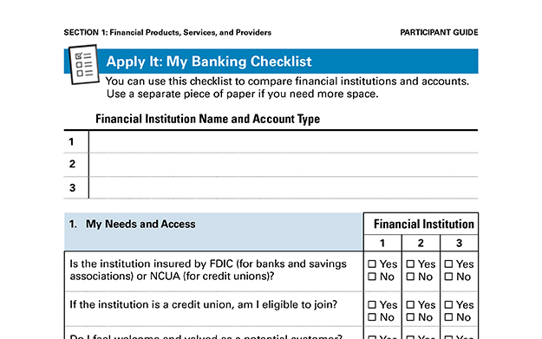
Apply It: My Banking Checklist See page 10 in your Participant Guide

Slide 19
Six Sections in Apply It: My Banking Checklist
My Needs and Access
Checking Accounts, Reloadable Prepaid Cards, and Other Transactional Accounts
Savings Accounts
Debit Cards and ATM Cards
Overdrafts and Overdraft Fees
Other Available Services

Slide 20
Section 1: Remember the Key Takeaway
Consider your needs and shop around for financial products and services.

Slide 21

Section 2: Opening an Account
Section 2
Opening an Account
See page 14 in your Participant Guide

Slide 22
Section 2: Key Takeaway
Know the general process for opening a savings or checking account, including options if you are initially unable to open an account.

Slide 23
Savings and Checking Accounts
Safety and security from federal deposit insurance
Earning interest, depending on the account
Convenience
Relationship-building
Important consumer protections

Slide 24
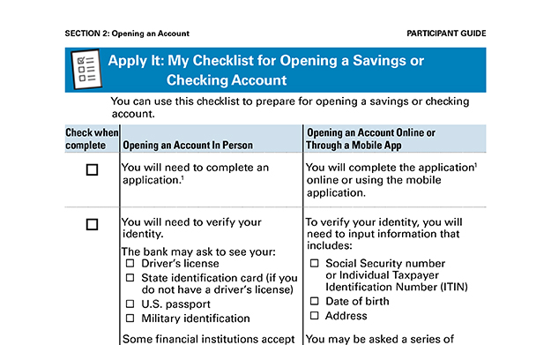
Apply It: My Checklist for Opening a Savings or Checking Account See page 15 in your Participant Guide

Slide 25
Apply In Person or Online
Complete an application
Verify you are who you say you are
Decide whether to “opt-in”
Make first deposit
Receive disclosures, possibly sign documents
Activate account tools
Ask questions

Slide 26
Banking History Reports
Everyone is not approved for an account
Banking history reports include information on:
Unpaid negative balances on accounts
Suspected fraud related to accounts
Certain accounts closed by financial institution
Right to one free banking history report from each nationwide consumer reporting company every 12 months

Slide 27
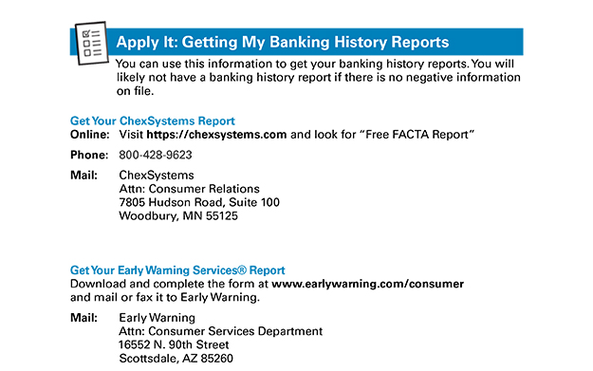
Apply It: Getting My Banking History Reports See page 17 in your Participant Guide

Slide 28
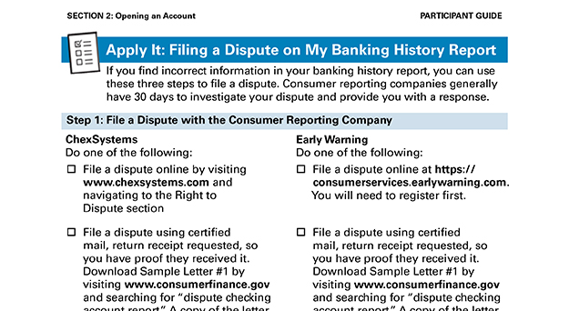
Apply It: Filing a Dispute on My Banking History Report See page 18 in your Participant Guide

Slide 29
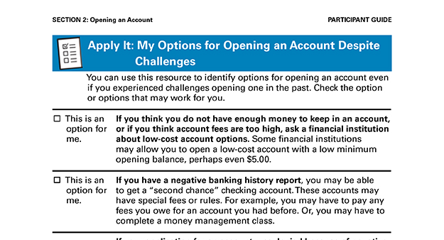
Apply It: My Options for Opening an Account Despite Challenges See page 21 in your Participant Guide

Slide 30
Possible Options
For This Challenge | Consider…
Not enough money or account fees too high | Low-cost account options
Negative information in banking history report | “Second chance” checking account
Negative information in credit reports and low credit scores | Credit-building loan, secured credit card, credit counseling
No Social Security number | Other identification documents
Cannot open a particular account | Another type of account; Perhaps a prepaid card

Slide 31
Section 2: Remember the Key Takeaway
Know the general process for opening a savings or checking account, including options if you are initially unable to open an account.

Slide 32

Section 3: Managing an Account
Section 3
Managing an Account
See page 23 in your Participant Guide

Slide 33
Section 3: Key Takeaway
Learn the rules of your account and keep track of how you use it. This can help you keep costs down and develop a positive banking relationship.

Slide 34
Using a Savings Account
Build savings by depositing money and keeping it there to earn interest
Designed to save money for the future
Often offer higher interest rates than checking accounts that earn interest
Not designed for high numbers of transactions

Slide 35
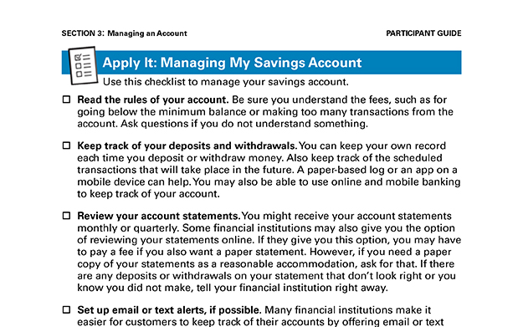
Apply It: Managing My Savings Account See page 24 in your Participant Guide

Slide 36
Managing My Savings Account
Read the rules of your account
Keep track of your deposits and withdrawals
Review your account statements
Set up email or text alerts, if possible
Stay safe online

Slide 37
Using a Checking Account
For frequent use and multiple transactions -- deposit money, pay bills, make purchases, access cash
ATM cards and debit cards
Not the same thing
Money is taken out of your account
Checks
Tell your financial institution to pay money to someone else, the payee
Some checking accounts don’t use checks

Slide 38
Overdrafts
Transaction goes through but there’s not enough money in the account to cover it
Programs to cover overdrafts for ATM card and debit card transactions
Opt-in: Certain transactions processed for a fee
Do not opt-in: Certain transactions declined
Financial institutions decide if they will cover checks and other payments that would cause an overdraft if processed
Covered: expect to be charged an overdraft fee
Not covered: expect to be charged a non-sufficient funds fee and possibly a returned check fee

Slide 39
Rodney: Overdraft Example
$50 in checking account with “opt-in”
March 1 transactions:
$15 birthday cake
$25 gas
$45 phone bill on auto-pay
Result: One or two overdraft charges of $35
Depends on order transactions are processed

Slide 40
Direct Deposit
Deposit money safely and securely into your account electronically
No need to make deposits in person
Many employers offer direct deposit for paychecks
Might be able to have part of your paycheck directly deposited into your savings account

Slide 41
Automatic Bill Payment / Automatic Debit
Automatic Bill Payment
Schedule and send payments through your financial institution
One-time or recurring payments
Automatic Debit
Give permission to merchant or lender to take payments from your account
Make sure you have enough money in your account to cover these payments

Slide 42
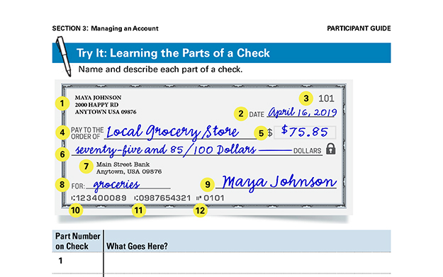
Try It: Learning the Parts of a Check See page 27 in your Participant Guide

Slide 43
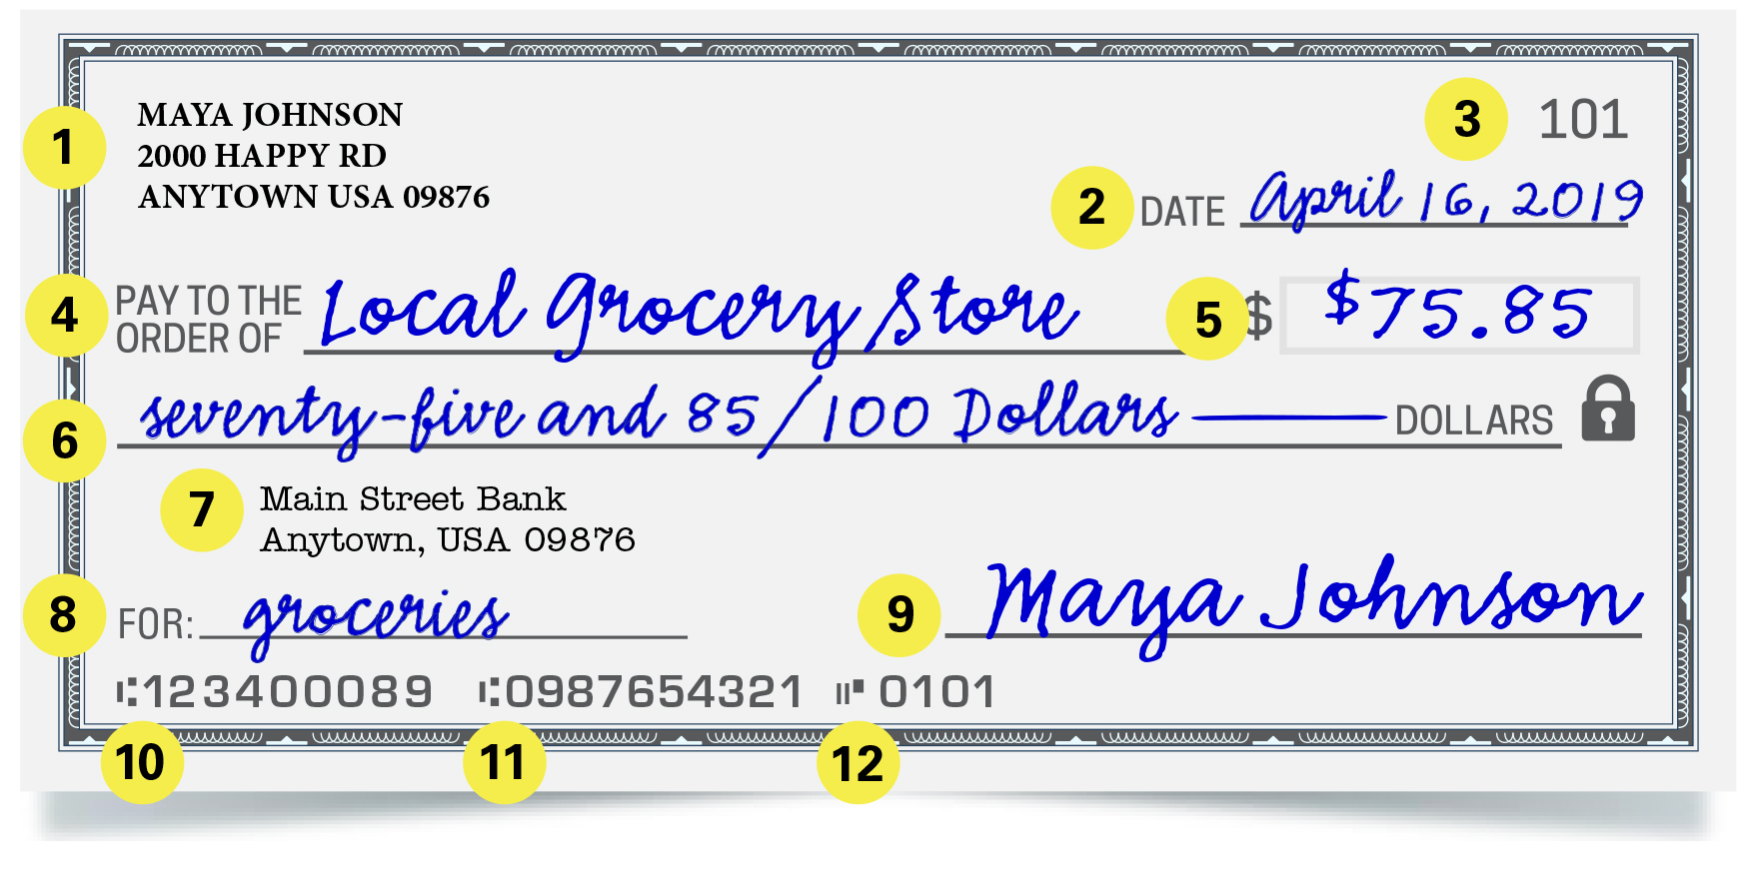
Example Check

Slide 44
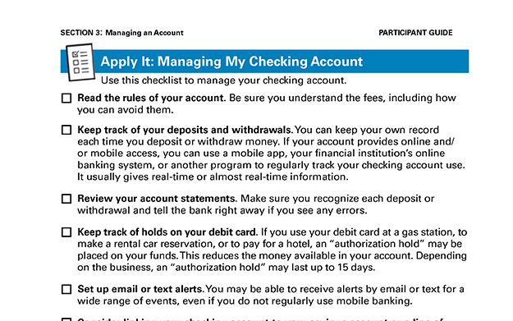
Apply It: Managing My Checking Account See page 28 in your Participant Guide

Slide 45
Managing a Checking Account
Read the rules of your account
Keep track of your deposits and withdrawals
You can use:
A mobile app
Your financial institution’s online banking system
Another program
A transaction register

Slide 46
More Ways to Manage a Checking Account
Review your account statements
Keep track of holds on your debit card
Set up email or text alerts
Consider linking your checking account to your savings account or line of credit
Protect your debit card
Stay safe online

Slide 47
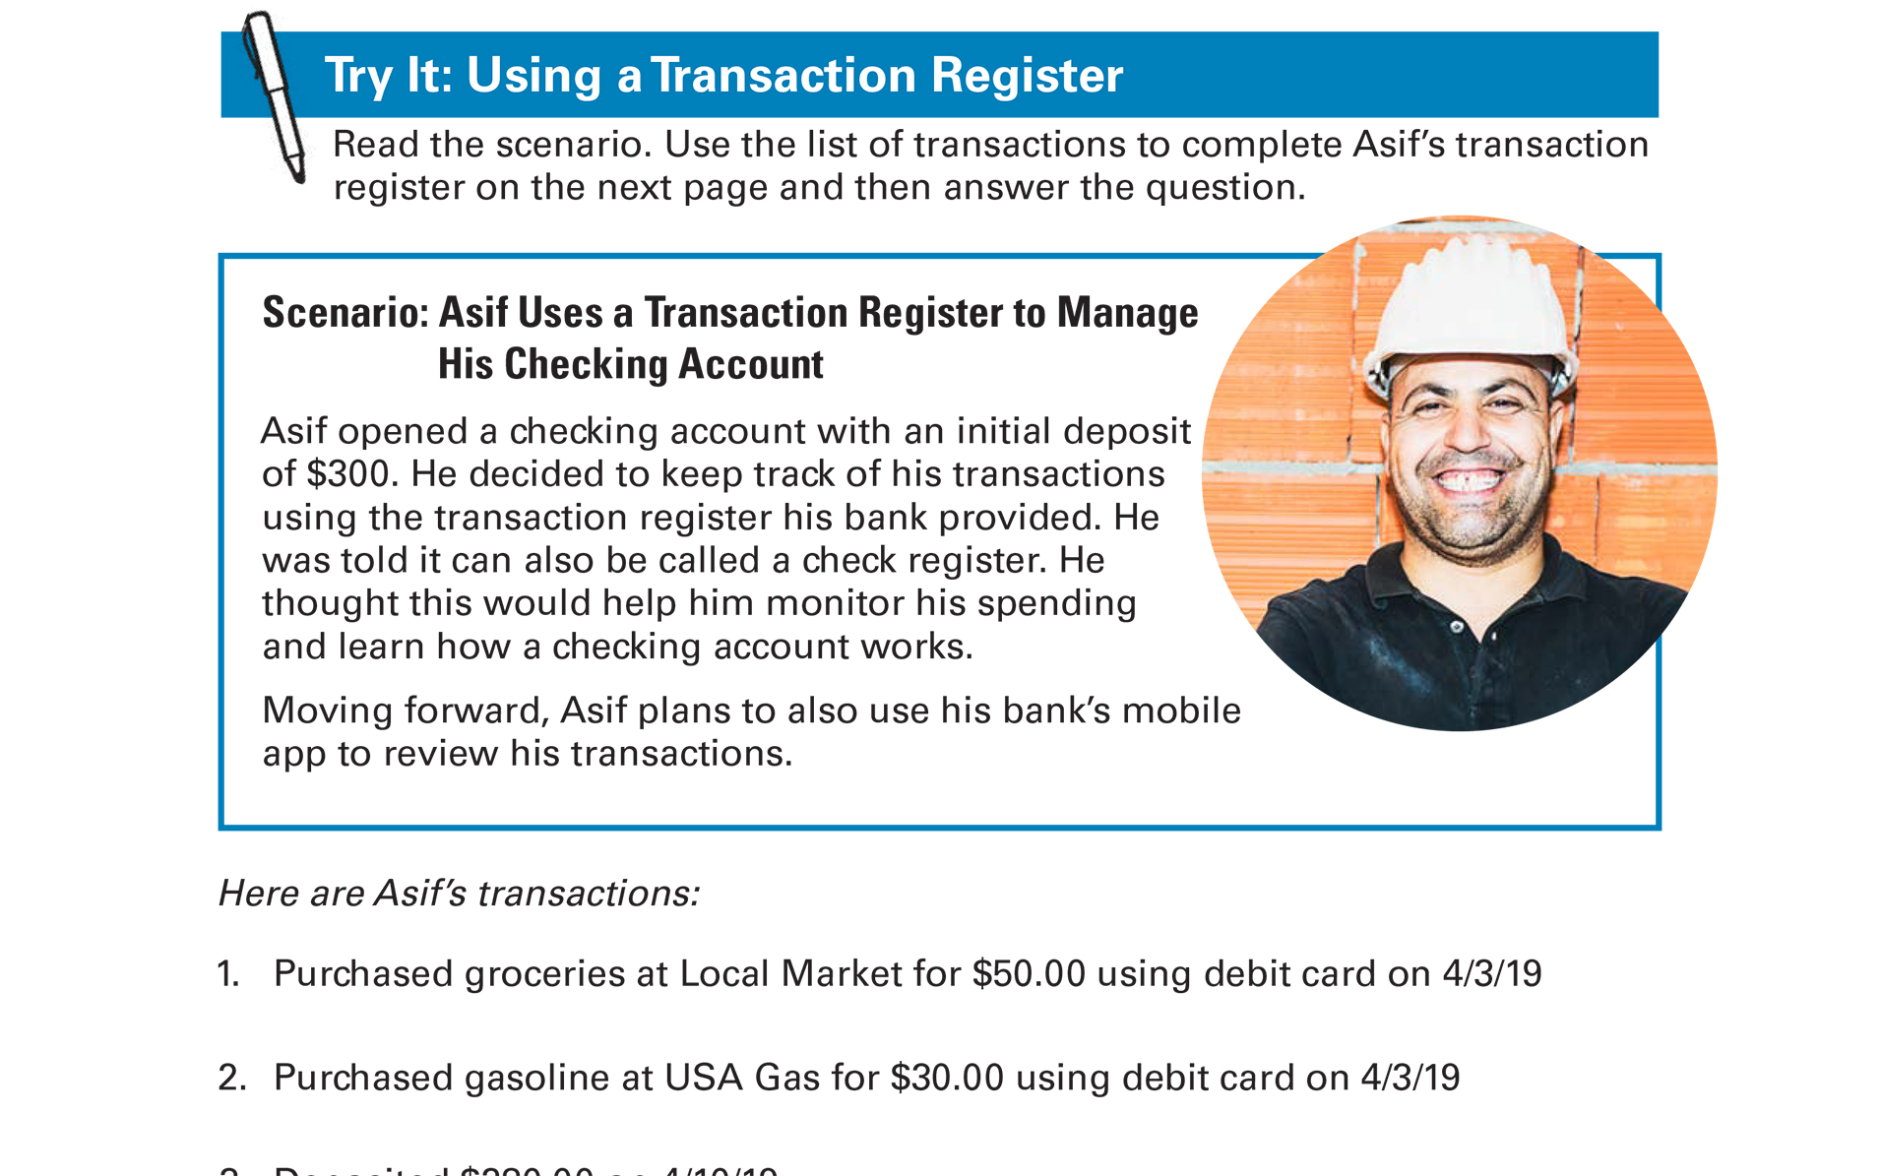
Try It: Using a Transaction Register See page 29 in your Participant Guide

Slide 48
Try It: Using a Transaction Register--Answer Key
Check Number | Date | Transaction | Withdrawal |  | ✓ | Deposit |  | Balance
 |  |  |  |  |  | $300 | 00 | $300 | 00
 | 4/3/19 | Local Market | 50 | 00 |  |  |  | 250 | 00
 | 4/3/19 | USA Gas | 30 | 00 |  |  |  | 220 | 00
 | 4/10/19 | Deposit |  |  |  | 280 | 00 | 500 | 00
 | 4/13/19 | Auto Lender USA | 150 | 00 |  |  |  | 350 | 00
 | 4/25/19 | Deposit |  |  |  | 300 | 00 | 650 | 00
 | 4/28/19 | ATM | 50 | 00 |  |  |  | 600 | 00
 | 4/28/19 | ATM Fee | 4 | 00 |  |  |  | 596 | 00
715 | 5/1/19 | Happy Properties | 500 | 00 |  |  |  | 96 | 00

Slide 49
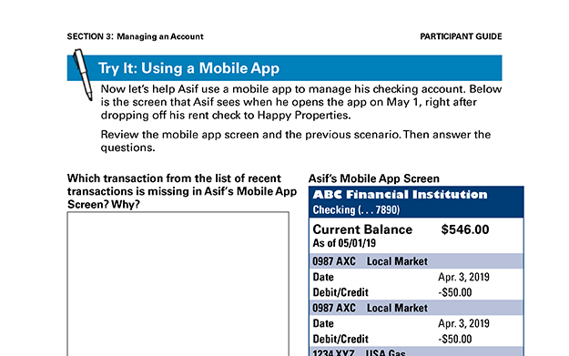
Try It: Using a Mobile App See page 31 in your Participant Guide

Slide 50
Automated Teller Machine (ATM) Cards
Use an ATM for a variety of account transactions
Ask your financial institution about purchases with an ATM card
Money comes out of your financial institution account
There are various accessibility features
Keep safety in mind

Slide 51
Debit Cards
Do what ATM cards do, plus more
Look like credit cards because they have a card network logo on them
But they are not credit cards
Can be processed on credit network, but still not using credit
Money is taken out of your checking account

Slide 52
“Person to Person” Payments (P2P)
Money transfers to another person
Help with everyday money transactions, such as paying babysitter or reimbursing lunch
Different P2P systems – each work differently
Rapidly changing area
Keep in mind federal deposit insurance, fees, privacy, funds availability, and more

Slide 53
Mobile Wallet Apps
Make point-of-sale purchases with your mobile device instead of a debit, credit, or prepaid card
Keep your device and information secure
Visit OnGuardOnline.gov

Slide 54
Section 3: Remember the Key Takeaway
Learn the rules of your account and keep track of how you use it. This can help you keep costs down and develop a positive banking relationship.

Slide 55

Section 4: Prepaid Cards
Section 4
Prepaid Cards
See page 34 in your Participant Guide

Slide 56
Section 4: Key Takeaway
Prepaid cards allow you to spend or access money loaded onto them. They usually aren't linked to a checking or savings account. Before you use one, review its features and fees.

Slide 57
How Prepaid Cards Work
Not linked to a checking or savings account
Access money loaded onto the card
Load money in person, by phone, online, or through a mobile app
Use direct deposit (some cards)
Register card to use all its features
Not the same as activating the card

Slide 58
Kinds of Prepaid Cards
Reloadable prepaid cards
Payroll cards
Electronic benefit transfer (EBT) cards
College or university identification cards
Prepaid cards for specific stores or public transportation systems

Slide 59
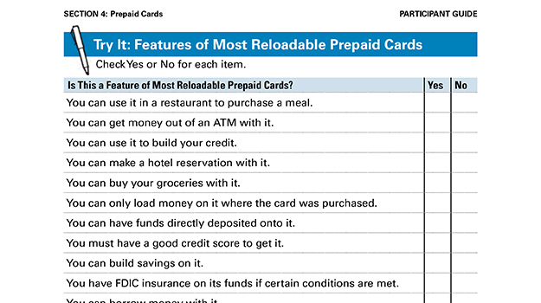
Try It: Features of Most Reloadable Prepaid Cards See page 35 in your Participant Guide

Slide 60
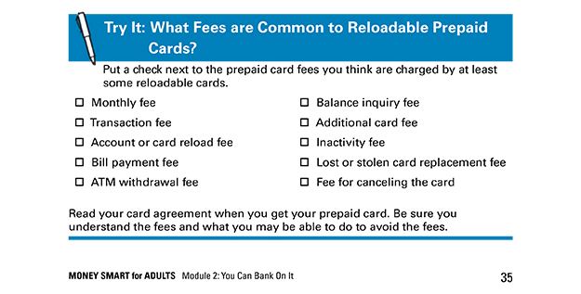
Try It: What Fees are Common to Reloadable Prepaid Cards? See page 35 in your Participant Guide

Slide 61
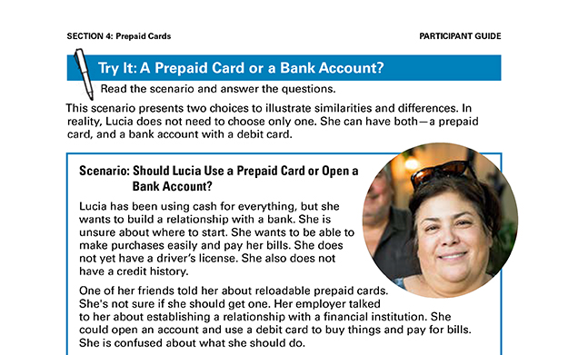
Try It: A Prepaid Card or a Bank Account? See page 36 in your Participant Guide

Slide 62
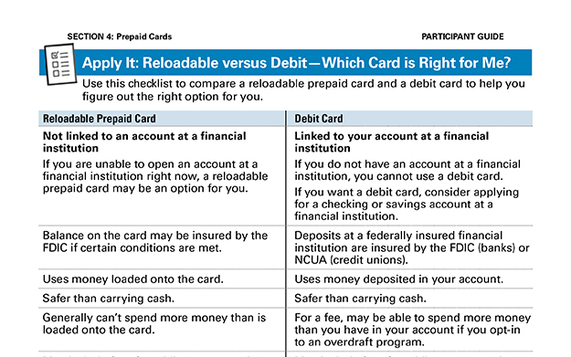
Apply It: Reloadable versus Debit—Which Card is Right for Me? See page 37 in your Participant Guide

Slide 63
Lost or Stolen Prepaid Cards
Report loss, theft or charge you did not make right away to the card issuer
Protections depend on type of card
Generally must register card to get protections offered by card issuer

Slide 64

Tips for Using Prepaid Cards
Review your account and dispute charges you did not authorize
Understand your card’s limits
Know the fees and how to avoid them
Report loss or theft immediately
Stay safe online

Slide 65
Section 4: Remember the Key Takeaway
Prepaid cards allow you to spend or access money loaded onto them. They usually aren't linked to a checking or savings account. Before you use one, review its features and fees.

Slide 66
Take Action See page 39 in your Participant Guide
What will I do?
How will I do it?
Will I share my plans with anyone? If so, who?
Visit fdic.gov/education to learn more

Slide 67

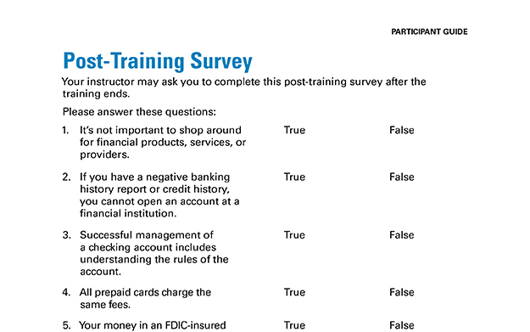
Post-Training Survey See page 43 in your Participant Guide

