Slide 1


Module 1: Your Money Values and Influences
Module 1
Your Money Values and Influences
September 2018

Slide 2
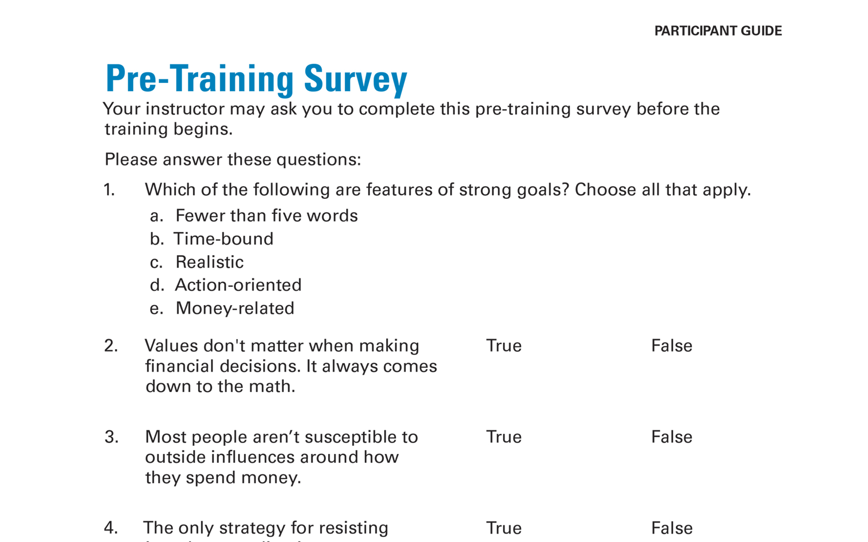
Pre-Training Survey See page 19 in your Participant Guide

Slide 3

Section 1: Values and Money
Section 1
Values and Money
See page 3 in your Participant Guide

Slide 4
Section 1: Key Takeaway
Understanding your values can help you set achievable financial goals.

Slide 5
What Are Values?
People, things, and places that are important to you and guide how you make decisions
Values shape how you prioritize time, energy, and money

Slide 6
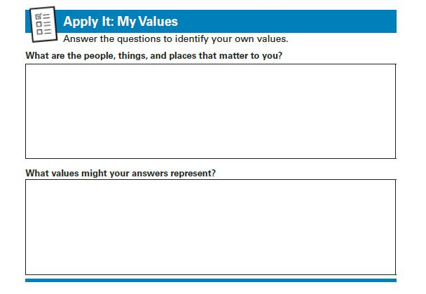
Apply It: My Values See page 3 in your Participant Guide

Slide 7
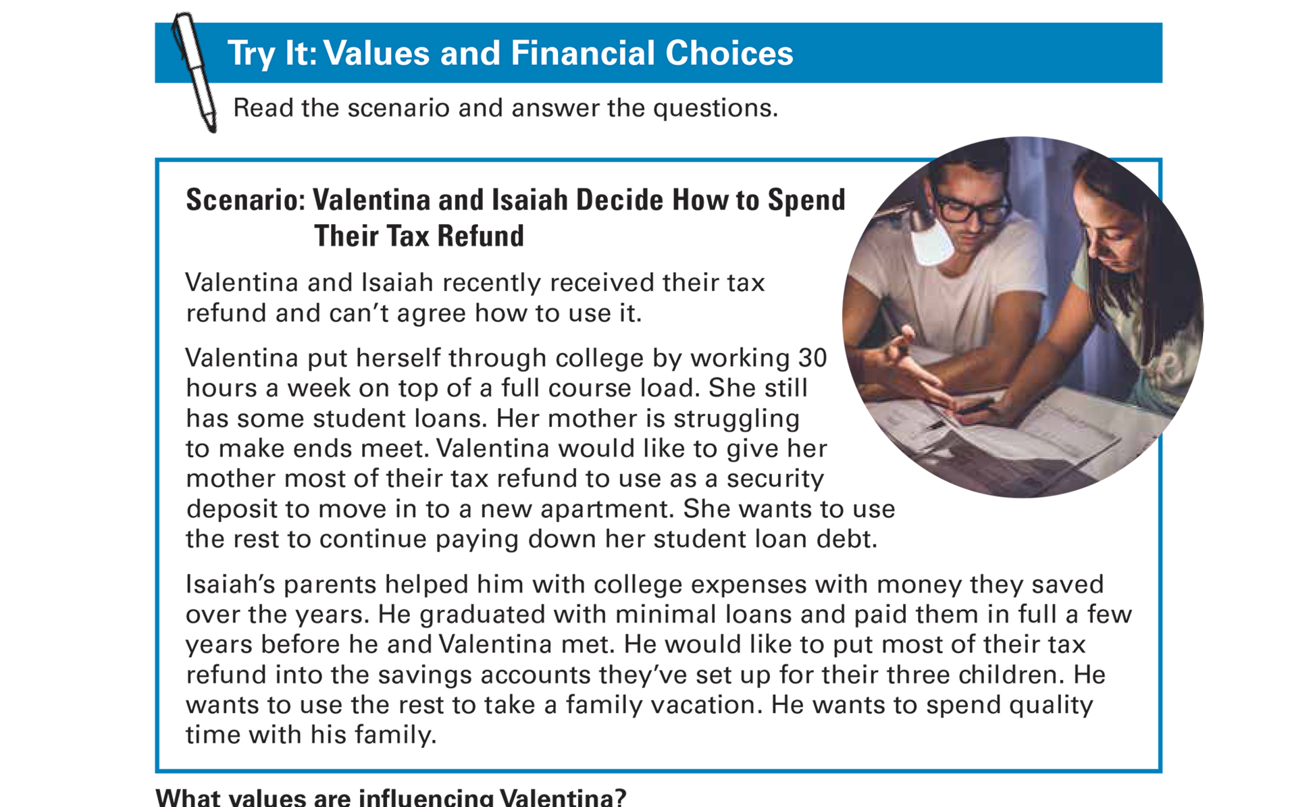
Try It: Values and Financial Choices See page 4 in your Participant Guide

Slide 8
Section 1: Remember the Key Takeaway
Understanding your values can help you set achievable financial goals.

Slide 9

Section 2: Goals and Money
Section 2
Goals and Money
See page 6 in your Participant Guide

Slide 10
Section 2: Key Takeaway
Setting SMART goals helps you achieve your hopes and dreams for the future by providing a realistic plan to follow.

Slide 11
What are Goals?
What kind of future do you want?
These are your hopes and dreams
Goals are your desired results
Set goals:
To prioritize how you use money
To measure and track progress

Slide 12
Setting SMART Goals
Goals should be:
Specific
Measurable
Action-oriented
Reachable
Time-bound

Slide 13
SMART Goals
To ensure your goals are… | Ask yourself…
Specific | What exactly do I want to accomplish? Why is this important to me? Is this something I really want?
Measurable | How much? How many? How will I know when I’ve met my goal?
Action-oriented | What specific actions do I need to complete in order to meet this goal?
Reachable | Is this goal something I can actually reach?
Time-bound | When will I reach this goal?

Slide 14

Try It: Writing a SMART Goal See page 7 in your Participant Guide

Slide 15
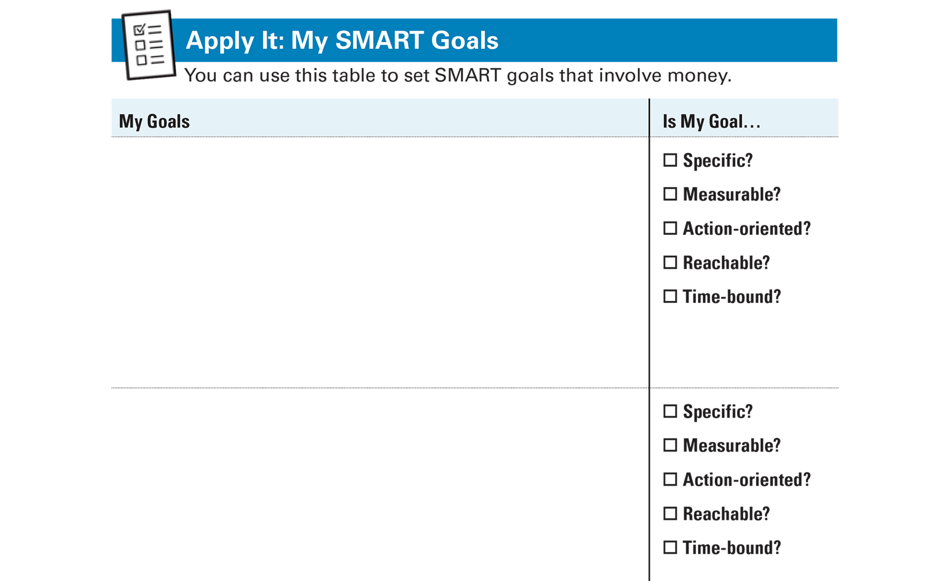
Apply It: My SMART Goals See page 9 in your Participant Guide

Slide 16
Section 2: Remember the Key Takeaway
Setting SMART goals helps you achieve your hopes and dreams for the future by providing a realistic plan to follow.

Slide 17

Section 3: External Influences
Section 3
External Influences
See page 10 in your Participant Guide

Slide 18
Section 3: Key Takeaway
External influences impact financial choices. Use strategies to stay focused on your goals.

Slide 19

Influences on Choices about Money
Advertisements
Media
Celebrities
Peers/friends

Slide 20

Influences Can Be…
Productive
Helping you achieve your goals
Unproductive
Getting in your way

Slide 21
External Influences: Small Groups
Advertisements
Media
Celebrities
Peers/friends

Slide 22

Social Pressure and Advertising
It’s human nature to want what others have
Advertisers spend money to influence how we spend our money
Impulse purchases can make it harder to achieve goals

Slide 23




Strategies for Staying Focused on Your Goals
Recognize tactics used by advertisers
Notice when and where you’re tempted
Control your environment
Build in a pause

Slide 24

More Strategies for Staying Focused on Your Goals
Talk yourself out of it
Calculate hours or days an item is worth
Think about your hourly wage
Divide cost of item by hourly wage
Quantify purchase in terms of a very valuable thing → your time
$
cost of item
÷
$
hourly
wage
=
Hours you have to work to pay for item

Slide 25
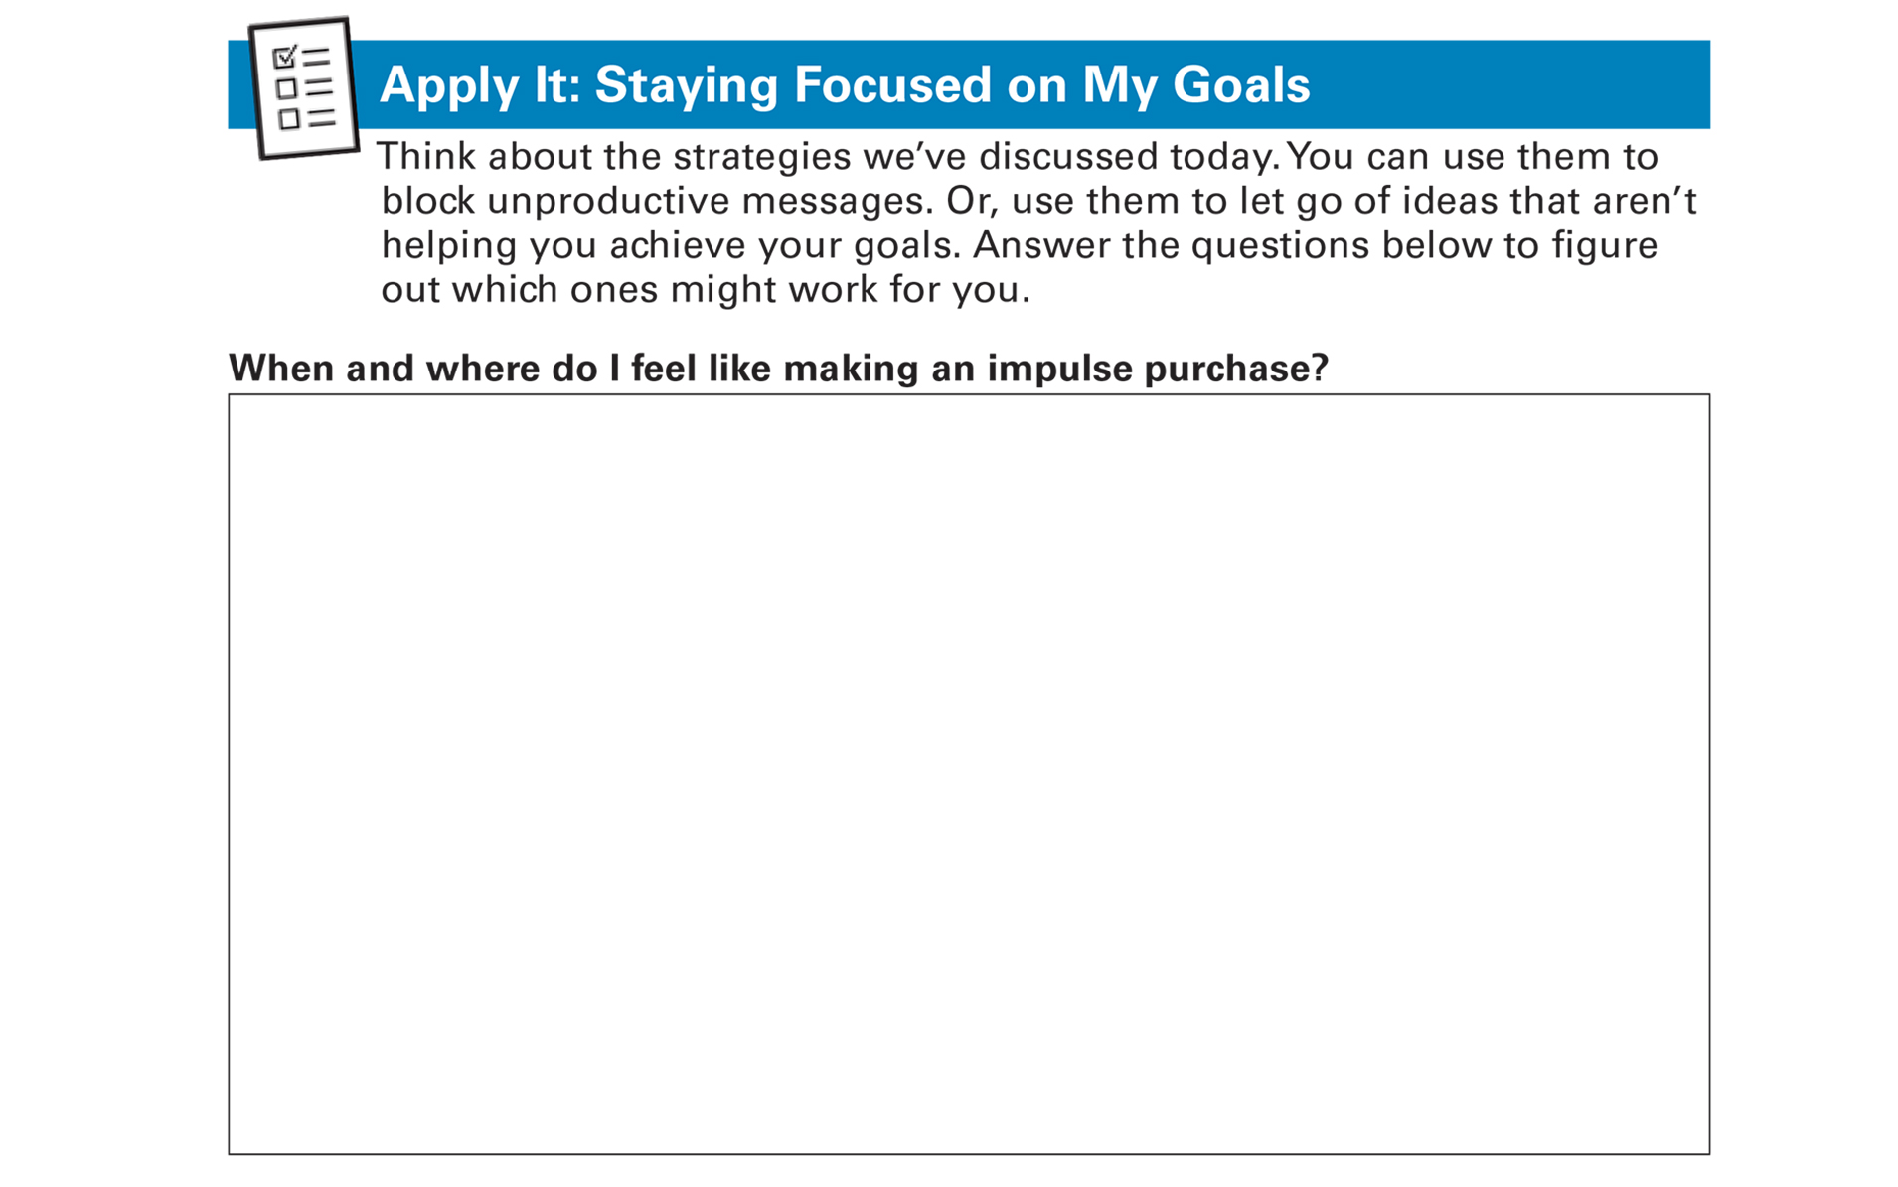
Apply It: Staying Focused on My Goals See page 14 in your Participant Guide

Slide 26
Section 3: Remember the Key Takeaway
External influences impact financial choices. Use strategies to stay focused on your goals.

Slide 27
Take Action See page 16 in your Participant Guide
What will I do?
How will I do it?
Will I share my plans with anyone? If so, who?
Visit fdic.gov/education to learn more

Slide 28

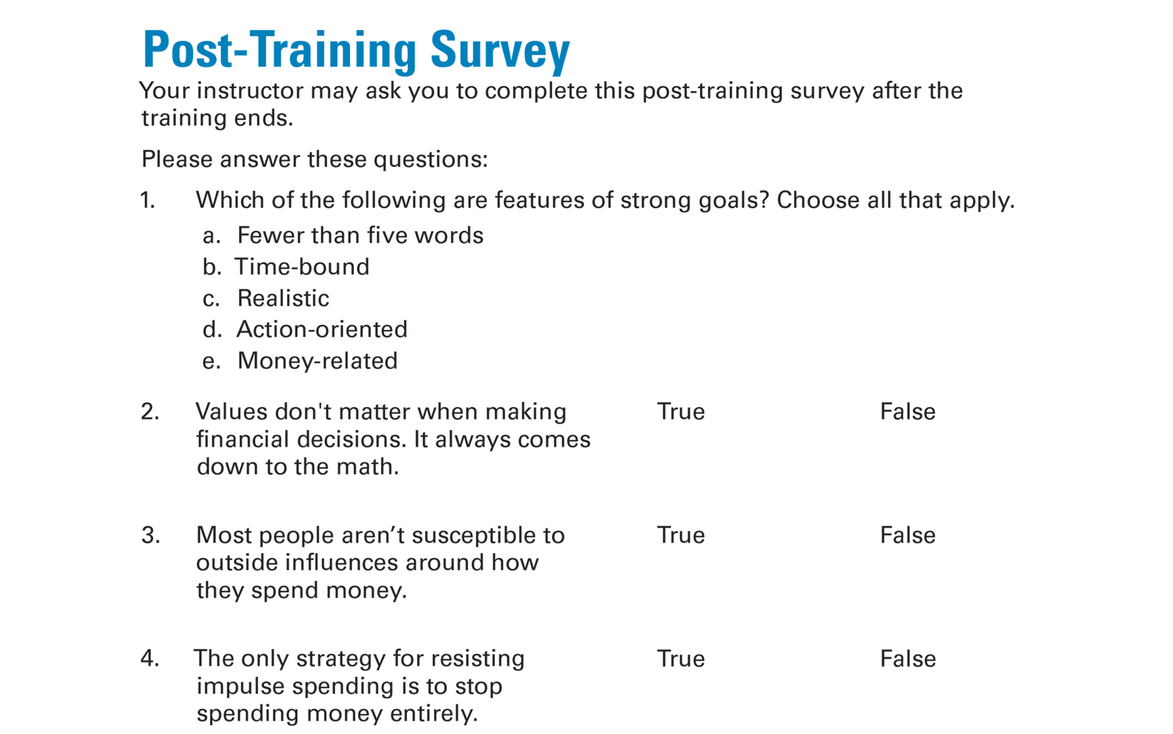
Post-Training Survey See page 21 in your Participant Guide

