Slide 1



Time
Management
FOR A SMALL BUSINESS
Updated: 09-2016

Slide 2

Welcome
Agenda
Ground Rules
Introductions

Slide 3
Objectives
After completing this training, you will be able to:
Explain the concept of time management and why it is important to small businesses
Explain some commonly employed time management practices, including:
  Pareto analysis
  ABC method Eisenhower method
  POSEC method

Slide 4

What Do You Know?
What do you know or want to learn about time management?

Slide 5
Time Management:
Systematically prioritizing tasks and competing demands to complete the most important tasks within a certain amount of time
Goal is to reduce distractions so that more tasks and demands are completed

Slide 6
Importance of Time Management for a Small Business
Poor time management can cost you money
Maximize the number of hours in your workday
Work smarter not harder within the time constraints of a workday

Slide 7

Benefits of Time Management for a Small Business
More business equals more
More focused
More organized
Less stress
More time for family and friends
income

Slide 8

Discussion Point #1: Benefits of Time Management
Describe how you could benefit from using time management.

Slide 9
Time Management Plan
A written guide of prioritized tasks to complete on a daily, weekly, and monthly basis that will achieve your written goals

Slide 10
Sample Time Management Plan
GOAL
I will generate a minimum of $6,000 in sales every month, starting the month after next (March).

Slide 11
Time Management Plan Key Elements
Clearly defined written goals
Detailed list of tasks
Prioritization of the tasks
List of important ongoing business functions
Built in flexibility

Slide 12
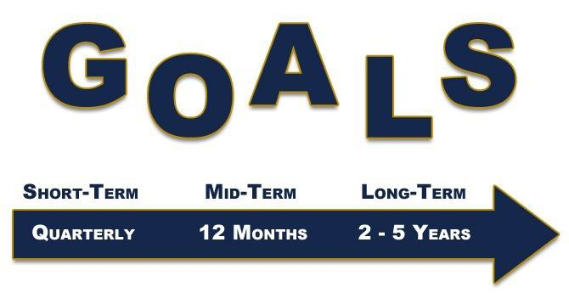
Key Element 1:
Clearly Defined Written Goals

Slide 13
For each task
Key Element 2:
Detailed List of Tasks:
What needs to be done?
Who needs to do it?
When is it due?
Where is it being done or being delivered?
Any other details

Slide 14
Key Element 3:
Prioritization of the Tasks
Assign a priority level to every task under each step
Rearrange the tasks in order of priority
Allocate ample time to complete the most critical tasks first

Slide 15
Include in your task list time to:
Key Element 4: List Important Ongoing Business Functions
Pay bills
Invoice clients
Review correspondence
Make bank deposits

Slide 16
When assigning an estimated amount of time to complete each task, be sure to:
Key Element 5:
Built-in Flexibility
Allow for time to address opportunities and issues as they arise
Allow extra time for critical tasks, if needed
Allow time for interruptions
Allow time for breaks

Slide 17
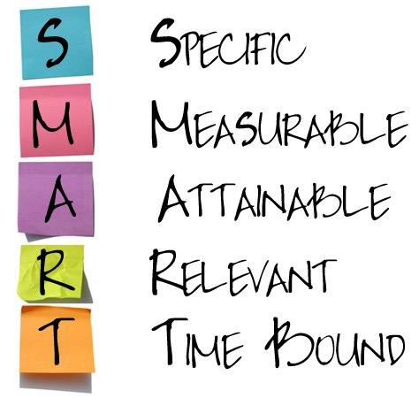
SMART Goals

Slide 18
Discussion Point #2: SMART Goals
Write one of your business goals using the SMART format.

Slide 19
Using SMART Goals
Write the steps and tasks to identify:
Who
What
When
Where
Why

Slide 20
Discussion Point #3: Tasks Developed with SMART Goals
Look at the SMART goal you wrote for your business. Write the steps and tasks needed to achieve your goal.

Slide 21

Pareto Analysis
20% of tasks or a person’s efforts will produce 80% of the result
Tasks that generate the greatest return should be completed first
Prioritizing tasks is critically important because small business owners usually juggle many priorities

Slide 22
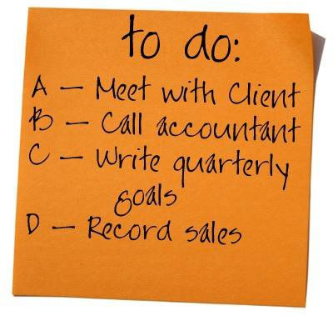
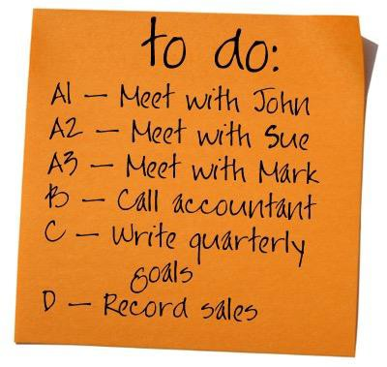
ABC Method
Give most important tasks the letter A
Less important tasks the letter B
Least important tasks the letter C

Slide 23

Eisenhower Method

Slide 24
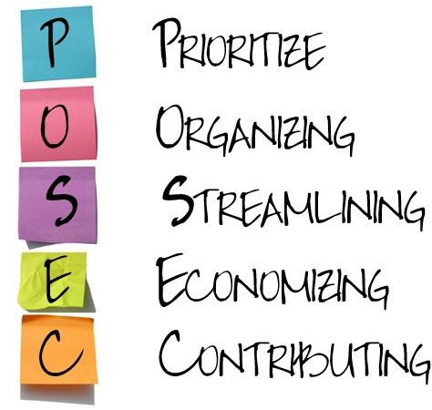
POSEC Method

Slide 25
Managing Your Time
For the next work week:
Prioritize the list of tasks
Allocate ample time to complete each task
Don’t forget those important ongoing business functions
Select a tool for planning your daily and weekly time

Slide 26
Tips for prioritizing your tasks
A Closer Look at Allocating Time in Your Time Management Plan
Know the number of hours in your work day
Allocate only 75 percent of the available work hours

Slide 27
Working Your Plan
Tips for prioritizing your tasks
Use timers or alarms to stay on task
Work high priority tasks FIRST
Take time to manage your business
Take breaks
Set aside time to prioritize for next week

Slide 28
Assigning Tasks and Delegating Roles and Responsibilities
Who else can do one or some of the tasks in this week’s plan?
Am I the only person who can do this?

Slide 29
Discussion Point #4: Task Delegation
To whom can you delegate tasks?

Slide 30
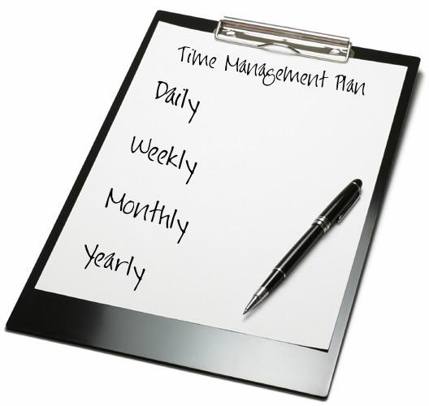
Reviewing and Updating Your Time Management Plan

Slide 31
Common Distractions, Obstacles, and Solutions
People
  In person
  By telephone
  Meetings
E-mail
Work environment
Self-initiated distractions

Slide 32
Top Four Key Points to Remember
The five key elements of a good time management plan
Use written SMART goals with steps and tasks to create clarity of focus
The four ways to prioritize goals for writing your time management plan
Update time management plans daily and weekly

Slide 33

Summary
What final questions do you have?
What have you learned?
How would you evaluate the training?

Slide 34
Conclusion
You have learned about:
The concept of time management and why it is important to small businesses
Some commonly employed time management practices, including: Pareto analysis, ABC method, Eisenhower method, and POSEC method

