Slide 1


Disasters–Financial Preparation and Recovery
Module 14
September 2018

Slide 2
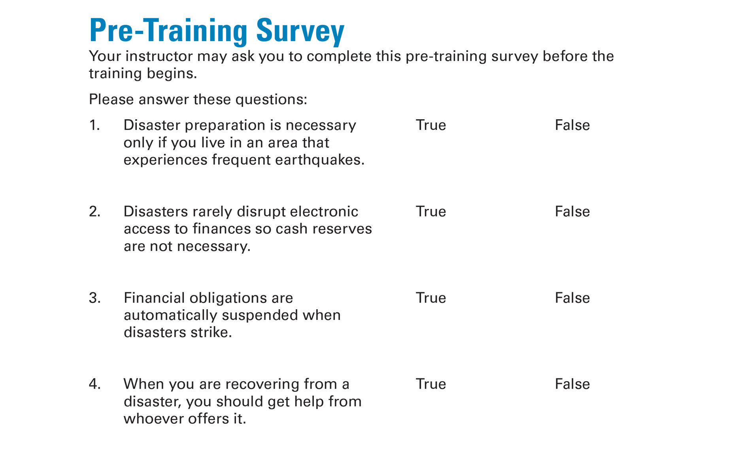
Pre-Training Survey See page 19 in your Participant Guide

Slide 3

Section 1 – Preparing Financially for Disasters
Section 1
Preparing Financially for Disasters
See page 3 in your Participant Guide

Slide 4
Section 1: Key Takeaway
Save time, money, and stress when a disaster strikes by making financial preparations.

Slide 5

How Disasters Can Affect Finances
Costs of meeting immediate needs
Costs of repairing and replacing items
Ongoing costs of items you need
Identity theft
Scams
Access to financial resources
Penalties of missing payments

Slide 6
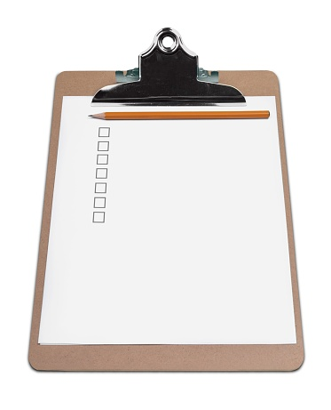
Prepare in Advance for Disasters
Visit Ready.gov for general preparations
Be better prepared financially:
Get the insurance you need
Set money aside in an emergency savings fund
Keep some cash in a safe place
Sign up for direct deposit
Consider online or mobile banking
Keep financial documents and information in a safe place

Slide 7

Get the Insurance You Need
Insurance is a critical support after disasters -- get it before you need it
Shop around for the best deals
Review your policies – know what’s covered and what is not covered
Keep records of your personal property
What types of insurance could help you be better prepared?

Slide 8

Types of Insurance
Automobile
Disability
Life
Renter’s
Homeowners

Slide 9
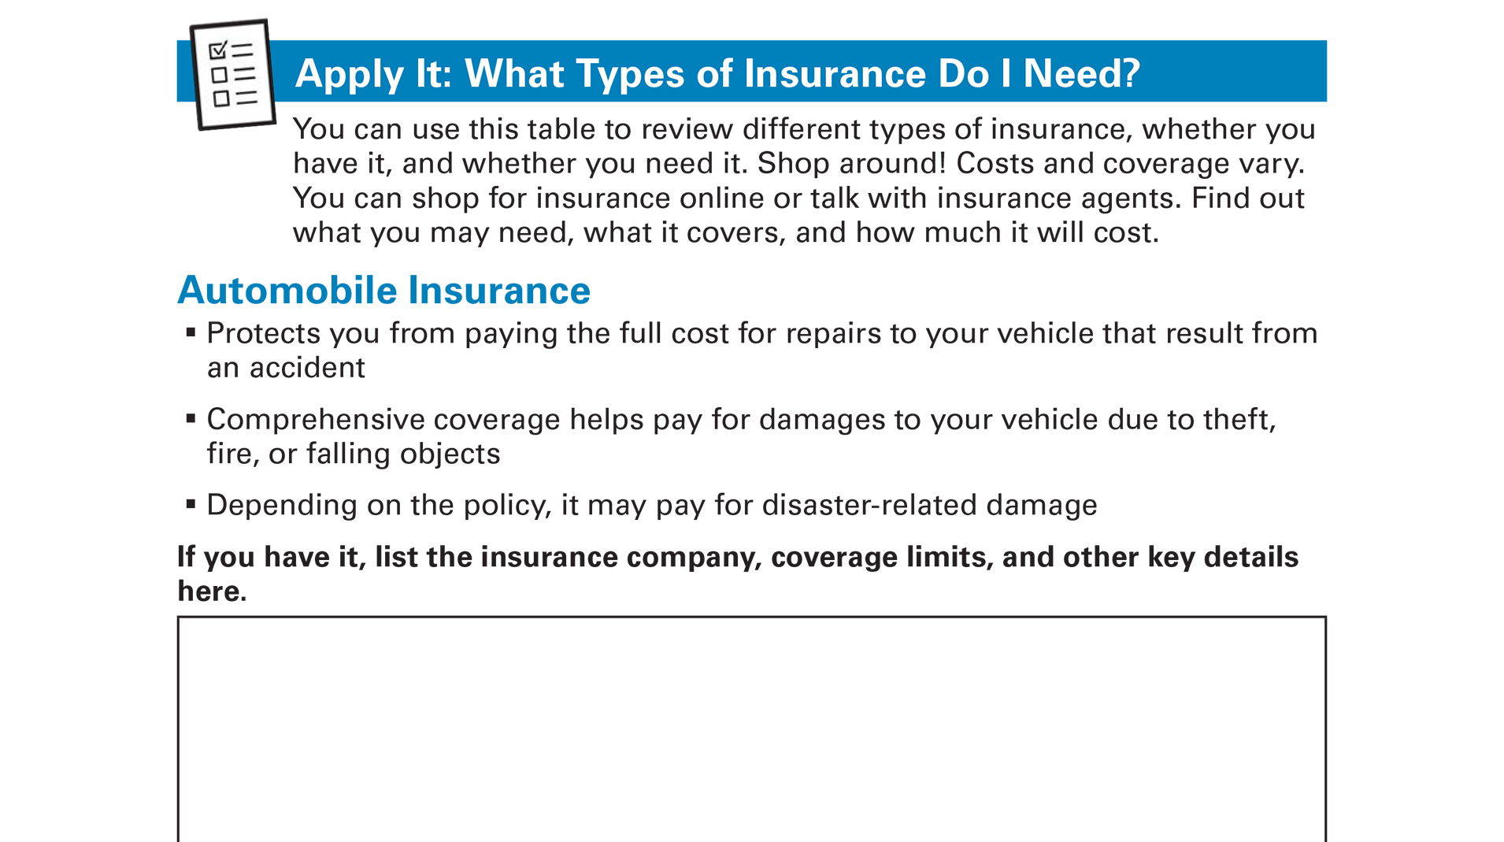
Apply It: What Types of Insurance Do I Need? See page 5 in your Participant Guide

Slide 10
Set Money Aside in an Emergency Savings Fund
Why have an emergency savings fund?
?

Slide 11

Building an Emergency Savings Fund
Set a realistic goal
It takes time and commitment
It’s a cycle
It’s still worth doing
It’s an important step to improve financial health and stability

Slide 12
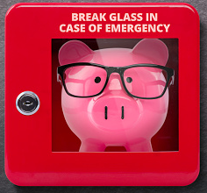
Keep Some Cash in a Safe Place
Cash may be the only option right after a disaster
Keep some cash in a safe place where you can access it quickly
May want to keep it in a larger emergency kit (Go bag, Bug Out Bag, BOB)
Do not keep more cash than necessary

Slide 13
Sign Up for Direct Deposit
With direct deposit, your paycheck, pension, and public benefits go directly into your account at a financial institution
Helps you have access to important income during a disaster
If you don’t already have an account, you may want to consider one

Slide 14
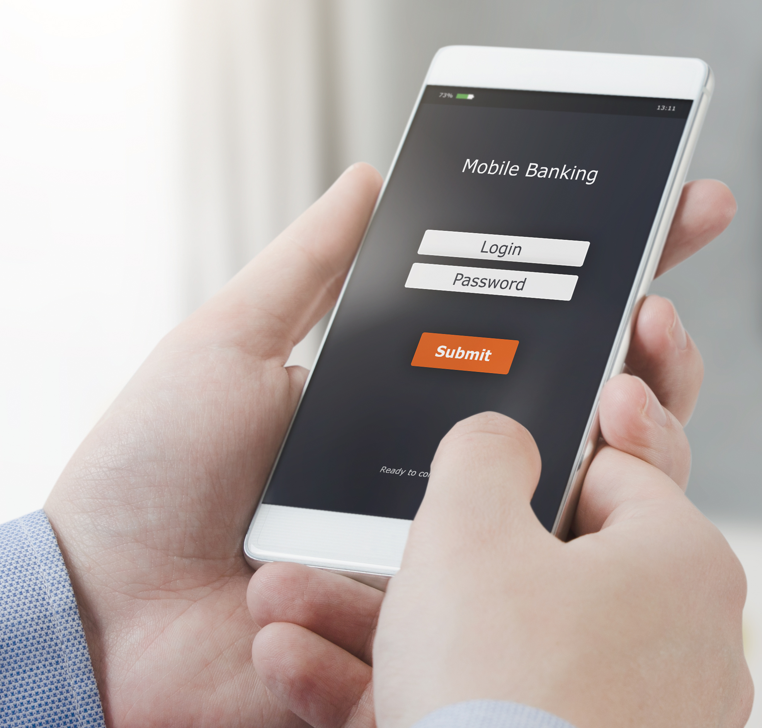
Consider Arranging for Online or Mobile Banking
Your financial institution may be temporarily unavailable
Online and mobile banking
Pay bills
Deposit checks
Conduct other transactions through an online browser or phone app
Communicate with your financial institution

Slide 15
Keep Financial Documents and Information in a Safe Place
Hardcopy records
At home, waterproof bag in fire resistant box or safe
In your GO bag, Bug Out Bag, or BOB
In a safe deposit box at a financial institution
Scan and email securely to yourself
Electronic records
Password-protected format
Secure offsite data storage service
Keep records updated!

Slide 16
Emergency Financial First Aid Kit (EFFAK)
The Federal Emergency Management Agency (FEMA) recommends everyone should have an EFFAK
FEMA.gov includes checklists and forms to help you prepare an EFFAK
Visit FEMA.gov and search for “EFFAK”

Slide 17
Section 1: Remember the Key Takeaway
Save time, money, and stress when a disaster strikes by making financial preparations.

Slide 18

Section 2: Recovering Financially from Disasters
Section 2
Recovering Financially from Disasters
See page 10 in your Participant Guide

Slide 19
Section 2: Key Takeaway
Develop an initial plan to recover financially from a disaster. Watch out for scams.

Slide 20
Steps to Financial Recovery: Small Groups
Property (Other than a home)
Home
Income/Job
Bills/Expenses
Protecting Your Money

Slide 21
Property (Other than a home)
Assess and document the damage
Contact your insurance providers
Find a safe place to store cash and valuables
Arrange for alternative transportation
Repair, replace or borrow assistive technology you use that was damaged

Slide 22
Home
Continue making housing payments or contact lender or landlord
Assess and document damage
Contact your insurance providers
Contact your landlord about damage if you rent
Get help from a HUD-certified housing counseling agency

Slide 23
Income/Job
Contact your employer
Contact your benefits providers
Keep track of work days lost
Care for your service animal and repair assistive technology
Contact your disability insurance provider
Explore public benefits
Contact your life insurance providers
Contact schools and financial aid offices

Slide 24
Bills/Expenses
Continue paying your bills
Contact the post office
Contact your financial institutions
Contact your creditors
Keep records of what you spend
Access assistance programs

Slide 25
Protecting Your Money
Get and review your credit reports
Contact your financial institutions
Contact department of motor vehicles
Find a safe place for financial information, cash, and other valuables
Contact the post office

Slide 26
Be Proactive
First, contact the company directly
Then if needed, contact the regulatory agency
Consider filing a complaint with state regulators or state attorney general’s office

Slide 27
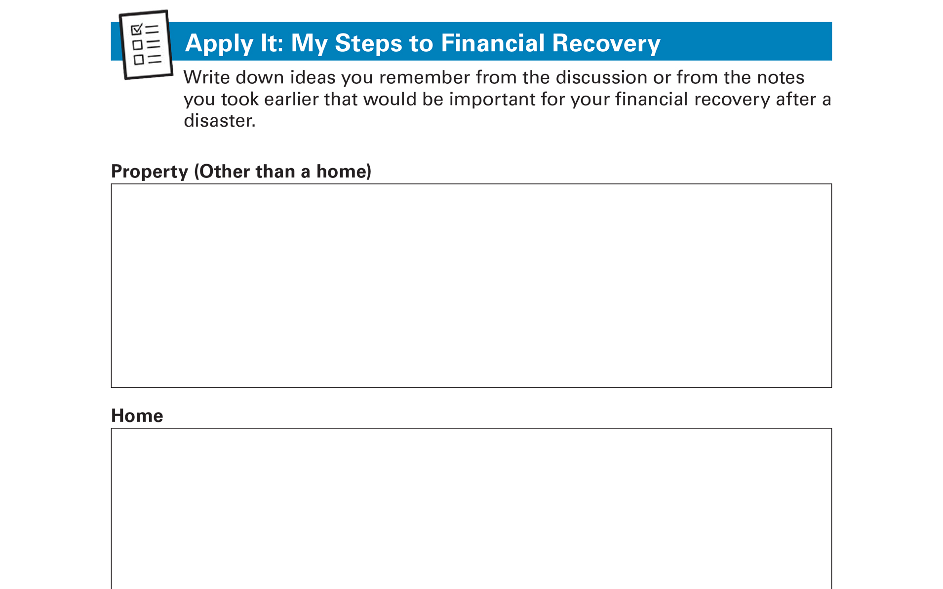
Apply It: My Steps to Financial Recovery See page 12 in your Participant Guide

Slide 28
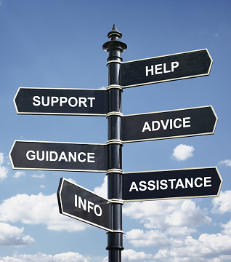
Get Help
DisasterAssistance.gov
Federal Emergency Management Agency (FEMA) Disaster Recovery Centers
Locally-organized disaster relief and recovery meetings

Slide 29
Financial Recovery Resources
Again, start with DisasterAssistance.gov
FEMA’s Individuals and Households Program
Small Business Administration’s low-interest, long-term disaster loans
Department of Agriculture’s disaster loans
Department of Housing and Urban Development’s approved housing counseling agencies
Home Preservation Hotline

Slide 30

Watch Out for Scams
Not everyone who offers help is a legitimate source of help
Be on the lookout for scams
Protect yourself by being cautious
Be selective when you hire or accept help

Slide 31
To Avoid Scams
Get and check references
Ask to see state or local permits
Don’t pay in full upfront
Get and keep receipts
Don’t pay for services that should be free

Slide 32
More Tips to Avoid Scams
Research organizations you are not familiar with
Protect your information
Monitor your credit reports
Read scam alerts and report scams

Slide 33
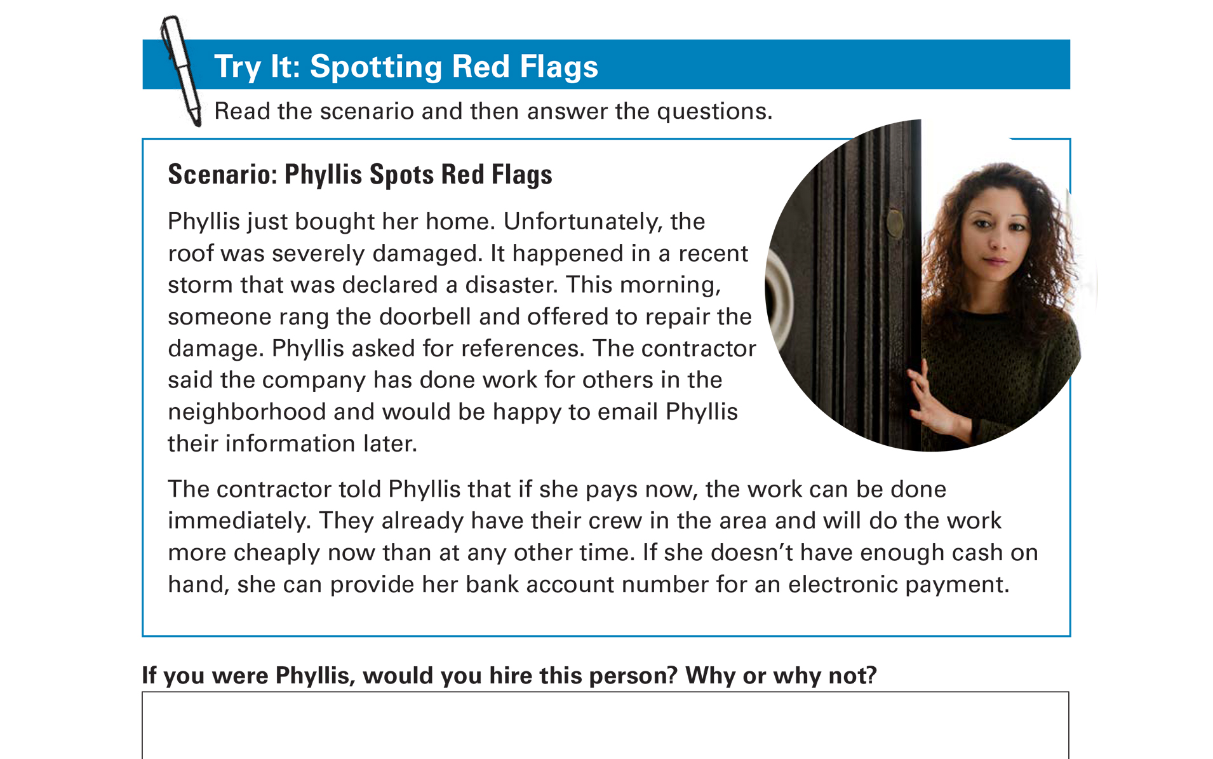
Try It: Spotting Red Flags See page 15 in your Participant Guide

Slide 34
Adjust Your Financial Picture After the Disaster
Take time to grieve and get used to your new reality
Review and adjust spending and saving plan
Contact your lenders
Contact your financial institution
Get and review your credit reports
Set new goals and make plansto reach them

Slide 35
Section 2: Remember the Key Takeaway
Develop an initial plan to recover financially from a disaster. Watch out for scams.

Slide 36
Take Action See page 17 in your Participant Guide
What will I do?
How will I do it?
Will I share my plans with anyone? If so, who?
Visit fdic.gov/education to learn more

Slide 37

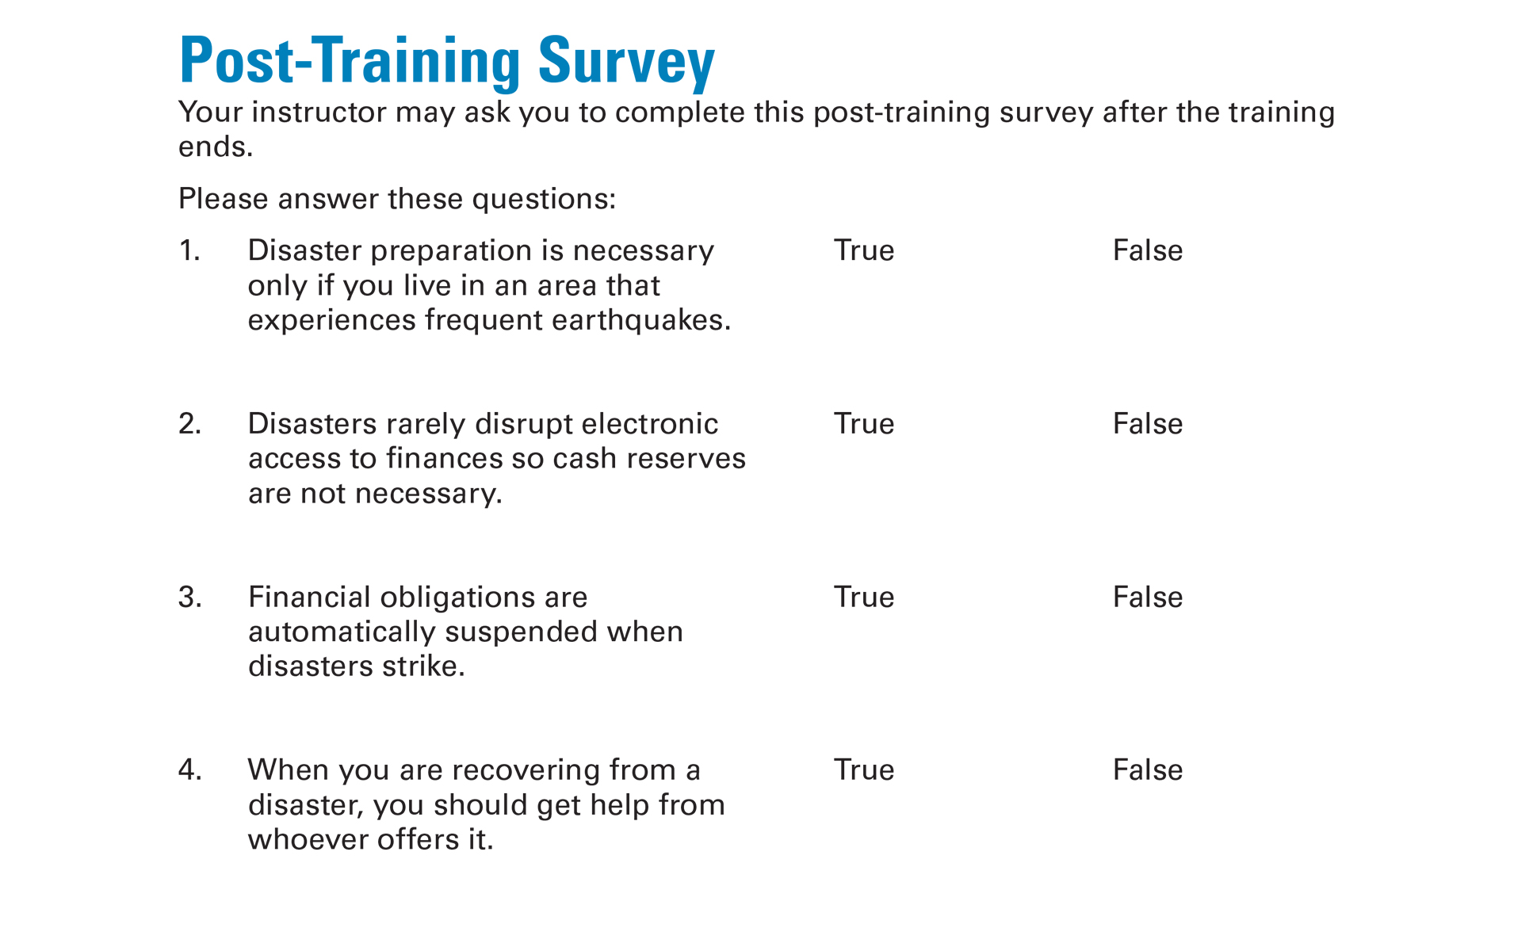
Post-Training Survey See page 21 in your Participant Guide

