Slide 1


Module 4: Your Spending and Saving Plan
Module 4
Your Spending and Saving Plan
September 2018

Slide 2
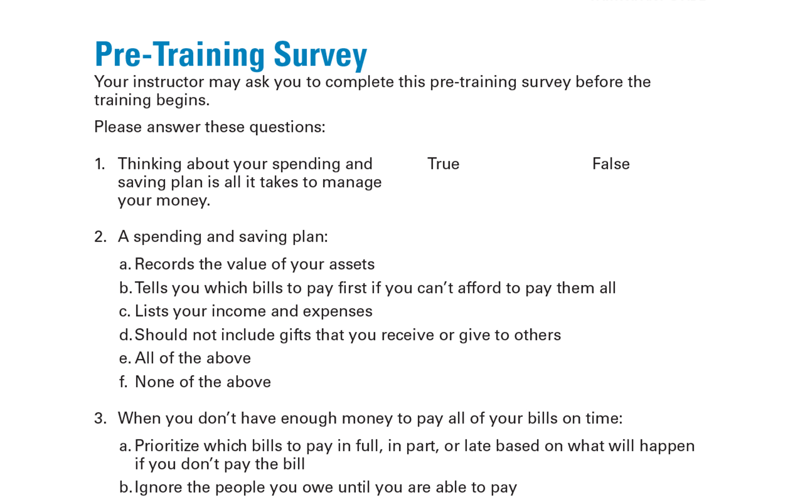
Pre-Training Survey See page 25 in your Participant Guide

Slide 3

Section 1: Making a Monthly Spending and Saving Plan
Section 1
Making a Monthly Spending and Saving Plan
See page 3 in your Participant Guide

Slide 4
Section 1: Key Takeaway
Use a monthly spending and saving plan to guide how you use your money.

Slide 5
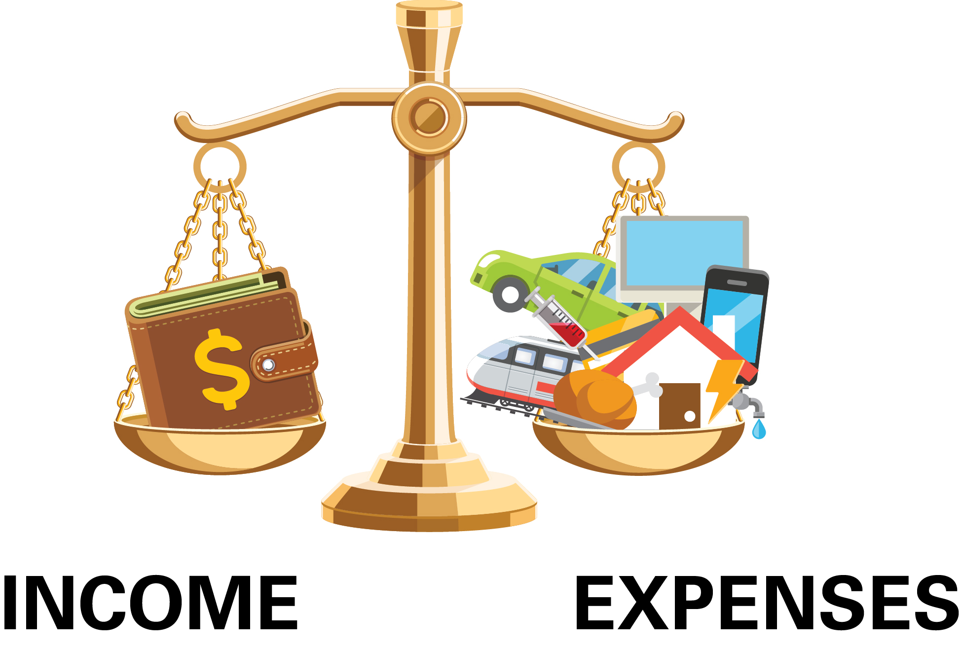
Building Blocks of a Spending and Saving Plan
Compare income and expenses
Understand where your money is going
Make adjustments
Income:
Money you receive
Expenses: How you use your income

Slide 6
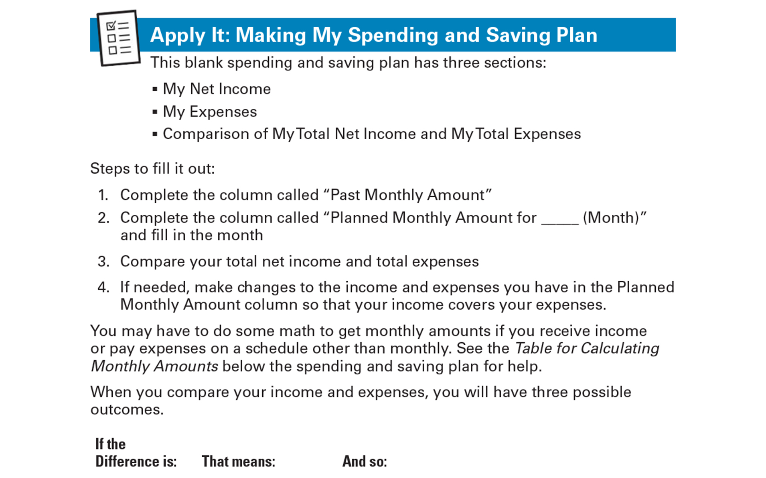
Apply It: Making My Spending and Saving Plan See page 4 in your Participant Guide

Slide 7
Filling Out My Spending and Saving Plan
Three sections:
My Net Income
My Expenses
Comparison
Steps to fill it out:
Complete Past Monthly Amount
Complete Planned Monthly Amount
Compare total net income and total expenses
If needed, make changes

Slide 8

When You Compare
My Total Net Income minus My Total Expenses
If the Difference is:
Zero -- your income equals your expenses
Positive -- you have more income than expenses
Negative -- you have more expenses than income

Slide 9
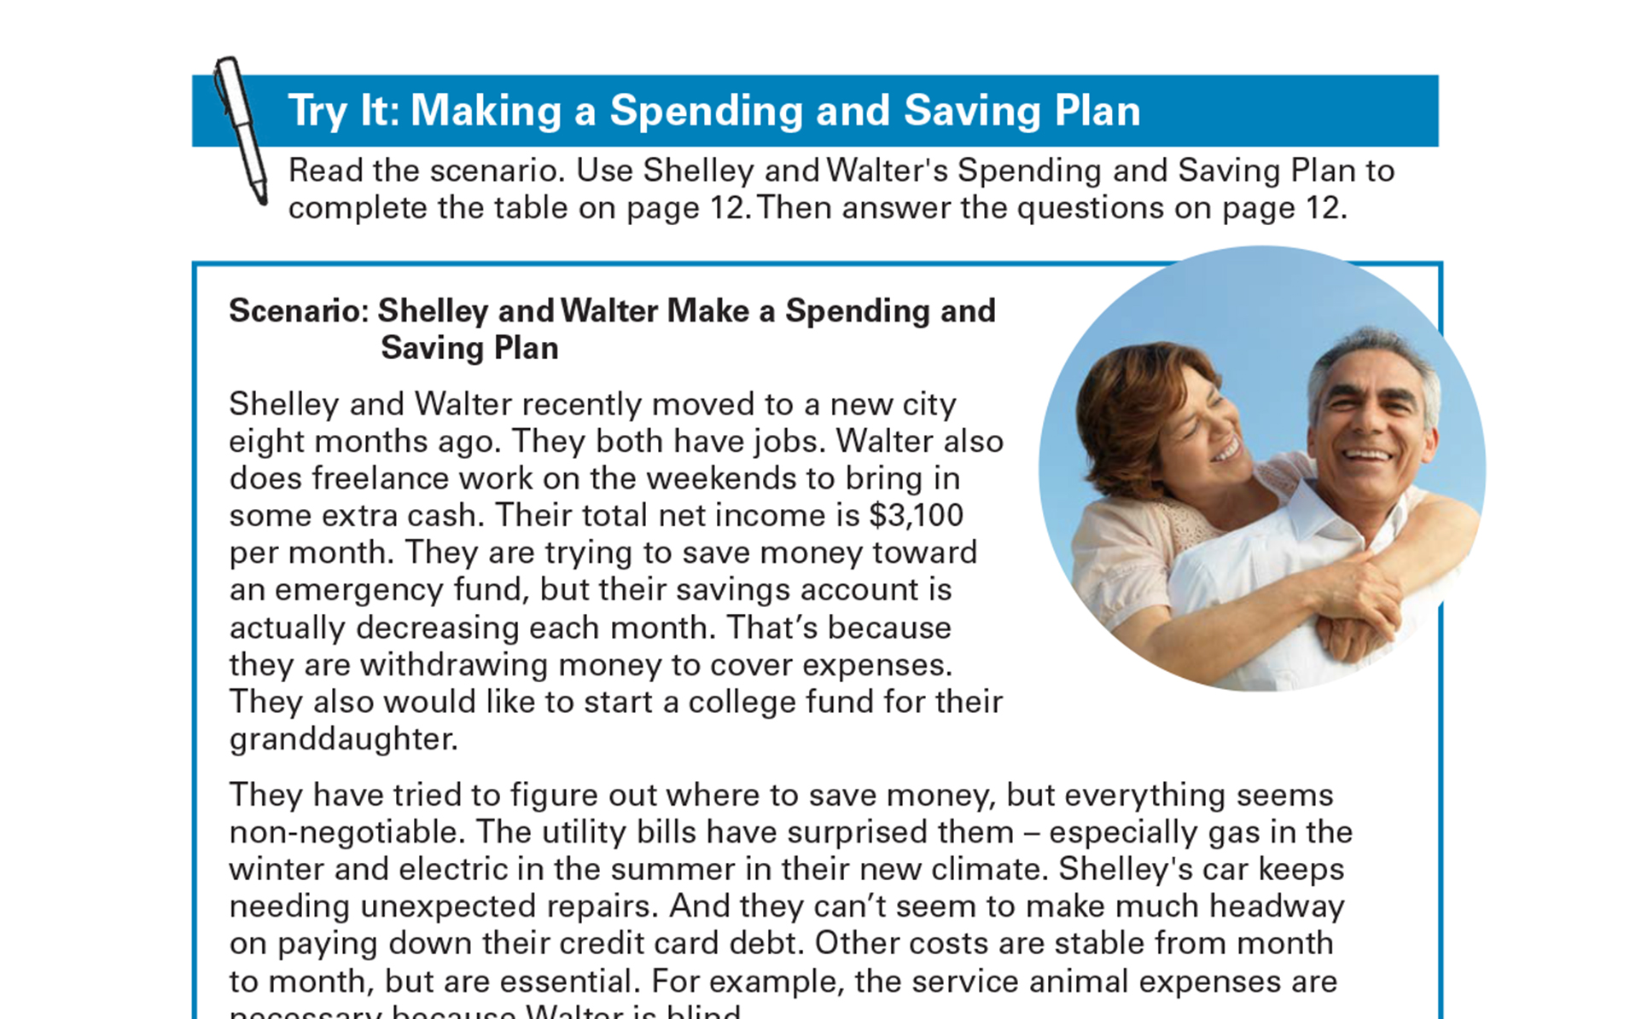
Try It: Making a Spending and Saving Plan See page 9 in your Participant Guide

Slide 10
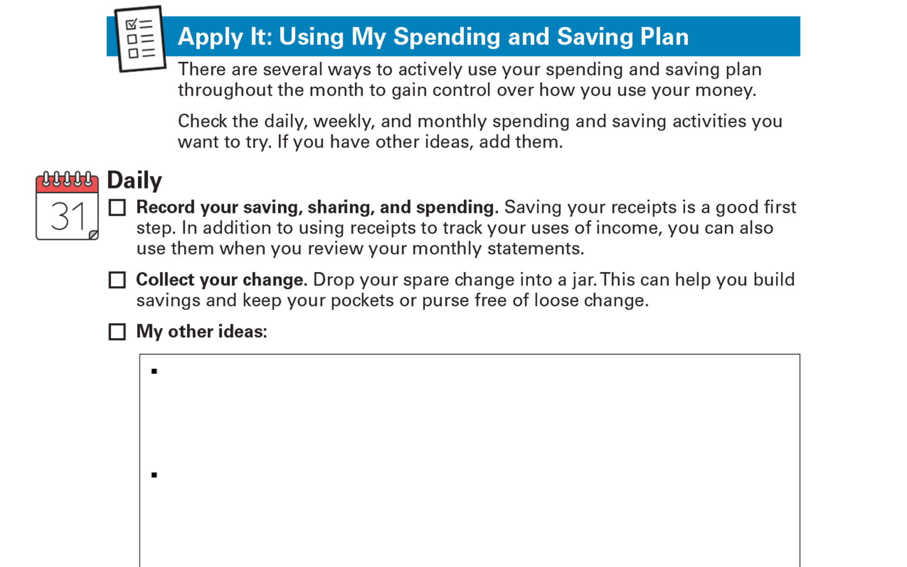
Apply It: Using My Spending and Saving Plan See page 13 in your Participant Guide

Slide 11
Daily and Weekly Ideas
Daily Ideas
Record your saving, sharing, and spending
Collect your change
Other ideas?
Weekly Ideas
Envelope system
Weekly money check-in
Other ideas?

Slide 12
Monthly Ideas
Monthly Ideas
Conduct a monthly review
Have a monthly goal-setting session
Celebrate successes
Prepare for taxes
Other ideas?

Slide 13
Increasing Income
Can help you cover expenses, save, or share
Once (sell something)
Occasionally (a few garage sales)
Ongoing (part-time second job)
Long-term (workforce development)
What are other ways to increase your income?

Slide 14
Decreasing Expenses
Think about needs, wants and obligations
Conserve:
What can you get cheaper, or use less of?
Adjust:
What can you renegotiate?
Do without:
What can you eliminate?

Slide 15
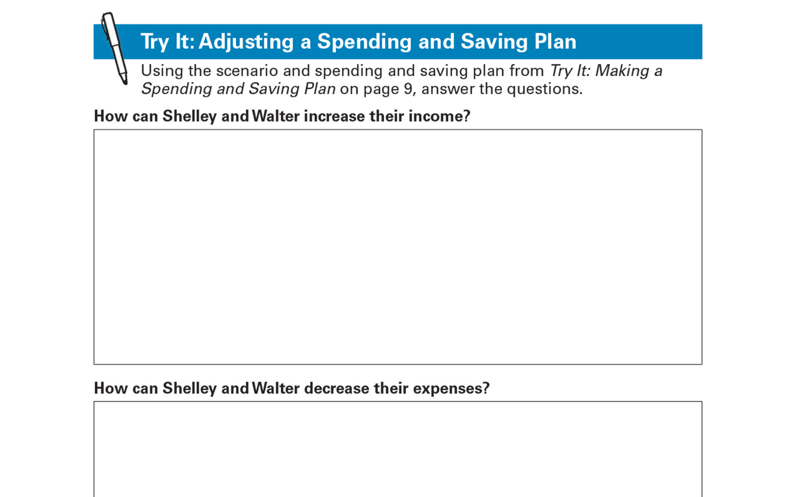
Try It: Adjusting a Spending and Saving Plan See page 17 in your Participant Guide

Slide 16
Section 1: Remember the Key Takeaway
Use a monthly spending and saving plan to guide how you use your money.

Slide 17

Section 2: When Money is Short
Section 2
When Money Is Short
See page 18 in your Participant Guide

Slide 18
Section 2: Key Takeaway
Prioritize which bills to pay first when money is short.

Slide 19

How Does It Happen?
Even with careful planning, money can run short

Slide 20
What Can I Do?
?
Increase income
Decrease expenses
Contact your creditors
Reach out for help
Prioritize what to pay first

Slide 21
Prioritizing Based on What Might Happen
Make choices about which bills to pay in full, pay partially, or pay late
Pay attention to consequences that:
Prevent you from earning income
Jeopardize your shelter
Impact health or ability to live independently
Could result in loss of your assets

Slide 22
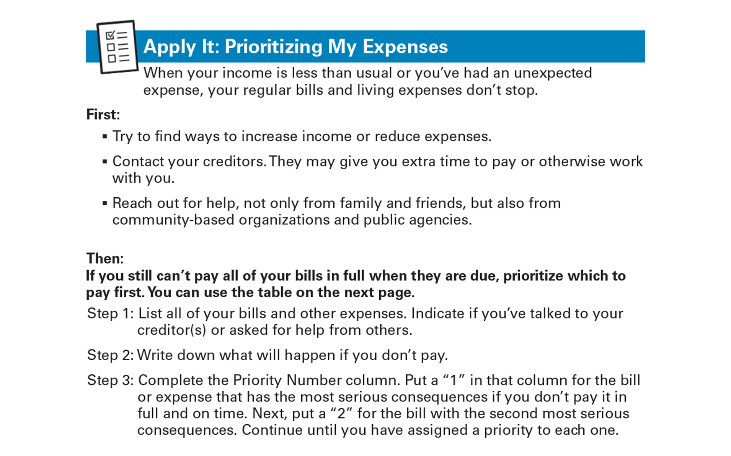
Apply It: Prioritizing My Expenses See page 20 in your Participant Guide

Slide 23
Section 2: Remember the Key Takeaway
Prioritize which bills to pay first when money is short.

Slide 24
Take Action See page 22 in your Participant Guide
What will I do?
How will I do it?
Will I share my plans with anyone? If so, who?
Visit fdic.gov/education to learn more

Slide 25

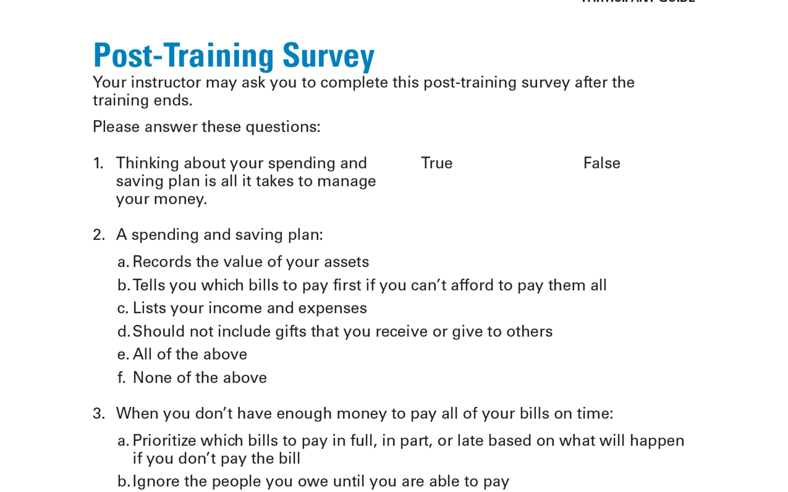
Post-Training Survey See page 27 in your Participant Guide

