Slide 1


Module 8: Managing Debt
Module 8
Managing Debt
September 2018

Slide 2
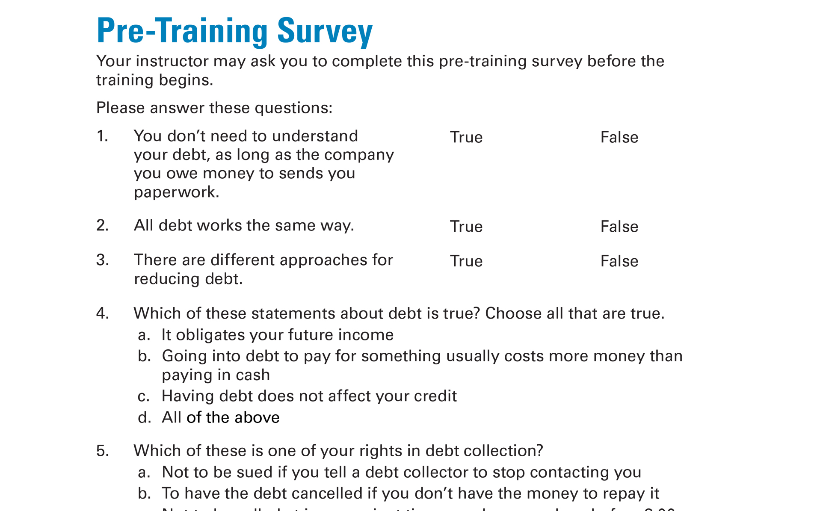
Pre-Training Survey
See page 49 in your Participant Guide

Slide 3

Section 1: What is Debt?
Section 1
What is Debt?
See page 4 in your Participant Guide

Slide 4
Section 1: Key Takeaway
Understanding your debt is the first step to managing it.

Slide 5
Debt and Credit
?
What is the difference between credit and debt?

Slide 6
Debt Is Not The Same as Credit
Debt is money you owe
Credit is the ability to borrow money
You use credit to borrow money
Which then becomes your debt

Slide 7
Debtors and Creditors
?
What is the difference between a creditor and debtor?

Slide 8
Debtors Owe Money to Creditors or Lenders
Debtors owe money (they borrowed it)
Creditors and lenders loan money

Slide 9
Understanding Your Debt
You need to know:
Who you owe
How much you owe them
How much the payments are
When the payments are due
Other important facts about your debts

Slide 10
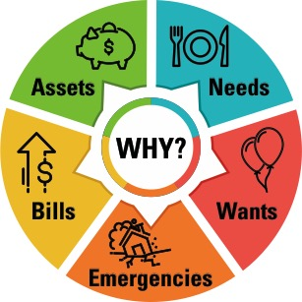
People Get into Debt for Many Reasons
Purchase assets
Pay bills (or as a result of not paying them)
Cover unexpected expenses or emergencies
Buy something they want or need

Slide 11
How Debt Can Affect Your
Financial Situation
Need to use future income to pay your debts
  Called “obligating future income”
Generally pay interest and sometimes fees on your debt until paid
May impact how soon you can achieve your goals

Slide 12
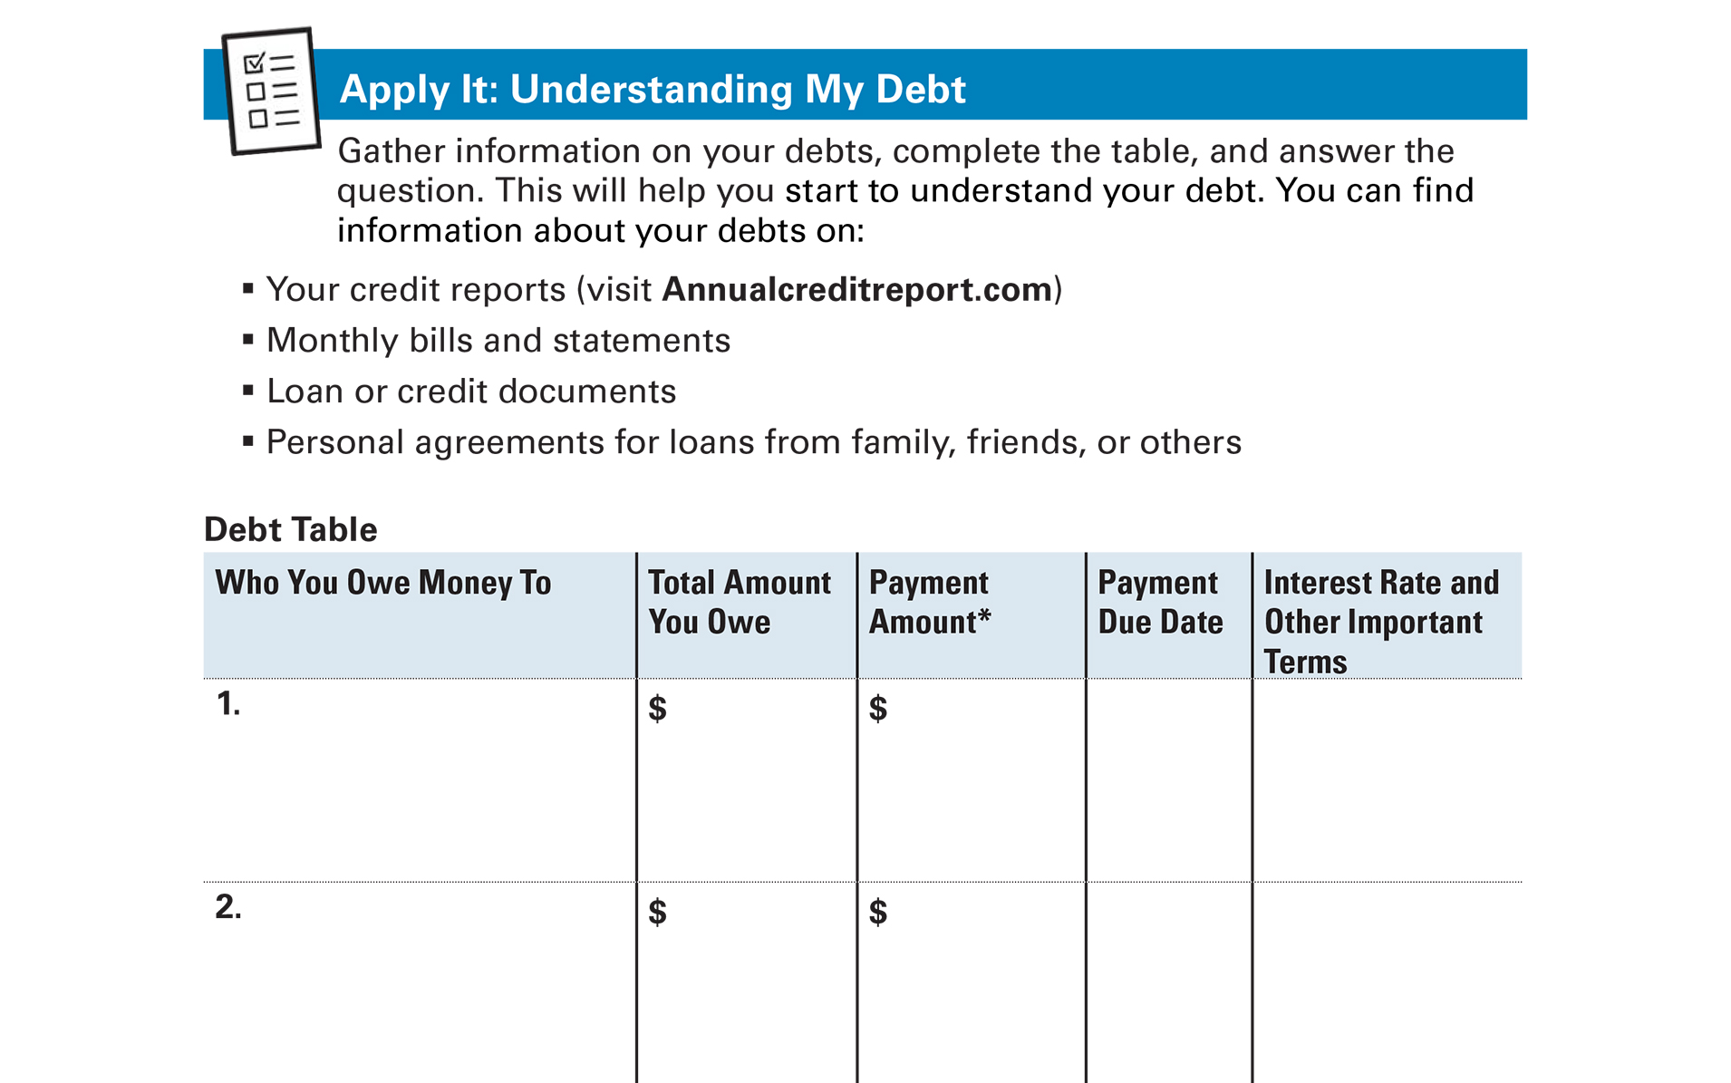
Apply It: Understanding My Debt
See page 6 in your Participant Guide

Slide 13
Section 1: Remember the Key Takeaway
Understanding your debt is the first step to managing it.

Slide 14
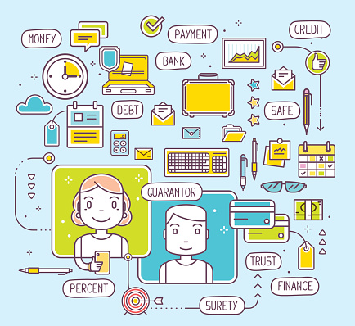
Section 2: How Debt Works
Section 2
How Debt Works
See page 8 in your Participant Guide

Slide 15
Section 2: Key Takeaway
Consider how debt works so you can make informed decisions about it.

Slide 16
Debt Lingo 1
A loan with collateral that the lender can take if the loan is not repaid according to the loan agreement
Principal
Secured Loan
Annual Percentage Rate

Slide 17
Debt Lingo 2
How much money you borrow
Principal
Interest
Fees

Slide 18
Debt Lingo 3
The main cost of borrowing money
Current balance
Interest
Credit

Slide 19
Debt Lingo 4
A credit agreement that allows you to borrow money from time to time up to a
pre-approved maximum credit line
Installment loan
Revolving credit
Lease agreement

Slide 20
Debt Lingo 5
The total cost of credit on a yearly basis
Annual fees
Annual adjustment
Annual percentage rate

Slide 21
Debt Lingo 6
When you borrow a specific amount of money and repay it over a set period of time
Revolving credit
Principal
Installment loan

Slide 22
Debt Lingo 7
A loan with no collateral
Secured loan
Unsecured loan
Mortgage

Slide 23
Installment Loans
Principal
  Amount you borrow
Term
  How long you have to repay the principal and pay the interest
Generally pay same amount every payment unless there is a variable or adjustable interest rate

Slide 24
Revolving Credit
Credit limit – the most you can borrow
Payment – based on credit you have used
Minimum payment – often 1% to 5% of the outstanding balance
Pay more Pay off sooner Pay less interest!
Notes:
You borrow up to a credit limit
Limit often based on credit scores
Payment is based on the amount of the credit limit you have used
Billed a monthly minimum—1% to 5% of outstanding balance

Slide 25
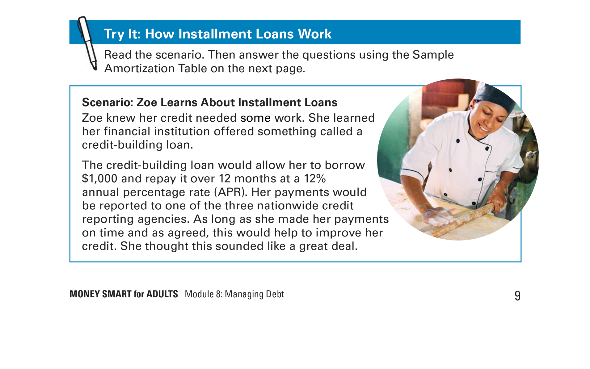
Try It: How Installment Loans Work
See page 9 in your Participant Guide

Slide 26
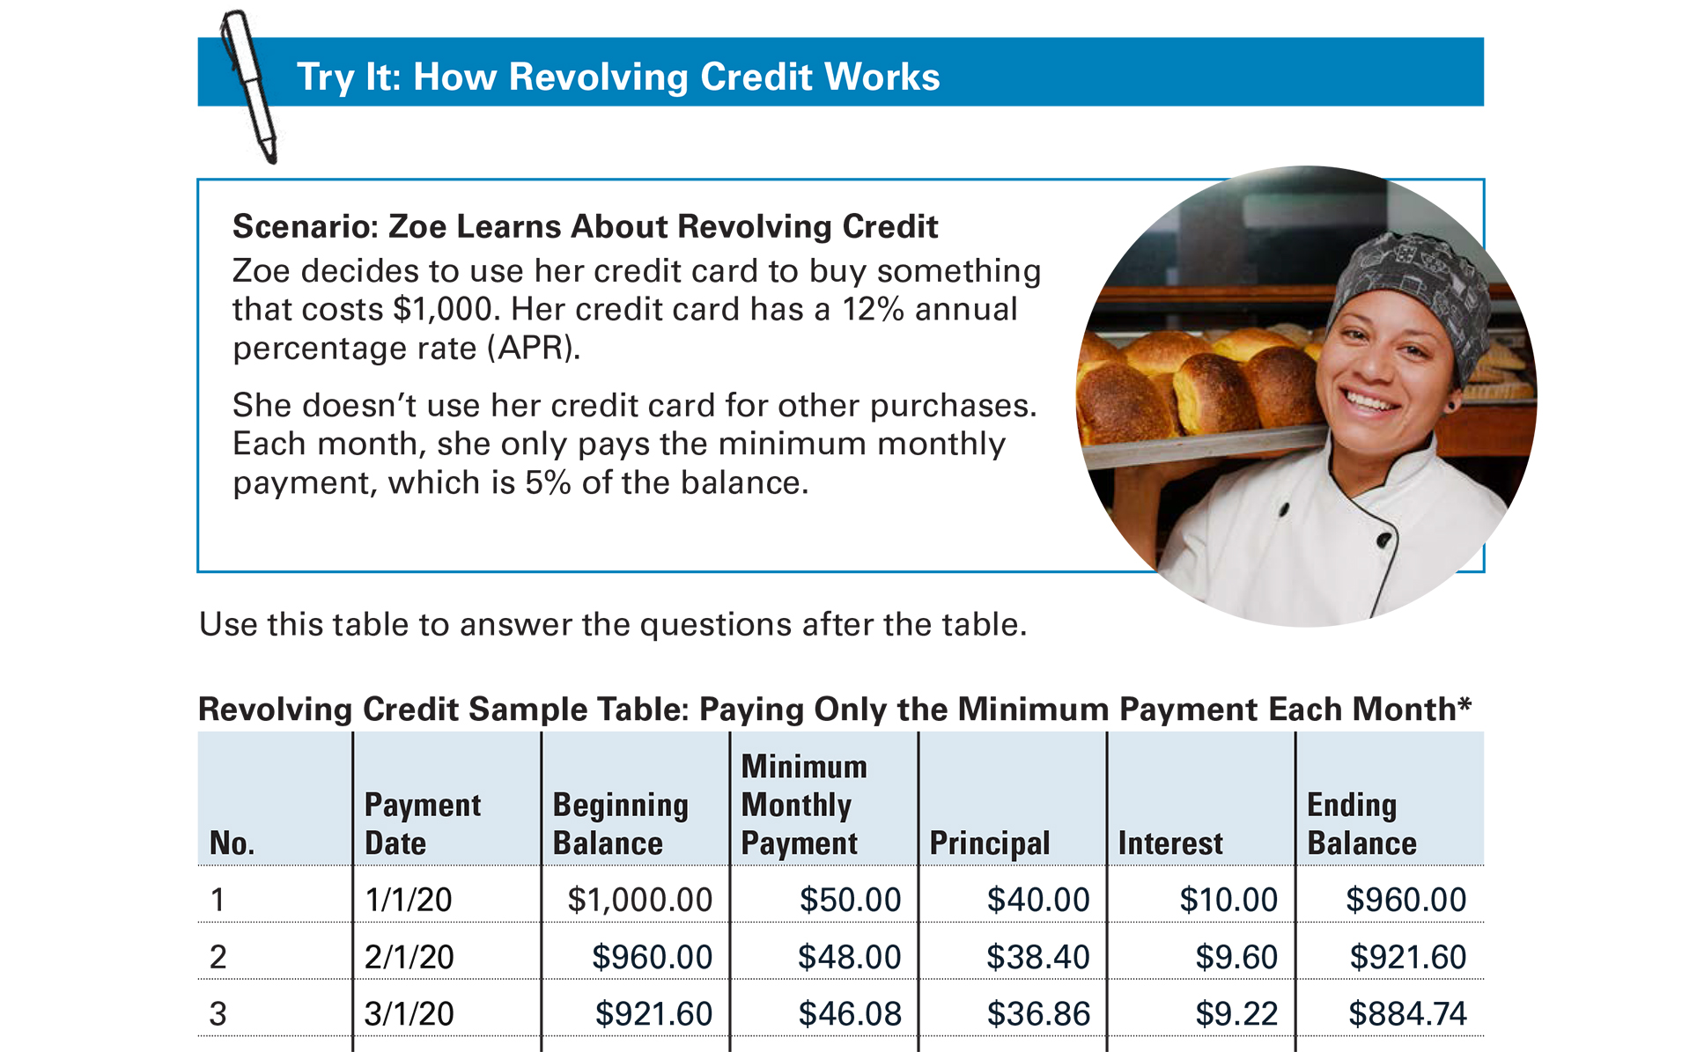
Try It: How Revolving Credit Works
See page 11 in your Participant Guide

Slide 27

Fees
Additional charges; they are not interest
Make sure you understand:
  The fees you will be charged
  The fees you may be charged

Slide 28
Prepayment
Early repayment of all or part of a loan
  Reduces interest costs
  May mean an earlier payoff date
Ask if there are any fees for prepayment

Slide 29
Section 2: Remember the Key Takeaway
Consider how debt works so you can make informed decisions about it.

Slide 30

Section 3: Reducing Debt
Section 3
Reducing Debt
See page 14 in your Participant Guide

Slide 31
Section 3: Key Takeaway
Develop a plan to reduce your debt and get help if needed, such as from a trained credit
counselor.

Slide 32
Two Strategies for Reducing Debt
High Cost Debt First method
  First pay off debt with highest cost to you
Snowball method
  First pay off debt with lowest balance

Slide 33
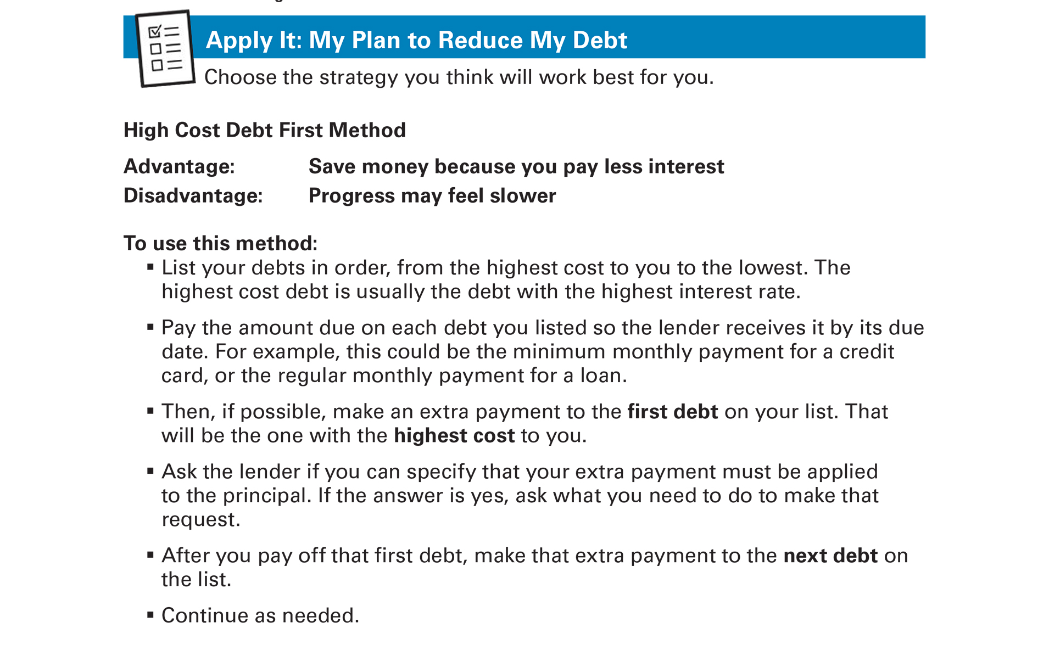
Apply It: My Plan to Reduce My Debt
See page 15 in your Participant Guide

Slide 34
High Cost Debt First Method
Advantage—save money
Disadvantage—progress may feel slower
List debts: Highest cost to you to the lowest
Pay amount due on each debt
Make extra payment to first debt on list
After you pay off first debt, make extra payment on next debt on the list
Continue as needed

Slide 35
Snowball Method
Advantage—make progress faster
Disadvantage—may pay more money
List debts: Lowest balance to the highest
Pay amount due on each debt
Make extra payment to first debt on list
After you pay off first debt, make extra payment on next debt on the list
Continue as needed

Slide 36
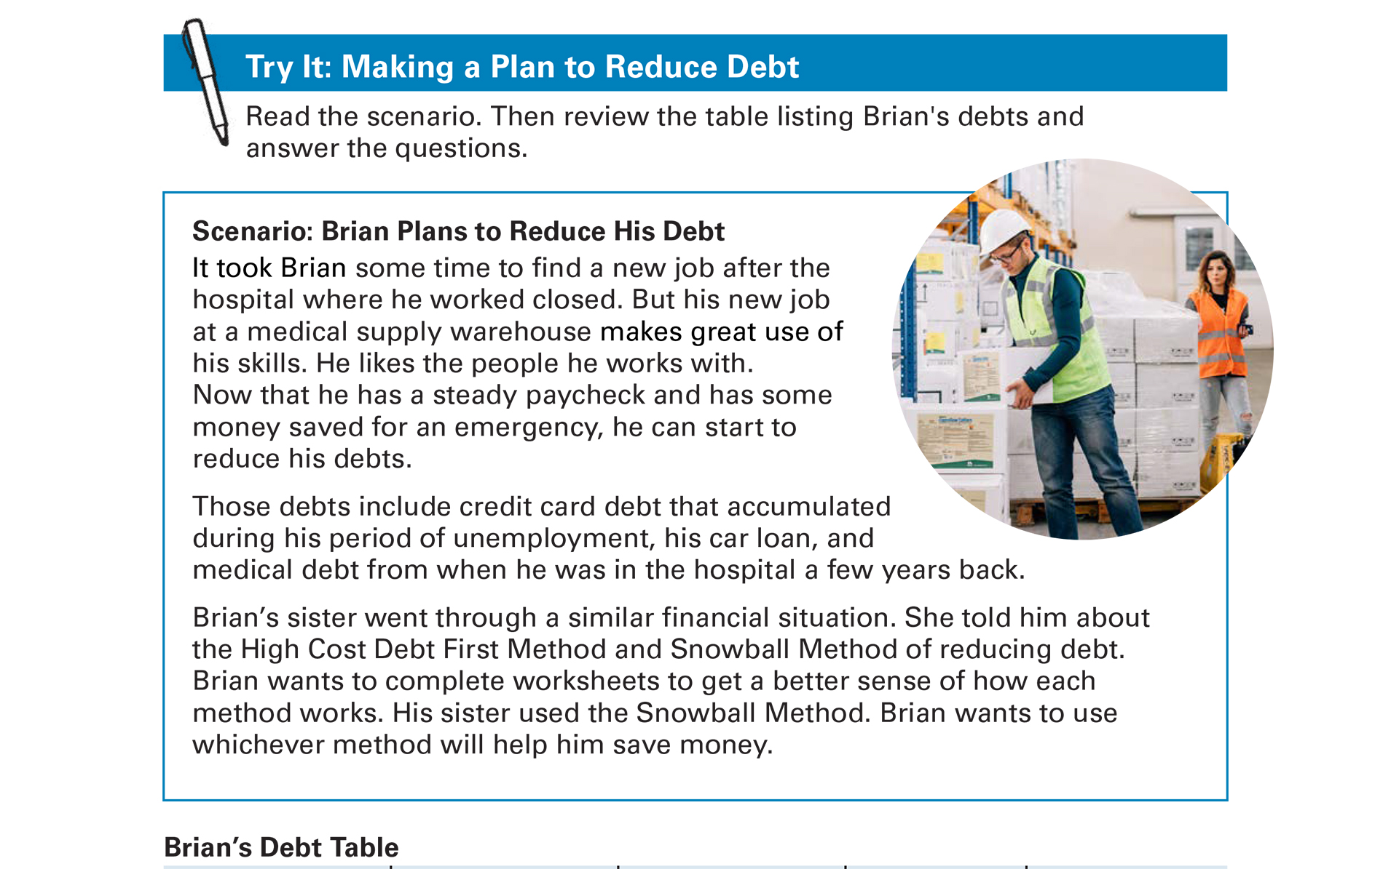
Try It: Making a Plan to Reduce Debt
See page 19 in your Participant Guide

Slide 37
High Cost Debt First Method Worksheet
Answer Key
Order of Pay Off | Who He Owes Money To | How Much He Owes | Interest Rate (highest to lowest)
1 | Credit Card Company (Credit Card) | $8,000 | 14%
2 | Hospital (Medical Debt) | $10,000 | 10%
3 | Bank (Car Loan) | $2,000 | 6%

Slide 38
Snowball Method Worksheet
Answer Key
Order of Pay Off | Who He Owes Money To | How Much He Owes (list from lowest to highest)
1 | Bank (Car Loan) | $2,000
2 | Credit Card Company (Credit Card) | $8,000
3 | Hospital (Medical Debt) | $10,000

Slide 39
Where to Get Help
Nonprofit credit counseling organizations
Go to www.usa.gov and search for “credit counseling”
  Tips from the Federal Trade Commission on how to find and choose a credit counselor

Slide 40

Choose Help Carefully
Debt settlement companies
  They offer to make deals with your
  creditors
  Ask about fees and process
Debt consolidation loans
  One loan used to pay off multiple debts
  Ask about interest rates, fees, other costs

Slide 41
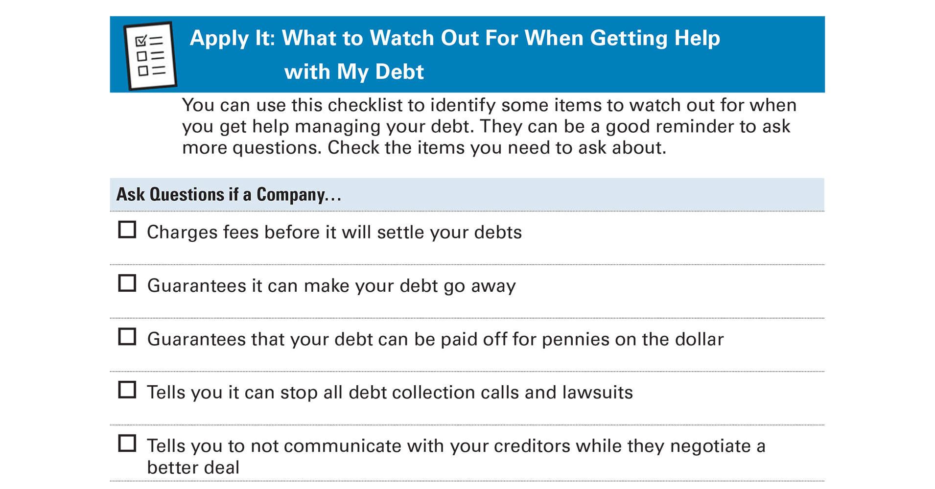
Apply It: What to Watch Out For When Getting Help With My Debt
See page 22 in your Participant Guide

Slide 42
Section 3: Remember the Key Takeaway
Develop a plan to reduce your debt and get help if needed, such as from a trained credit counselor.

Slide 43

Section 4: Nonpayment of Debts and Debts in Collection
Section 4
Nonpayment of Debts and
Debts in Collection
See page 24 in your Participant Guide

Slide 44
Section 4: Key Takeaway
Don’t ignore a debt collector. Make sure any debt you are asked to pay is valid as soon as possible. Get help if
you need it.

Slide 45
The Life Cycle of Debt – Current
Take on debt
Pay on time and as agreed = Current
Paid off

Slide 46
The Life Cycle of Debt – Not Current
Take on debt
Miss payments = Delinquent
In Default
Charge off
Collections =
Assigned or sold to debt collector

Slide 47
Not Paying Debts
?
What can happen if you don’t pay your debts on time and as agreed?

Slide 48
Several Things Can Happen if
You Don’t Pay Your Debts
Late fees or more money in interest
Contact by debt collector
Losing services or paying costs to reestablish them
Losing collateral

Slide 49
What Else Can Happen?
Negative entries on your credit reports
Drop in credit scores
Lawsuits from creditors
Wage garnishment
Account garnishment
Treasury offset

Slide 50
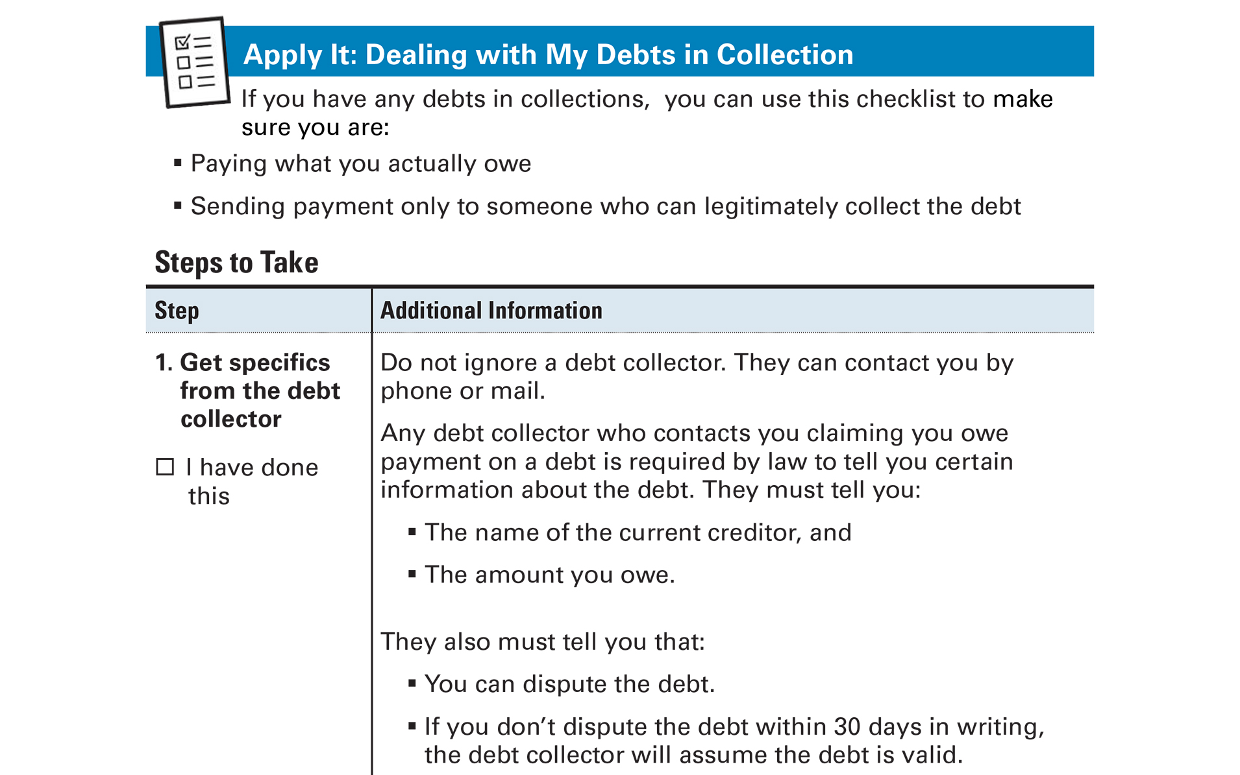
Apply It: Dealing with My Debts in Collection
See page 26 in your Participant Guide

Slide 51
Before Making a Plan to Pay a Debt
Be sure you know:
  You owe the debt
  The statute of limitations has not expired
  You are dealing with a legitimate debt collector
If you know those three items,
pay the debt in full if possible

Slide 52
If Payment in Full is Not Possible
  Set up a payment plan
    Make sure it’s a plan you can afford
  Negotiate a lower balance
    Ask for “paid in full” and not “settled”

Slide 53

Debt Collectors Must Follow Rules
No abusive, unfair, or deceptive practices
  No inconvenient times or places
  No calls at work if told not to call
  No threats of violence
  No obscene or profane language
Report problems with debt collectors

Slide 54
Section 4: Remember the Key Takeaway
Don’t ignore a debt collector. Make sure any debt you are asked to pay is value as soon as possible. Get help if you need it.

Slide 55

Section 5: Dealing with Student Loan Debt
Section 5
Dealing with Student Loan Debt
See page 30 in your Participant Guide

Slide 56
Section 5: Key Takeaway
When it’s time to pay back your student loans, consider your options and understand what will happen if you are late
with payments. Your loan
servicer can help you
explore repayment plans.

Slide 57
What is Student Loan Debt?
Money owed on student loans
Biggest debt some people will ever have
Sometimes a stressful topic

Slide 58
What Can Happen if I Don’t Repay My
Student Loans?
Paying more fees and interest
Wage garnishment
Account garnishment
Treasury offset

Slide 59
What Else Can Happen if Student Loan Debt is Not Paid?
Unable to get more federal student aid
  May need to take one or more semesters off
Negative entries on credit reports
Decrease in credit scores
Decreased ability to borrow money
Stress of owing the money
Delay in reaching other goals

Slide 60
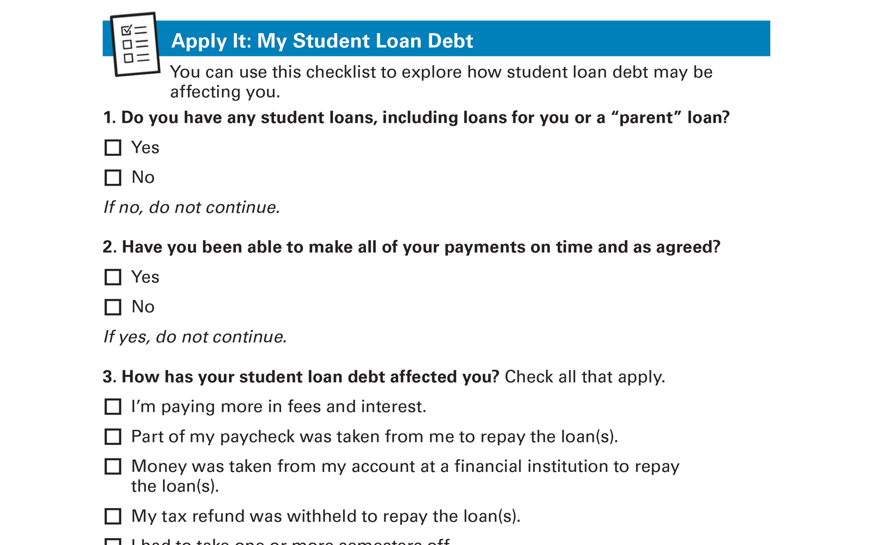
Apply It: My Student Loan Debt
See page 31 in your Participant Guide

Slide 61
Types of Student Loans
Private student loans
Federal student loans
We will not be discussing
private student loans

Slide 62
Federal Student Loan
Repayment Options
Grace period
Standard Repayment Plan -- Default
Restructured payments not based on income
  Graduated Repayment Plan
  Extended Repayment Plan

Slide 63
Repayment Plans Based on Income
Revised Pay as You Earn Plan (REPAYE)
Pay as You Earn Plan (PAYE)
Income Based Repayment Plan (IBR)
Income Contingent Repayment Plan (ICR)

Slide 64
Forbearance and Deferment
Forbearance
  Temporary postponement or reduction of payments due to financial difficulty
Deferment
  Temporary suspension of loan payments for specific situations

Slide 65
Loan Forgiveness, Cancellation, and Discharge
Closed School Discharge
Public Service Loan Forgiveness
Teacher Loan Forgiveness
Total and Permanent Disability Discharge
Discharge Due to Death

Slide 66
Take Action to Prevent Default
To prevent default, explore:
  Different payment due date
  Different repayment plan options
  Forbearance, deferment, loan forgiveness, loan cancellation, or loan discharge
Declaring bankruptcy does not automatically discharge federal student loans

Slide 67
Beware of Student Loan Scams
Never pay an upfront fee
Only scammers promise fast loan forgiveness
A Department of Education seal doesn’t mean it’s legitimate
Don’t share your Federal Student Aid Identification Number (FSA ID)

Slide 68
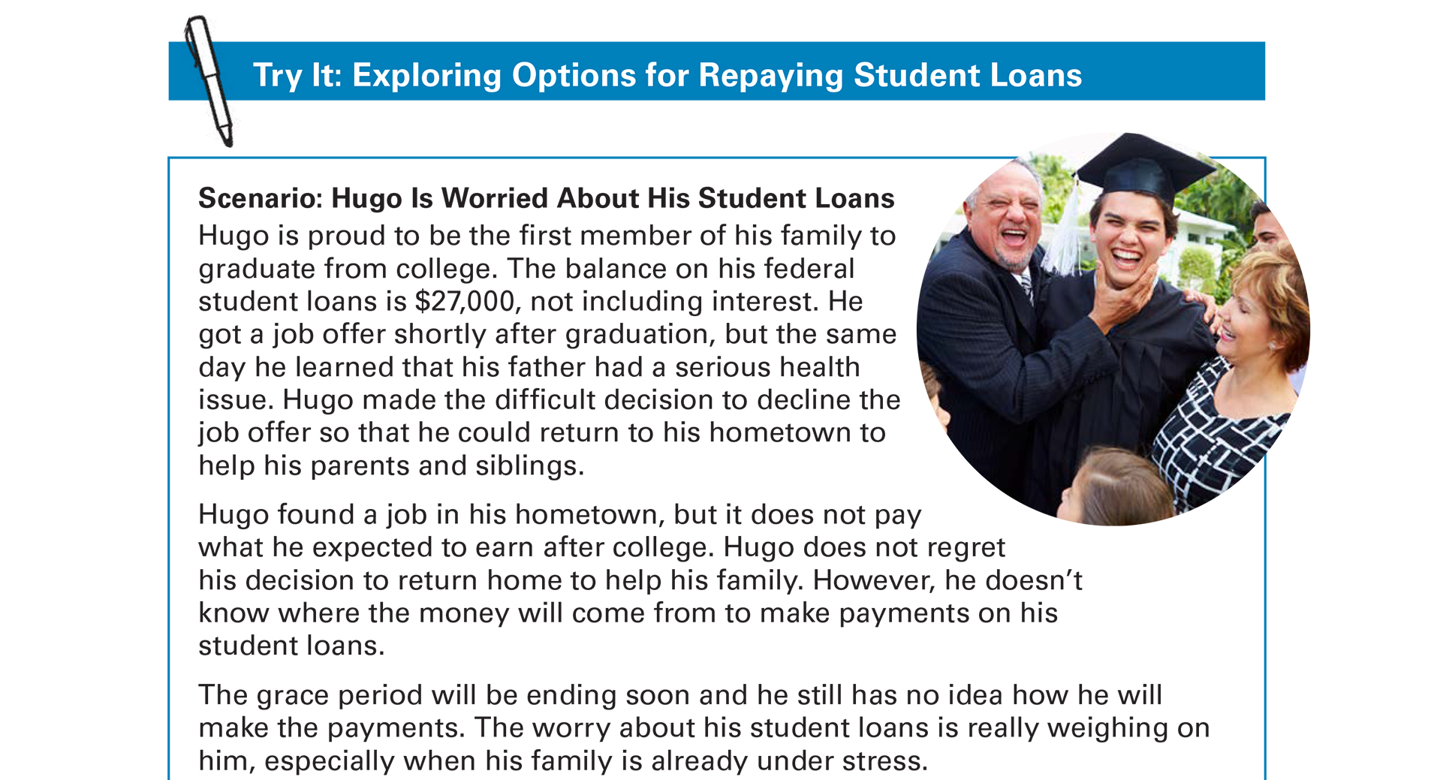
Try It: Exploring Options for Repaying Student Loans
See page 34 in your Participant Guide

Slide 69
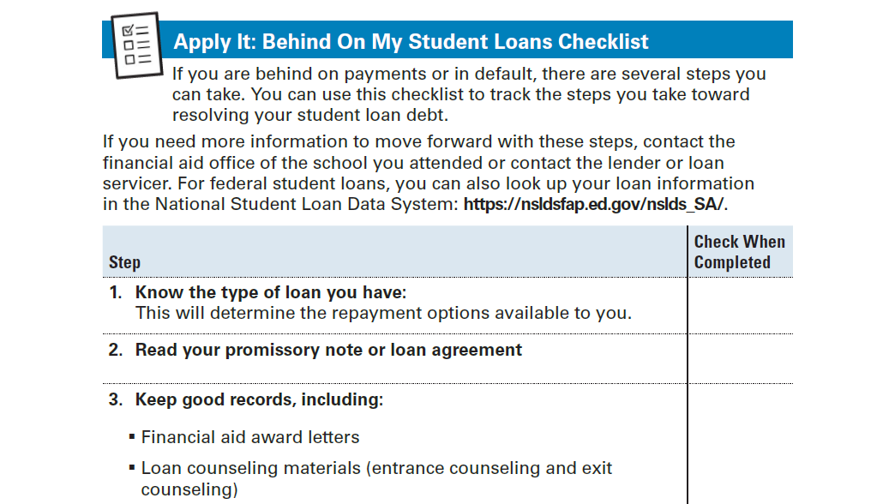
Apply It: Behind on My Student Loans Checklist
See page 35 in your Participant Guide

Slide 70
Section 5: Remember the Key Takeaway
When it’s time to pay back your student loans, consider your options and understand what will happen if you are late with payments. Your loan servicer can help you explore repayment plans.

Slide 71

Section 6: Managing Medical Debt
Section 6
Managing Medical Debt
See page 37 in your Participant Guide

Slide 72
Section 6: Key Takeaway
If you receive a medical bill, make sure it is valid. If you can’t afford to pay it, try to set up a payment plan.

Slide 73
What is Medical Debt?
The result of not paying medical bills when they are due
You don’t start out with debt when you receive medical care

Slide 74
Why Do Medical Bills Often Turn Into Medical Debt?
Often unplanned
Total costs not known upfront
Expenses quickly add up
Can be confusing
  Many individuals providing care
  Lack of understandable detail
  Insurance information often unknown

Slide 75
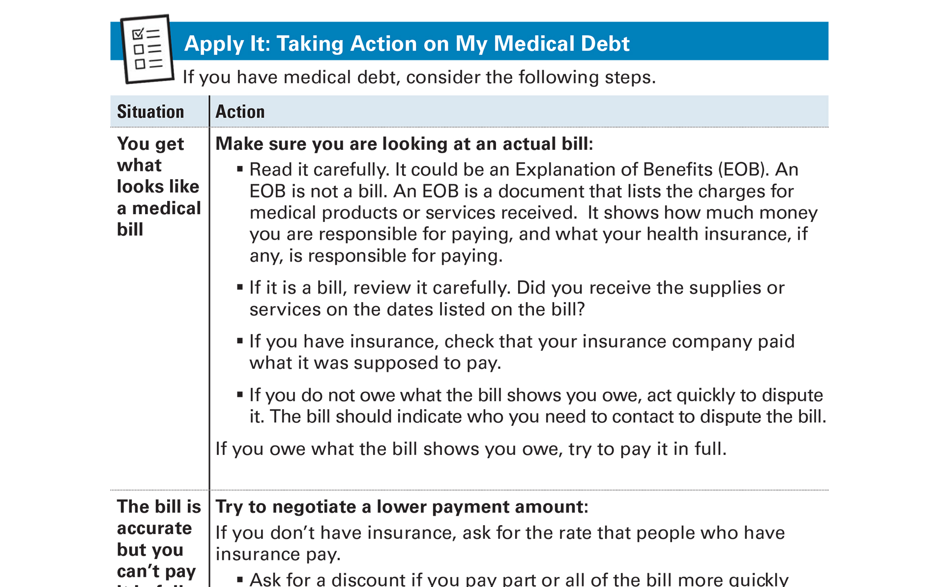
Apply It: Taking Action on My Medical Debt
See page 38 in your Participant Guide

Slide 76
Possible Actions
Make sure it’s a bill and you owe it
If you do not owe it, dispute the bill
If you do owe it, but cannot pay in full:
  Try to negotiate a lower payment amount
  Try to set up a payment plan
  Try to settle the debt
  Work with nonprofit credit counseling organizations
  Consider bankruptcy, perhaps as a last resort

Slide 77
Medical Debt in Collections and Credit
Unpaid medical debts appear on credit reports one year after first missed payment
Debts can still be referred to collections
Medical debt in collections is not included on credit reports after it is paid
Reach out for help if needed

Slide 78
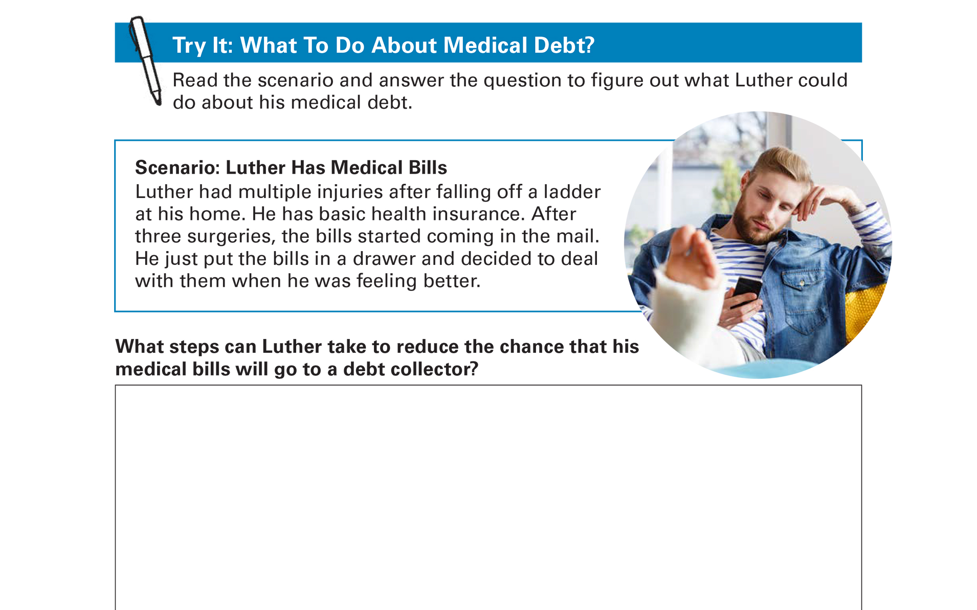
Try It: What To Do About Medical Debt?
See page 41 in your Participant Guide

Slide 79
Section 6: Remember the Key Takeaway
If you receive a medical bill, make sure it is valid. If you can’t afford to pay it, try to set up a payment plan.

Slide 80

Section 7: Understanding High Cost Debt
Section 7
Understanding High Cost Debt
See page 42 in your Participant Guide

Slide 81
Section 7: Key Takeaway
Understand how high cost debt works. Identify lower cost options for the future.

Slide 82
What is High Cost Debt?
The result of small-dollar, short-term loans with costly fees, or high interest rates, or both
There are risks and benefits of all financial products and services, including high cost debt

Slide 83
Car or Vehicle Title Loans
Loan for a small amount of money for a short time
Vehicle title is the collateral
Single-payment loans often due in
30 days
Can be very expensive

Slide 84
Payday or Payday Advance
Loans
Borrower gives lender a personal check dated 14 to 30 days in the future or gives permission for an automatic withdrawal from an account.
Lender gives borrower the amount of the loan.
When loan is due, if borrower doesn’t have money to cover the check or withdrawal, loan may be re-borrowed, with more fees.
Borrower visits payday lender in person or online to get a new loan OR borrower re-borrows a prior loan.
START
HERE

Slide 85
Pawn Shop Loans
Item you pawn is the collateral
Loan amount – usually 25% to 50% of how much pawn shop considers item to be worth
Repay the loan, renew it, or lose the item

Slide 86
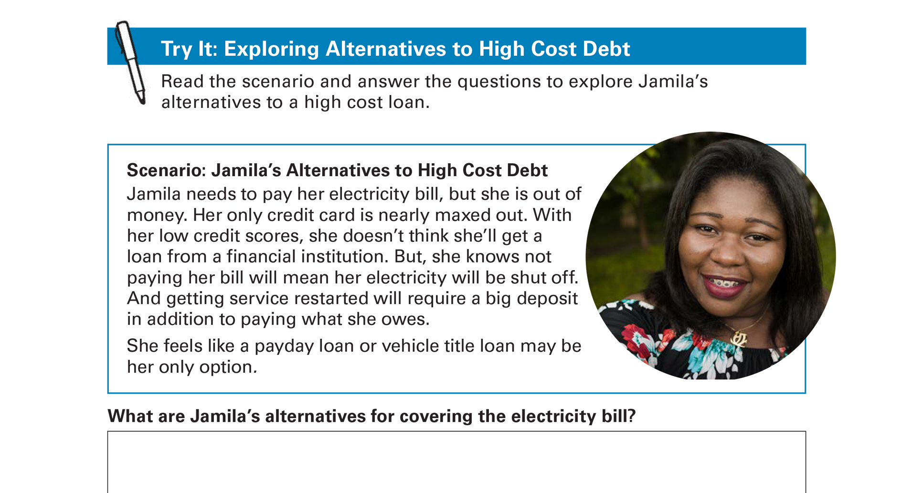
Try It: Exploring Alternatives to
High Cost Debt
See page 44 in your Participant Guide

Slide 87
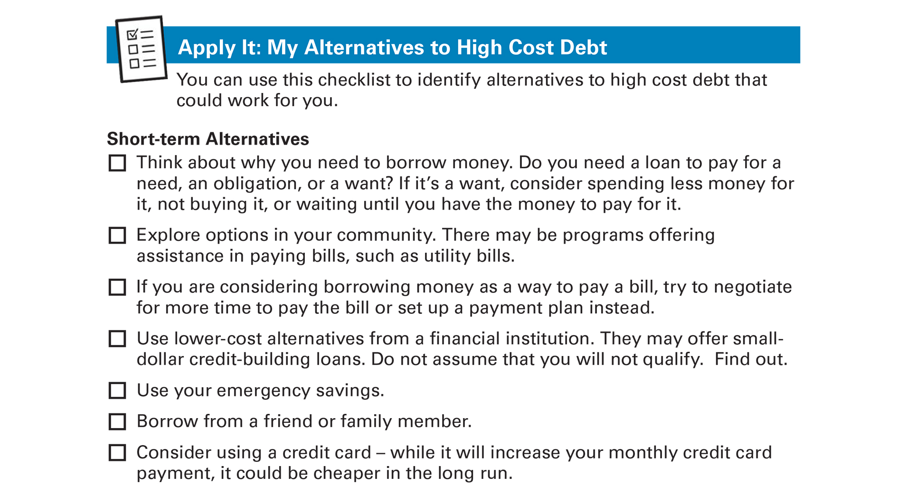
Apply It: My Alternatives to High Cost Debt
See page 45 in your Participant Guide

Slide 88
Section 7: Remember the Key Takeaway
Understand how high cost debt works. Identify lower cost options for the future.

Slide 89
Take Action
See page 46 in your Participant Guide
What will I do?
How will I do it?
Will I share my plans with anyone? If so, who?
Visit fdic.gov/education to learn more

Slide 90

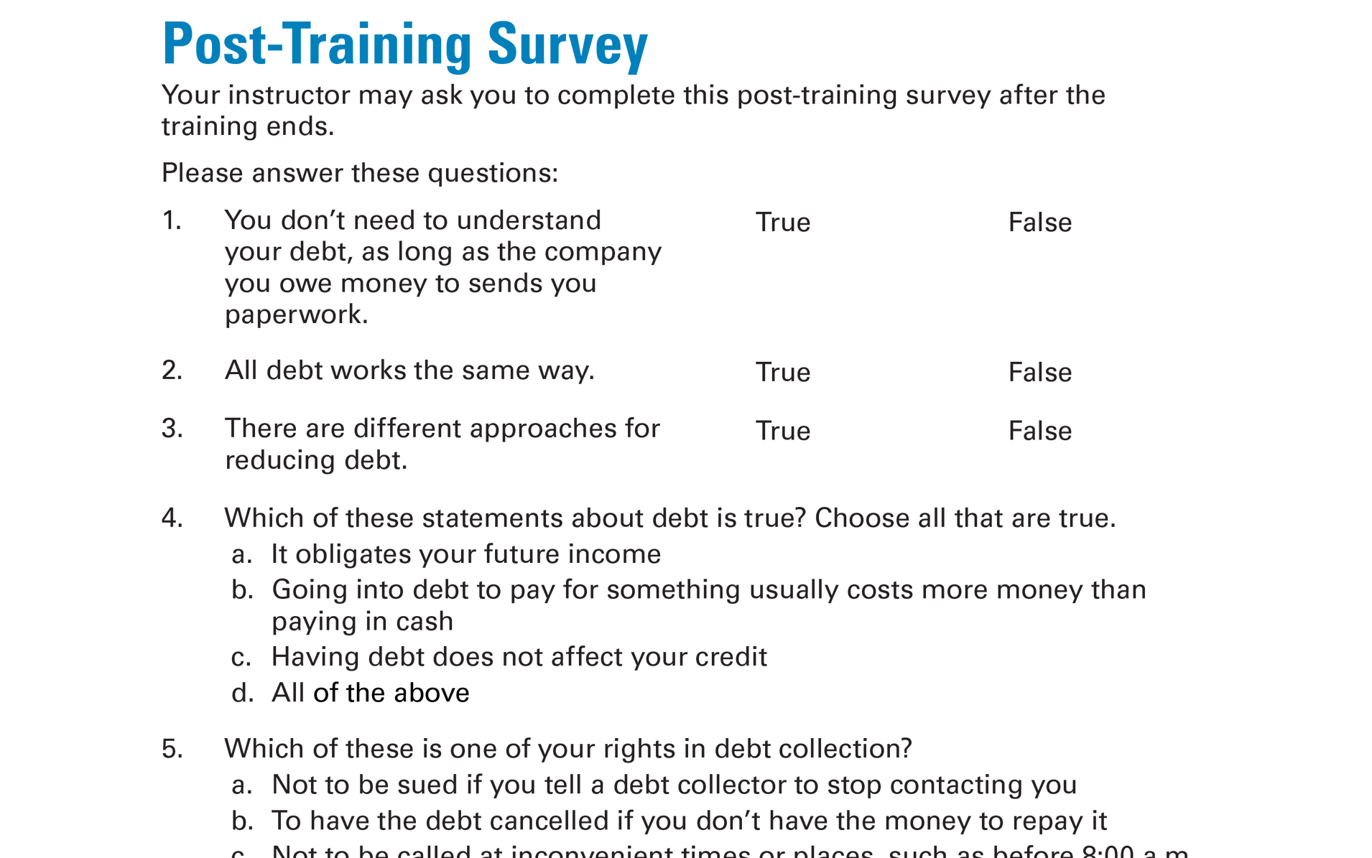
Post-Training Survey
See page 51 in your Participant Guide

