Slide 1
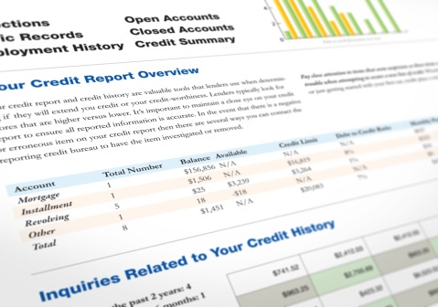

Module 6: Credit Reports and Scores
Module 6
Credit Reports and Scores
September 2018

Slide 2
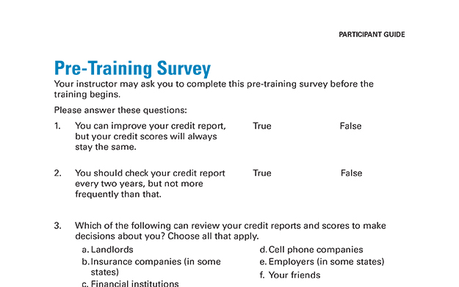
Pre-Training Survey
See page 57 in your Participant Guide

Slide 3
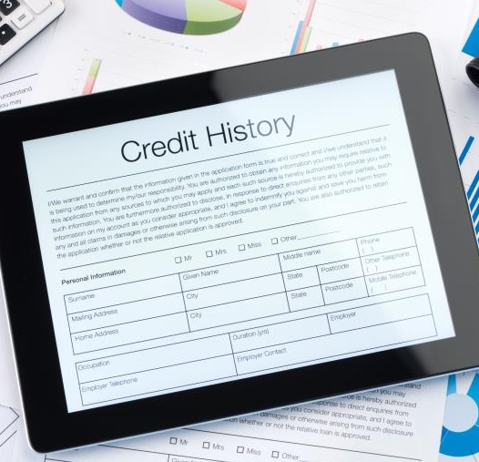
Section 1: Credit Reports
Section 1
Credit Reports
See page 3 in your Participant Guide

Slide 4
Section 1: Key Takeaway
Your credit history can affect your access to credit, loans, jobs, housing, insurance, and other important services. Understanding your rights helps you know how to protect your credit history.

Slide 5
Try It: Is This in a Credit Report?
See page 3 in your Participant Guide
Your name
Your age
Arrests and convictions
Your credit card payments
Your income
Bankruptcies
Cell phone plan payments
Debt-to-income ratio
Student loan payments
Credit card limits
Traffic tickets and fines
Savings account balance
Debit card purchases

Slide 6
What is Listed in a Credit Report?
Your identifying information
Your debts and some bills
Public record information
Your applications for new credit and other “inquiries”

Slide 7



Nationwide Credit Reporting Agencies
Equifax
Experian
TransUnion

Slide 8
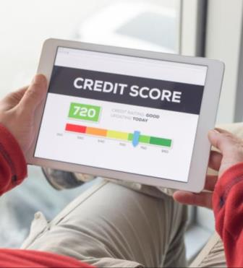
What Is a Credit Score?
A number based on information in credit reports
Predicts payment of bills and debts as agreed
People with higher credit scores likely to present lower risk to creditors

Slide 9
Who Uses Credit Reports and Scores?
Financial institutions
Some landlords
Utility companies
Some cell phone companies
Insurance companies (in some states)
Employers (in some states)
Some state agencies or affiliated organizations

Slide 10
Risk-Based Pricing
Credit reports and scores may be used as one factor in risk-based pricing
Lenders set interest rates and other terms based on estimated risks
  Must tell you if they used your credit reports or credit scores to deny your application or offer you less favorable terms
    Adverse action notices
    Risk-based pricing notices

Slide 11
Having No Credit Reports or Scores
“Credit invisible”
May result in having a harder time:
  Getting credit or a loan
  Renting an apartment
  Getting a favorable cell phone plan
  Obtaining some jobs
  Turning on utilities without paying a large deposit

Slide 12
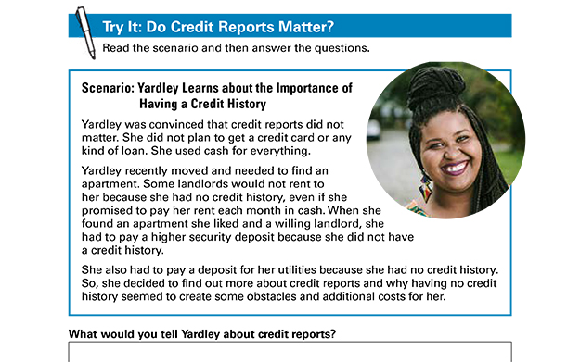
Try It: Do Credit Reports Matter?
See page 7 in your Participant Guide

Slide 13
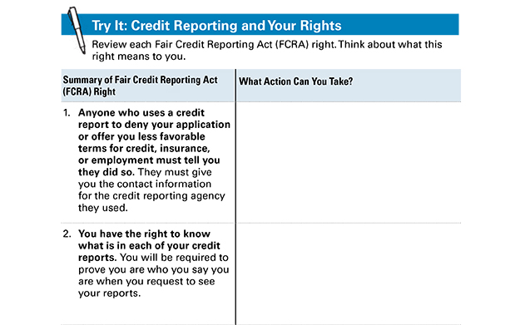
Try It: Credit Reporting and Your Rights
See page 8 in your Participant Guide

Slide 14
Opting Out
You can opt out of receiving prescreened offers of credit or insurance
  For five years or permanently
You may still get offers based on lists from other sources
If you opt out, you can opt back in
But you can’t opt out of having a credit report

Slide 15
Section 1: Remember the Key Takeaway
Your credit history can affect your access to credit, loans, jobs, housing, insurance, and other important services. Understanding your rights helps you know how to protect your credit history.

Slide 16
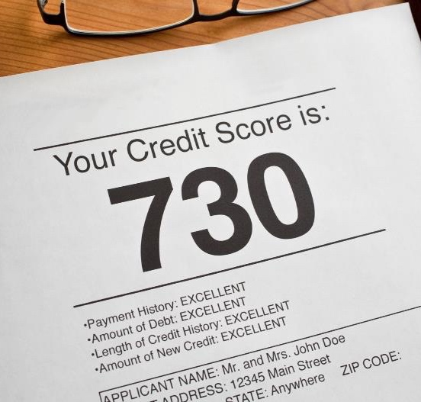
Section 2: Credit Scores
Section 2
Credit
Scores
See page 11 in your Participant Guide

Slide 17
Section 2: Key Takeaway
You can take steps to improve and manage your credit scores. This includes paying your bills on time
and as agreed.

Slide 18
The Basics of Credit Scoring
Number calculated from information in credit reports
Generally, higher number = better credit history
Predicts likelihood of payment of credit obligations on time and as agreed
Two significant factors affect your credit scores:
  Whether you repay debts on time and as agreed
  Your credit utilization rate

Slide 19
More Basics of Credit Scoring
Multiple producers of credit scores
You likely have multiple credit scores
  FICO® (Fair Isaac Corporation)
  Vantage Score®
  Others too
Different models for different types of credit

Slide 20
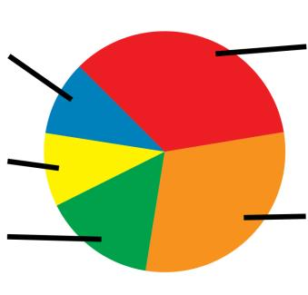
Five Factors in General FICO® Model
Payment History – 35%
New Credit – 10%
Credit Mix – 10%
Length of
Credit History – 15%
Amounts Owed – 30%

Slide 21
Order Your Credit Scores
May not be the ones that are used
If turned down for credit, you have the right to see the exact score used
Make sure your credit scores accurately reflect information in your credit reports
  Get and review your credit reports and dispute errors

Slide 22
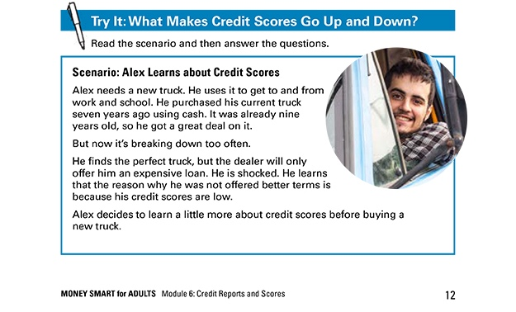
Try It: What Makes Credit Scores Go Up and Down?
See page 12 in your Participant Guide

Slide 23
What is a Good Credit Score?
Exceptional | 800 – 850
Very Good | 740 – 799
Good | 670 – 739
Fair | 580 – 669
Poor | 300 – 579
Note: this is an example, based on FICO®

Slide 24
Section 2: Remember the Key Takeaway
You can take steps to improve and manage your credit scores. This includes paying your bills on time and as agreed.

Slide 25
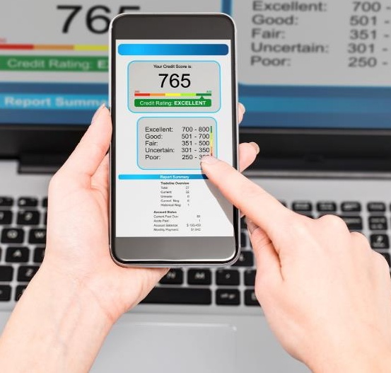
Section 3: Getting and Understanding Your Credit Reports and Scores
Section 3
Getting and Understanding Your Credit Reports and Scores
See page 18 in your Participant Guide

Slide 26
Section 3: Key Takeaway
Get and review your credit reports at least once every 12 months to make sure the information
is accurate.

Slide 27
What is a Productive Credit History?

Slide 28
Right to Free Credit Reports
One free credit report every 12 months from each nationwide credit reporting agency
  Equifax, Experian, and TransUnion
Go to Annualcreditreport.com
  Official website to fill orders for these free credit reports

Slide 29
Watch Out for Imposters
Others that advertise free credit reports, credit scores, or credit monitoring are not part of the legally mandated free annual credit report program
Often, “free” services convert to ones you have to pay for after the trial period
Go directly to Annualcreditreport.com

Slide 30
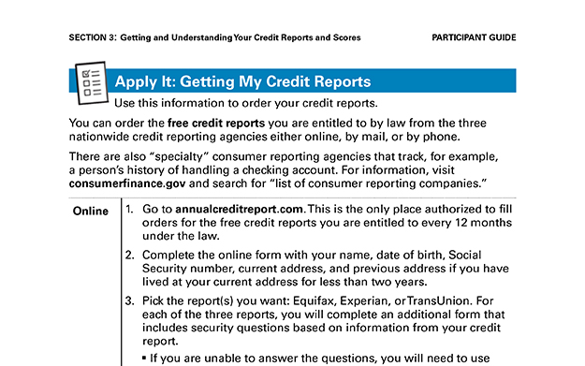
Apply It: Getting My Credit Reports
See page 19 in your Participant Guide

Slide 31

Right to Additional Free Credit Reports
Receive public assistance
Unemployed and looking for a job
Victim of identity theft or financial fraud
State law provides for a free credit report
Denied credit, service, an apartment, or employment

Slide 32

What Sections are in Credit Reports?
Personal or identifying information
Public records
Accounts assigned or sold
Credit accounts
Inquiries

Slide 33
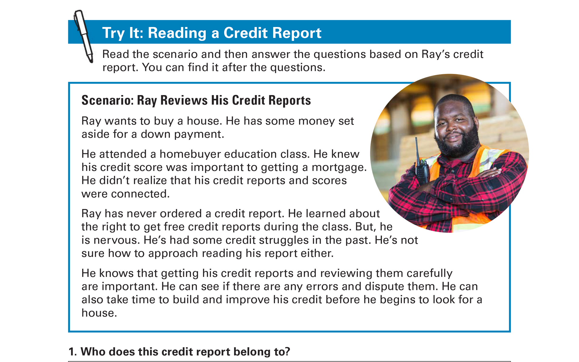
Try It: Reading a Credit Report
See page 25 in your Participant Guide

Slide 34
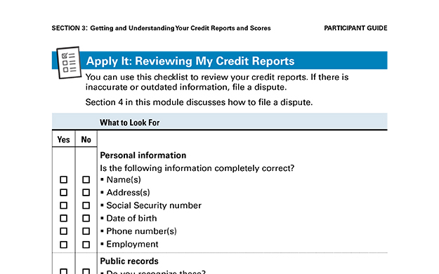
Apply It: Reviewing My Credit Reports
See page 29 in your Participant Guide

Slide 35
Getting Your Credit Scores
Some nonprofit organizations
Credit card statements or websites
When you have a right to a score
FICO® at www.myfico.com
VantageScore® at www.vantagescore.com
Three nationwide credit reporting agencies

Slide 36
Section 3: Remember the Key Takeaway
Get and review your credit reports at least once every 12 months to make sure the information is accurate.

Slide 37

Section 4: Disputing Errors in Your Credit Reports
Section 4
Disputing Errors in
Your Credit Reports
See page 32 in your Participant Guide

Slide 38
Section 4: Key Takeaway
If you find errors on your credit reports, file a dispute right away. Be sure to keep records and follow up.

Slide 39

Errors on Your Credit Reports
Identity errors
Incorrect reporting of account status
Data management errors
Balance errors
Outdated information

Slide 40

Time Limits on Negative Information
Generally can only be reported on credit reports for seven years
Some bankruptcies are an exception

Slide 41


No Time Limits
No time limits for negative information when someone applies for:
A job with yearly salary of $75,000 or more
More than $150,000 worth of credit
Life insurance with a face value of $150,000 or more

Slide 42
The Seven-Year Reporting Period
Can be confusing
Generally starts 180 days after you stopped paying on the debt

Slide 43
Seven-Year Reporting Example
August 2018: 30 days late
November 2018: 120 days late and creditor closes account
Delinquency started in August
July 2018 is the month before that
July 2018 + 180 days = January 2019
January 2019 + 7 years = January 2026
January 2026: account no longer reported

Slide 44
Medical Debt and Credit Reports
Medical debt generally not on credit reports until unpaid for at least 180 days
Provides time to:
  Resolve billing disputes
  Make payments
  Make payment arrangements

Slide 45

How to Dispute Errors on Your
Credit Reports
Option 1: Online
Option 2: By mail

Slide 46
What to Include in Dispute Letters
Your complete name and address
Clear description of each item you are disputing and reason for each dispute
A request for correction or removal

Slide 47
Also Include Supporting Information
Send copies – not originals
Receipts
Credit card or account statement
Image of a check
Screenshot of online transaction or automatic bill payment

Slide 48
After You File a Dispute
Credit reporting agency will send you a letter
Incorrect information cannot be put back
  Check to make sure
You can request notices of corrections to be sent to individuals or businesses that received your report

Slide 49
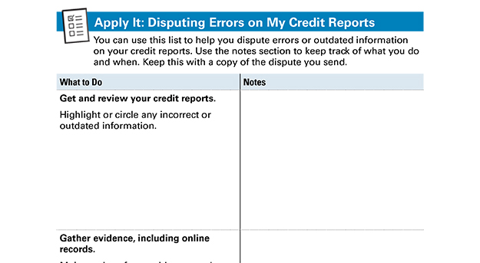
Apply It: Disputing Errors on My Credit Reports
See page 34 in your Participant Guide

Slide 50
Section 4: Remember the Key Takeaway
If you find errors on your credit reports, file a dispute right away. Be sure to keep records and follow up.

Slide 51

Section 5: Build, Repair, and Maintain a Productive Credit History
Section 5
Build, Repair, and Maintain a Productive Credit History
See page 38 in your Participant Guide

Slide 52
Section 5: Key Takeaway
Your credit history does not have to be your credit future.

Slide 53
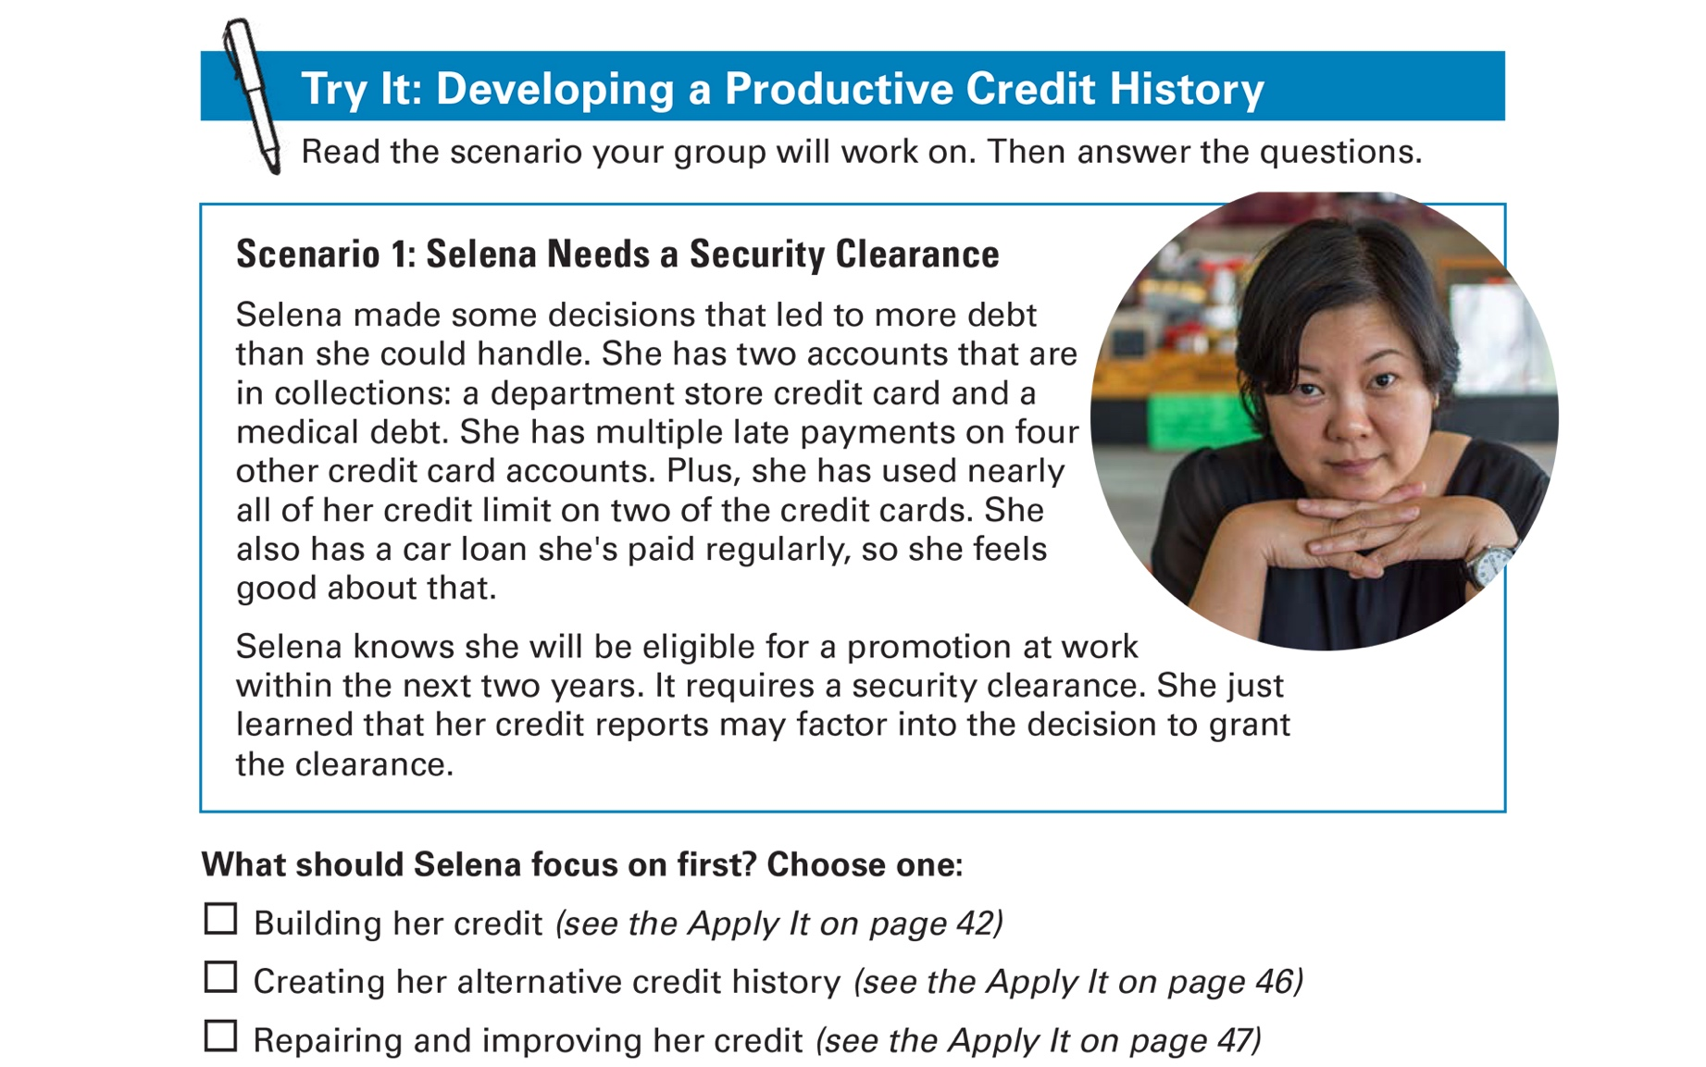
Try It: Developing a Productive Credit History
See page 39 in your Participant Guide

Slide 54
Repair and Improve Credit
Get and review your credit reports
Dispute and correct any errors
Pay all of your bills on time and as agreed
Use as little of your credit limit as possible
Use a credit building strategy
Keep old accounts open if you can
Apply for credit only if you need it
Negotiate different terms
Ask for a “good will” deletion

Slide 55
Build Alternative Credit History
Document other payments you regularly make, such as:
Rent
Childcare
Cell phone bill
Electric bill
Gas bill
Water, sewage, and garbage bills
Television service bill
Internet service bill
Insurance payments
Loan from friend or family member
Savings

Slide 56
Build Credit
Get a secured credit card
Get a credit-building loan
Become an authorized user on an account
Get a cosigner
Apply for a credit card at a store or gas station
Make a large down payment and negotiate a loan for the balance

Slide 57
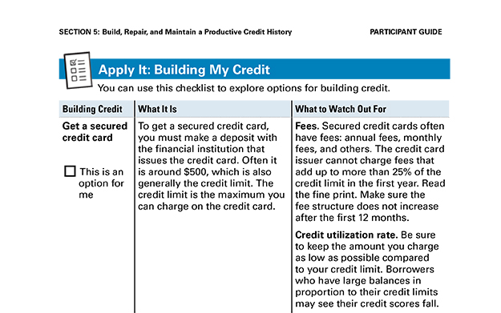
Apply It: Building My Credit
See page 42 in your Participant Guide

Slide 58
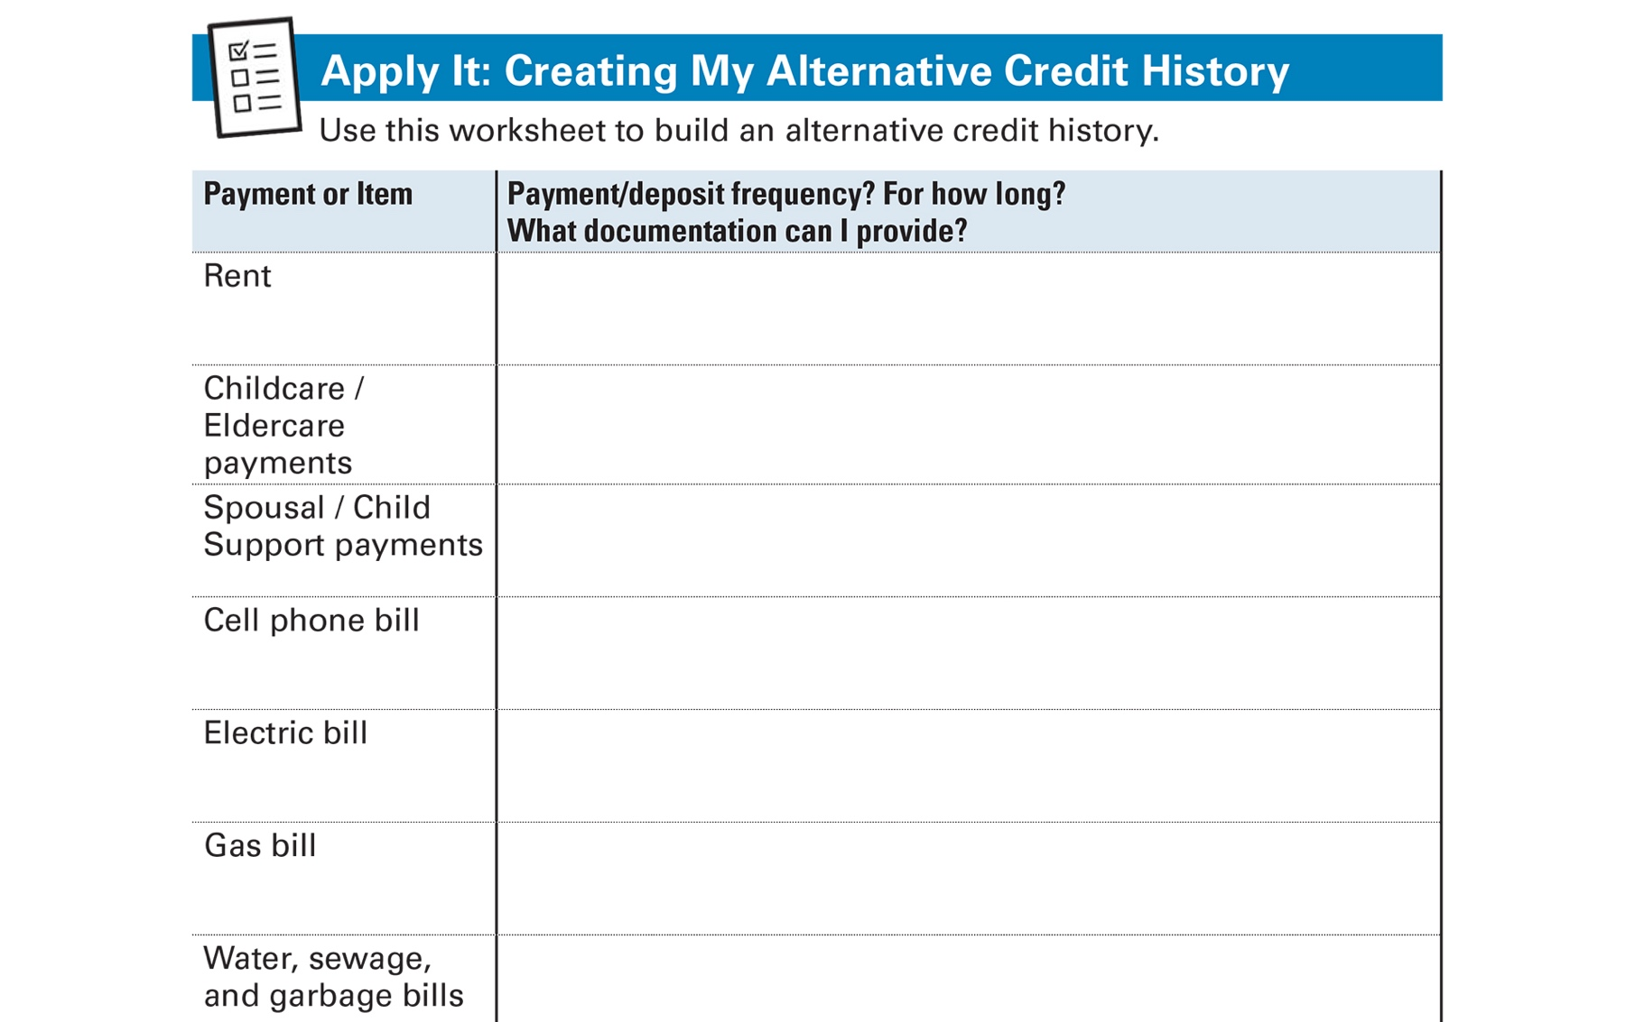
Apply It: Creating My Alternative Credit History
See page 46 in your Participant Guide

Slide 59
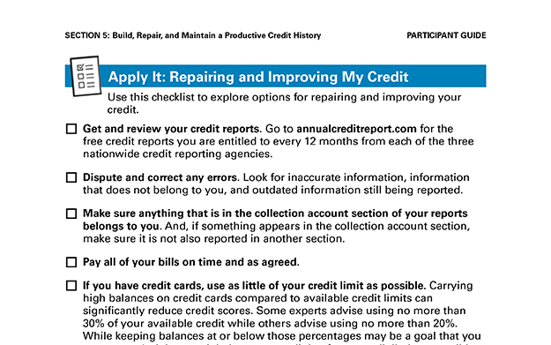
Apply It: Repairing and Improving My Credit
See page 47 in your Participant Guide

Slide 60
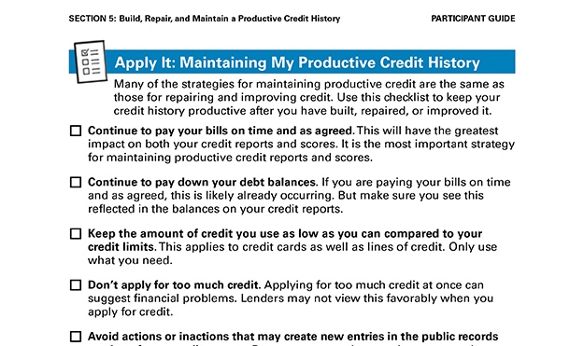
Apply It: Maintaining My Productive Credit History
See page 48 in your Participant Guide

Slide 61
Maintain Credit
Pay your bills on time and as agreed
Continue to pay down your debt balances
Keep the proportion of the credit you use low compared with credit limits
Don’t apply for too much credit
Avoid actions or inactions that may create new entries
Pay your taxes and child support in full and on time
Check your credit reports and regularly dispute errors
Keep good financial records

Slide 62
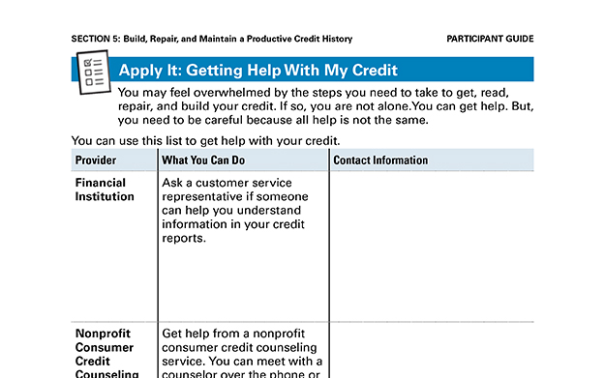
Apply It: Getting Help with My Credit
See page 49 in your Participant Guide

Slide 63

Get Help
Financial institution
Nonprofit consumer credit counseling
service
Housing Counseling Agency approved by Department of Housing and Urban Development (HUD)
Financial education nonprofit organization
Certified Financial Planners (CFPs)
Other

Slide 64
Credit Repair and Debt Consolidation
Credit Repair Companies
  Promise to fix your credit for a fee
Debt Consolidation Businesses
  Offer different services
  Often specialize in debt consolidation loans and debt settlement services

Slide 65

Use Caution
Debt consolidation
  Taking out new loan to pay off
  other debts
  Does not address underlying causes of debt
Debt settlement
  Working with creditors to accept lower payment and settle debt
  Might have to pay income tax on portion that was settled

Slide 66

Credit Repair Scams
Beware of credit repair companies that:
Promise to erase bad credit or remove other negative, but accurate, information
Promise fast and easy credit repair
Offer to create a new identity for you
Want you to pay upfront
Will not tell you about your rights

Slide 67
Protecting Your Credit History
Initial fraud alert
Active duty military alert
Extended fraud alert
Credit freeze
Credit lock

Slide 68
Section 5: Remember the Key Takeaway
Your credit history does not have to be your credit future.

Slide 69
Take Action
See page 54 in your Participant Guide
What will I do?
How will I do it?
Will I share my plans with anyone? If so, who?
Visit fdic.gov/education to learn more

Slide 70

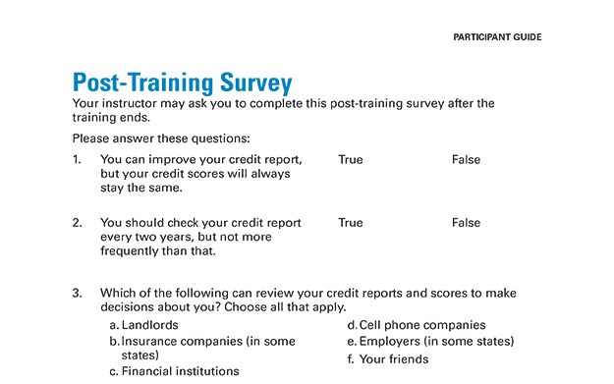
Post-Training Survey
See page 59 in your Participant Guide

